Slide 1

Chapter 10
Vitamins

Slide 2
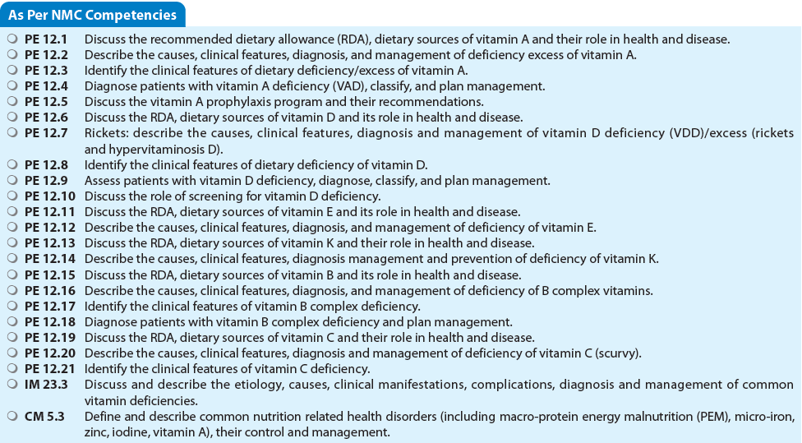

Slide 3
Introduction
Vitamins are required by the body in minute quantities.
They do not contribute to calories but indispensable for metabolic reactions.
Most vitamins cannot be synthesized in the body, they need to be supplied in diet.
Functions
  Cofactors and coenzymes in enzyme systems (e.g., vitamin B complex), hormones (e.g., vitamin D), and antioxidants (e.g., vitamin E).
  Essential for energy production, hematopoiesis, neurological functions, hydroxylation and synthesis of fats, amino acids, nucleic acids, and nucleoproteins.
Vitamins are classified into (1) Water-soluble vitamins: vitamin B complex and vitamin C; and (2) Fat-soluble vitamins: vitamin A, D, E, and K.

Slide 4
Deficiency of Vitamins
Vitamin deficiencies may be caused by:
  (1) Deficient intake (ignorance, food fads, and faulty cooking methods);
  (2) Faulty absorption (malabsorption and chronic diarrhea);
  (3) Increased losses;
  (4) Poor utilization (chronic liver disease); or
  (5) Greater demand.
The requirement of vitamins increases in preterm babies, during postoperative stress, infections, and in some genetic metabolic disorders.

Slide 5
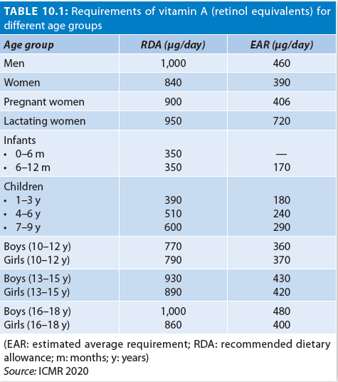
Vitamin A and Xerophthalmia
Retinoic acid is the most active form.
Ingested as carotene (from plant sources) and retinal (from animal sources).
Beta-carotene (provitamin A) yields the highest amount of retinol.
DAILY REQUIREMENTS
Daily requirement are in terms of retinol equivalents (ICMR, 2020).
50% of retinol equivalents should be derived from animal sources.
60 mg of retinol = 110 mg of retinyl palmitate = 69 mg retinyl acetate = 2 lakh IU of vitamin A

Slide 6
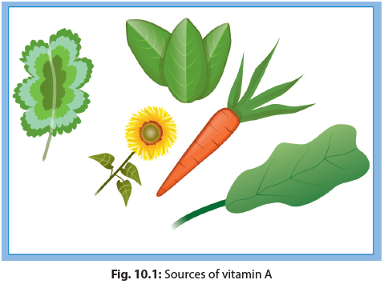
DIETARY SOURCES
Breastmilk fulfills the needs of vitamin A entirely for first 6 months of life and continues to be an important source up to 2 years.
Preformed vitamin A (retinol) is abundant in fish liver oils, liver, dairy products, and egg yolk.
Vegetarian sources of vitamin A are green leafy vegetables, and yellow fruits and vegetables, where it is present as carotenoids (Fig. 10.1).

Slide 7
Functions of Vitamin A
Necessary for the integrity of epithelial tissues and functioning of retina and vision.
Necessary for spermatogenesis and integrity of testicular and vaginal epithelium.
Involved in growth especially skeletal growth, fertility, and immune response.
Also termed as an anti-infective vitamin.

Slide 8
VITAMIN A DEFICIENCY
Causes
Insufficient intake of vitamin A
Severe malnutrition
Chronic diarrhea
Malabsorptive states
Chronic liver disease
Prematurity
Measles and respiratory tract infections
Subclinical

Slide 9
Subclinical Deficiency: Increased severity of certain infections and an increased risk of infection related mortality.
Early Features: Defective dark adaptation night blindness.
Xerophthalmia
Especially prevalent in 6–36 months old. It is often combined with general undernutrition.
Xerosis (dryness) of the conjunctiva is usually the first clinical sign.
This may be followed by corneal xerosis keratomalacia and perforation leading to blindness.

Slide 10
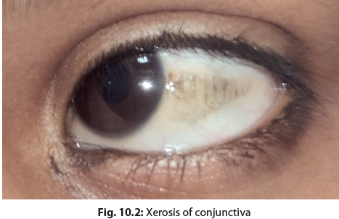
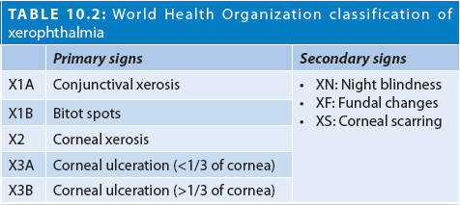
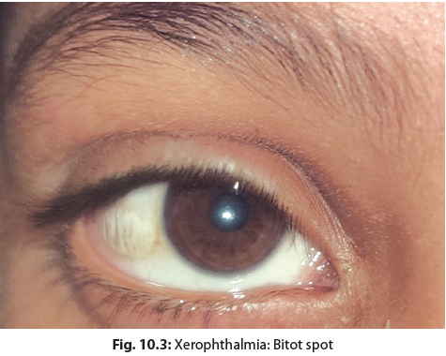
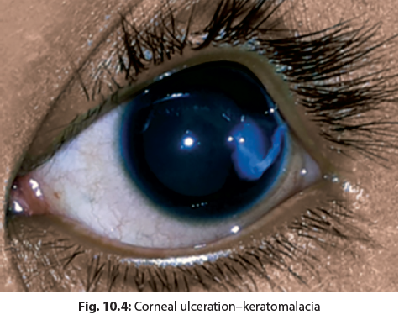
XEROPHTHALMIA
Bitot spots are the most characteristic feature of xerophthalmia.

Slide 11
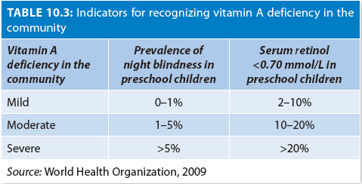
Indicators of Vitamin A Deficiency
Presence of night blindness is used as the best indicator for vitamin A deficiency (VAD).
Serum retinol of <0.70 μmol/L is used to identify those at risk for biochemical VAD.

Slide 12
Treatment of Vitamin A Deficiency
Give oral vitamin A on day 0, 1, and 2 weeks later
Dose: of 50,000, 1 lakh, and 2 lakhs IU in children aged <6 months, 6–12 months, and >1 year, respectively.
Injectable vitamin A is recommended (in half the doses) in impaired oral intake, persistent vomiting, and severe malabsorption.
Local Treatment
Antibiotic drops or ointment three times a day.
Padding the eye prevents corneal exposure, reduces pain and photophobia.
Mydriatics (atropine drops 1% or ointment) is applied once a day.

Slide 13
HYPERVITAMINOSIS A
Unnecessary intake or high-dose vitamin A supplementation.
Clinical Features
Acute Hypervitaminosis A: Pseudotumor cerebri.
Chronic Hypervitaminosis A: Skin desquamation, alopecia, hepatosplenomegaly, hyperostosis, and increased intracranial tension. Teratogenic during first trimester of pregnancy.
TREATMENT
Discontinue vitamin A intake immediately.
Acetazolamide, mannitol or a therapeutic LP may be needed is severe cases.

Slide 14
PREVENTION OF VITAMIN A DEFICIENCY
High-risk Conditions
Children suffering from measles and SAM should receive oral vitamin A (1 and 2 lakh IU each for <1 year and >1 year olds, respectively), on two consecutive days.
Those with persistent diarrhea given one dose in each episode.
Diet
Consumption of vitamin A rich food is encouraged by all pregnant and lactating women and children under 5 years of age,
Green leafy vegetables, yellow and orange vegetables and fruits, cereals, pulses, milk and milk products, egg, and liver must be promoted.
Long-term prevention strategies
Nutrition education for dietary diversification, home gardening, nutritional supplementation, and selective fortification for risk areas and special groups.

Slide 15
Vitamin A Prophylaxis
Launched in 1970 with the objective of reducing the disease and preventing blindness due to vitamin A deficiency.
Strategy: Administration of prophylactic vitamin A
100,000 international units (IU) at 9 months with measles immunization,
200,000 IU at 16–18 months, with DPT booster, and then
200,000 IU every 6 months, up to the age of 5 years.
Other components
Health and nutrition education to encourage colostrum feeding, exclusive breastfeeding, introduction of complementary feeding thereafter and adequate intake of vitamin A-rich foods.
Early detection and proper treatment of infections.

Slide 16
IN A NUTSHELL
Vitamin A and Xerophthalmia
Vitamin A and its metabolites play critical role in vision, fetal growth and development, reproduction, GI and respiratory function, and immunity. It is part of antioxidant defenses.
Sources of vitamin A include fish liver oils, liver, dairy products, egg yolk, green leafy vegetables, yellow fruits, and vegetables such as carrots, papaya, tomatoes, sweet potatoes, mango, broccoli, and spinach.
Vitamin A deficiency can lead to xerophthalmia, childhood blindness, anemia, decrease host resistance to infection, and increased risk of mortality in under-5 children.

Slide 17
Prevalence of night blindness, Bitot Spots, and serum retinol of <0.70 μmol/L are used as the indicators for VAD in a community.
Treat all children with clinical signs of VAD as early as possible with massive doses of vitamin A.
Improve the availability and consumption of vitamin A by dietary diversification; food fortification; and targeted mega-dose vitamin A supplementation

Slide 18
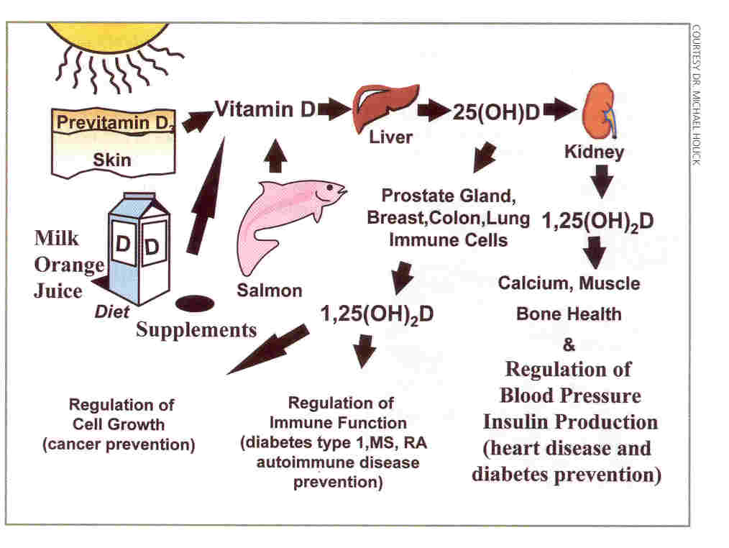
Endocrine, paracrine and intracrine functions of Vitamin D….

Slide 19
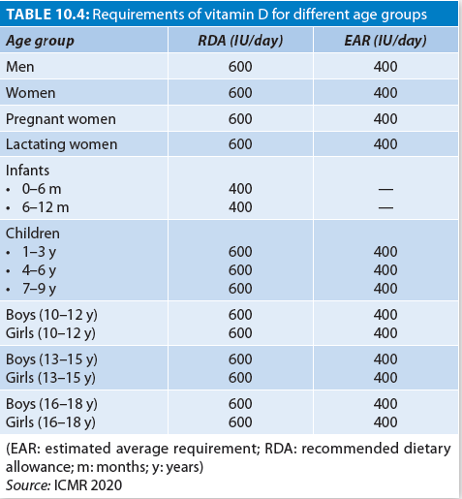
SUPPLEMENTATION
400 IU/day for breastfed infants from birth–1 year of age.
SOURCES
Sunlight (UV-B rays)
Fish oils, liver, egg yolk, and fortified foods

Slide 20
Functions of Vitamin D
To enhance intestinal calcium and phosphate absorption;
To inhibit parathormone production; and
To ensure formation and mineralization of bone.
1,25-dihydroxyvitamin D3, the hormonally active form of vitamin D, generates several extra skeletal biological responses
  inhibition of breast, colon, and prostate cancer cell progression;
  effects on the cardiovascular system; and
  protection against autoimmune diseases including MS, IBD.
However, is no high-quality evidence to support the effectiveness of vitamin D supplementation in pneumonia, diarrhea, tuberculosis, HIV, asthma, obesity, atopy, and neurodevelopmental conditions.

Slide 21
Vitamin D Deficiency
Disorders of vitamin D synthesis: – Increased skin pigmentation – Topical application of sunscreen agents – Overclothing preventing sunlight exposure – High-rise buildings and urbanization
Geographical location: – Latitude (>400 North or South) – Winter season – Air pollution and cloud cover – High-altitude – Avoidance of sunlight for cosmetic reasons and fear of skin cancer
Decreased intake of vitamin D—vegetarianism
Decreased maternal vitamin D stores and exclusive breastfeeding
Malabsorption: – Celiac disease – Pancreatic Insufficiency – Chronic cholestasis
Decreased synthesis or increased degradation of 25(OH)D: – Chronic liver disease – Drugs (rifampicin, isoniazid, antifungals, and anticonvulsants) – Genetic factors

Slide 22
VITAMIN D DEFICIENCY RICKETS
Vitamin D deficiency in growing children (before closure of epiphyses) leads to rickets.
Main causes of deficiency are inadequate dietary intake and lack of exposure to sunlight.
Poor vitamin D content of milk and vegetarian diets contribute to deficiency of vitamin D.

Slide 23
Clinical Features
Craniotabes. Frontal and parietal bossing may be evident beyond infancy.
Anterior fontanel is large and its closure is delayed beyond 18 months.
There is clinically apparent widening of the wrists (Fig. 10.5A).
Long bones of legs get deformed when the child starts bearing weight (after 1 year). Anterior bowing of legs, knock knee, and coxa vara are other deformities.
Medial malleolus of tibiae widens giving the appearance of double malleolus.
Costochondral junctions become prominent (rachitic rosary).
Increase in AP diameter of chest wall (pigeon chest).
A horizontal depression (Harrison’s groove) is seen along the lower border of chest.
Scoliosis, kyphosis, or lordosis may occur in severe cases.
Abdomen becomes protuberant (potbelly).
Eruption of primary teeth is delayed.

Slide 24
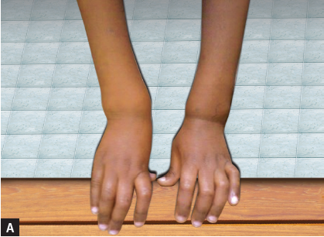
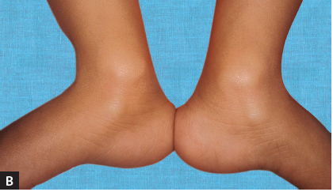
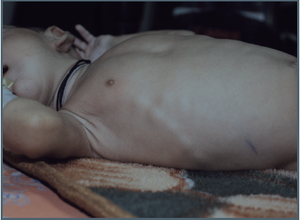
Figs. 10.5A and B: Rickets: (A) Widening of the wrists; (B) Double malleoli
Fig. 10.6: Rachitic rosary: Costochondral junctions become prominent

Slide 25
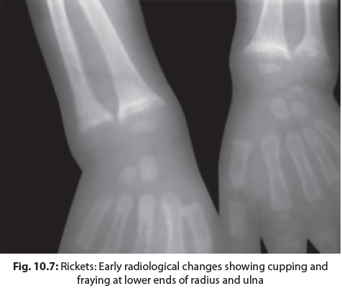
RADIOLOGICAL CHANGES
Early radiological changes are observed
  wrist at lower ends of radius and ulna
  lower ends of femur and upper end of tibia.
The normally convex or flat appearing metaphyses become concave (cupping).
There is widening of distal end of metaphysis with elongation of both ends (splaying).
The smooth margin of metaphysis appears irregular (fraying).
Rachitic rosary appear as beading of costochondral junctions in chest radiograph.

Slide 26
BIOCHEMICAL CHANGES
compensatory increase in parathormone concentration to maintain blood calcium levels (secondary hyperparathyroidism)
Parathormone acts on osteocytes to release calcium from bones, and also reduces the excretion of calcium by kidneys
associated decrease in the renal tubular reabsorption of phosphate
The net result is normal serum calcium level and low serum phosphorus
An increase in the osteoblastic activity results in elevation of serum alkaline phosphatase level
In later stages, the compensatory increase in parathormone cannot sustain normal calcium level and hypocalcemia occurs

Slide 27
IAP Classification of Vitamin D Deficiency
Grading | Serum 25(OH) D3
Severe deficiency | <5 ng/mL
Deficient | <12 ng/mL
Insufficient | 12–20 ng/mL
Sufficient | >20 ng/mL
Toxic | >150 ng/mL

Slide 28
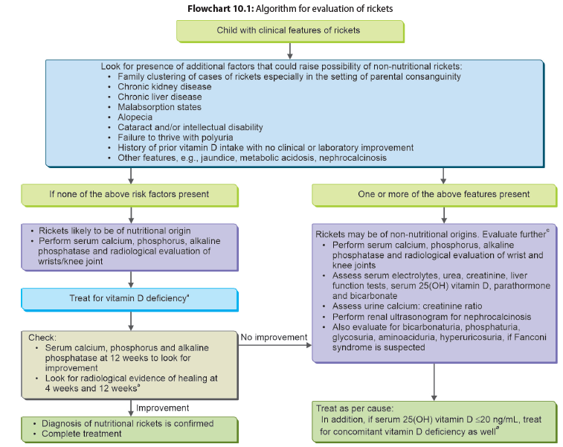
E
V
A
L
U
A
T
I
O
N
T
R
E
A
T
M
E
N
T

Slide 29
Vitamin D Deficiency Rickets
Indications for Treatment
Nutritional rickets, (clinical and radiological evidence is enough)
Hypocalcemic seizures, tetany, and hypocalcemic dilated cardiomyopathy) with serum 25(OH)D level <20 ng/mL.
Incidentally detected low serum 25(OH)D level <12 ng/mL in healthy children or <20 ng/mL in those at high-risk.
Children with clinical pointers toward non-nutritional rickets, should undergo evaluation for etiology of rickets including assessment of serum 25(OH)D levels and parathyroid hormone.

Slide 30
Dose and Duration of Vitamin D Therapy
Route:
  Oral treatment is the preferred, than intramuscular treatment. Intramuscular route is to be used only in malabsorption states.
Daily versus Intermittent bolus:
  Daily vitamin D therapy is more physiological than bolus doses.
Intermittent regimes:
  If compliance to daily dosing cannot be ensured, intermittent regimens may be prescribed for children above 6 months of age.

Slide 31
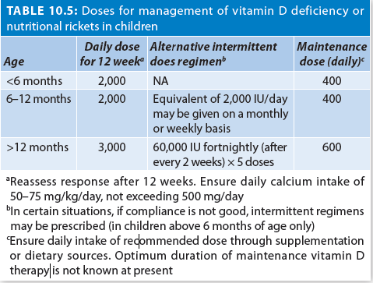
Vitamin D Dose for Treating Rickets and VDD

Slide 32
PREVENTION OF NUTRITIONAL RICKETS
Recommendation for vitamin D supplementation are as follows:
400 IU vitamin D/day to all infants (0–1 years.
Routine vitamin D supplementation is not recommended for children > 1year.
Routine Maternal Supplementation is not recommended during pregnancy or lactation.
A daily sunlight exposure of 17–30 minutes in infants and 30–45 minutes in older children over 15–40% body surface area is recommended, during 11 AM to 3 PM.
Encourage intake of vitamin D rich foods and intake should be encouraged. An adequate intake of calcium, i.e., 500 mg/day in calcium.
Indian Academy of Pediatrics 2021 Guidelines

Slide 33
High Risk Conditions
Routine vitamin D supplementation (minimum 400 IU daily) is recommended in children with underlying high-risk conditions:
  Receiving long term anticonvulsants or glucocorticoids, ketoconazole;
  Chronic kidney disease, Chronic liver disease,
  Malabsorption states,
  Hyperparathyroidism,
  Children with non-ambulatory states like cerebral palsy, neuromuscular disorders, chronic inflammatory diseases, and disorders with extensive cutaneous involvement.
Routine screening of apparently healthy children for VDD is not recommended.

Slide 34
HYPERVITAMINOSIS D
Caused by administration of vitamin D in therapeutic doses for long periods.
Clinical Features
Renal: Hypercalcemia, hypercalciuria, polyuria, nephrocalcinosis, nephrolithiasis, and renal failure.
GI: anorexia, abdominal pain, and constipation.
CNS: Hypotonia, irritability, disorientation, convulsions, and coma.
Death may occur due to cardiac arrhythmias.
Diagnosis
Confirmed by high-serum calcium, hypercalciuria.
Serum vitamin D 25(OH) (>100 ng/mL).
Treatment
Stop intake of vitamin D and manage dehydration and electrolyte abnormalities.
Oral prednisolone, calcitonin, and bisphosphonates are effective in decreasing serum calcium.

Slide 35
IN A NUTSHELL
Vitamin D and Rickets
Vitamin D, the sunshine hormone is required for skeletal health as well as for extra skeletal wellbeing.
Prevention of vitamin D deficiency needs appropriate sunlight exposure, changes in dietary habits, routine supplementation in children below 1 year of age, and food fortification.
Vitamin D deficiency in children older than 1 year and adolescents is not very high.
Nutritional rickets manifests mostly in infants and toddlers with bony deformities. Vitamin D deficiency in infancy may also present with hypocalcemic seizures.
The most common method to determine vitamin D status is serum 25(OH)D. Lower value than 12 ng/mL is considered vitamin D deficiency.
Measurement of alkaline phosphatase levels in plasma is a useful screening test for vitamin D deficiency.
All prevalent treatment regimens for deficiency with vitamin D3 are equally effective. Bolus high-dose therapy needs to be avoided.

Slide 36
Vitamin E
Vitamin E is an antioxidant that protects membrane phospholipids from free radical induced peroxidase damage.
It has antineoplastic, anti-inflammatory effect and may raise the concentration of high-density lipoprotein cholesterol.
As an antioxidant, it is used as a free radical scavenger.
Sources: Almond, peanuts, PUFA, seeds, whole wheat grain, egg yolk, milk fat, butter, green leafy vegetable, liver and fortified cereals.
DAILY REQUIREMENT: 7.5–10 mg tocopherol per day.

Slide 37
VITAMIN E DEFICIENCY
Clinical Features
Loss of reflexes, ataxia, diminished proprioception, muscle weakness, ptosis, pes cavus, scoliosis, and dysarthria.
Low vitamin E in premature infants are associated with hemolytic anemia, hyperbilirubinemia, and intraventricular hemorrhage.
Vitamin E prophylaxis may reduce the incidence of ROP.
Treatment
Treat underlying cause if any
Supplement 15–25 mg/kg once per day.
Diet should include rich sources of vitamin E such as whole grains, nuts, seeds, vegetable oils, and fortified cereals.

Slide 38
Vitamin K
Vitamin K is a fat-soluble vitamin that includes phylloquinone (vitamin K1) and menaquinones (vitamin K2).
Rich source of vitamin K1 are green leafy vegetables, vegetable oils, while K2 are present in animal-based and fermented foods cheese.
Severe deficiency manifests as Hemorrhagic Disease of the Newborn (HDN).
Diagnosis is clinically supported by elevated prothrombin time, and PIVKA-II levels.
All newborns at birth should receive 1 mg of intramuscular vitamin K to prevent deficiency.

Slide 39
Water-soluble Vitamins
Vitamin B Complex
Includes thiamine (B1), riboflavin (B2), niacin or pellagra preventing factor (B3), pyridoxine (B6), folic acid, cyanocobalamin (B12), pantothenic acid, and biotin.
Being water-soluble, excess amounts are excreted in the urine, rarely posing a threat of toxicity.
Since they cannot be stored in the body, they must be supplied in the diet.
Deficiency results in characteristic deficiency symptoms.

Slide 40
THIAMINE (VITAMIN B1)
Maintains good appetite, digestion, muscle tone, and a healthy mental attitude.
Deficiency causes mental and neurological disturbances.
Sources: Liver, organ meat, egg yolk, fish, dry beans and peas, soybean, peanuts, whole grains, enriched bread, cereals, and dried yeast are rich sources.
Daily Requirement: 0.5 and 1.7 mg per day.
Thiamine Deficiency
  Readily lost from rice during polishing, processing, and cooking in water.
  Thiamine deficiency is characteristically associated with consumption of polished rice as a staple food.
  Beri-Beri is the classical manifestation of thiamine deficiency.

Slide 41
BERI-BERI
Dry beriberi:
Neuritic form manifests as irritability, ataxia, tenderness of calf muscles, hypotonia, and diminished deep tendon reflexes.
Wernicke encephalopathy presents with altered sensorium, signs of raised ICT, meningeal irritation, and neurologic deficit.
B. Wet beriberi:
Manifests between the ages of 2–4 months with cardiomegaly, edema, and congestive heart failure.
Diagnosis: Decreased levels of red blood cell (RBC) transketolase.
TREATMENT: 3–5 mg of thiamine per day, orally, for at least 6 weeks.

Slide 42
RIBOFLAVIN (VITAMIN B2)
Involved in oxidative systems, energy metabolism, erythropoiesis, cellular growth and tissue respiration.
Sources
Eggs, green leafy vegetables, organ meats liver, milk products are good sources. Wheat, millets, and pulses are fair sources; rice germination increases the riboflavin content of pulses and cereals.

Slide 43
Riboflavin Deficiency
Deficiency occurs if the diet is deficient in animal protein and leafy vegetables.
During cooking, 15–100% of riboflavin is lost.
Malnutrition, malabsorption, and prolonged diarrhea are the main causes of riboflavin deficiency.
Clinical Features
  Riboflavin deficiency is characterized by lesions in oral cavity, eye, and skin.
  Oral lesions: Angular cheilosis and glossitis.
  Skin lesions: nasolabial dysbacea, Scrotal dermatitis.
  Eye manifestations: photophobia, lacrimation, itching, circumcorneal congestion, corneal vascularization.
  Peripheral neuropathy with hyperesthesia, altered temperature sensation, and pain.

Slide 44
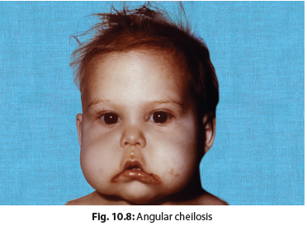
ARIBOFLAVINOSIS
TREATMENT: 3–10 mg riboflavin PO daily.

Slide 45
NIACIN (PELLAGRA PREVENTING FACTOR) (B3)
Essential for functioning of skin, intestinal tract, and nervous system. Plays an important role in DNA synthesis and repair.
Sources
Cereals, pulses, groundnut, GLV, fish, meat, poultry.
Eggs and milk, though contain little niacin, are rich sources of tryptophan which can be converted to niacin.
Deficiency
Predominantly seen in maize-eating populations.
Severe malnutrition and anorexia nervosa.
Milling and water-solubility leads to loss of niacin.

Slide 46
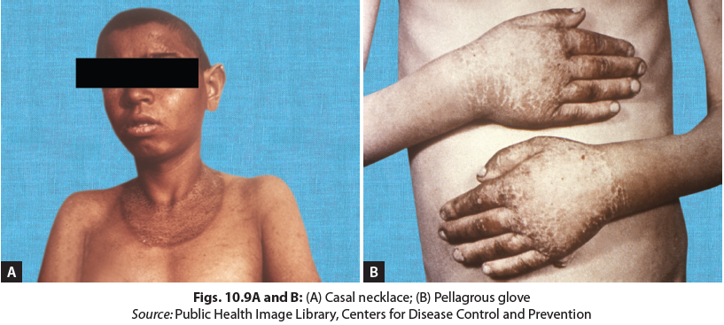
PELLAGRA
Classical triad of three D’s— diarrhea, dermatitis, and dementia
Characterized by pellagrous glove, pellagrous boot) and Casal necklace.
Neurological features include irritability, apathy, disorientation, confusion, and acute encephalopathy.
GI: diarrhea, loss of appetite, nausea, vomiting, and achlorhydria.
TREATMENT
Supplementation of 50–300 mg/day of niacin with a balanced diet

Slide 47
VITAMIN B6 (PYRIDOXINE)
Essential for normal brain metabolism and growth of infants.
Needed for gluconeogenesis, synthesis of neurotransmitters, immune system and nucleic acid metabolism.
Sources
  Liver, meat, fish, yeast, cereals, pulses, and peas potatoes, and bananas.
Pyridoxine Deficiency
  Seen after prolonged isoniazid, penicillamine, and hydralazine therapy.
Clinical Features
Pyridoxine dependency causes convulsions. Other features include failure to thrive, hyperirritability, hyperacusis, microcytic hypochromic anemia, nausea, vomiting, seborrheic dermatitis, peripheral neuritis, and depression.
Treatment
Child should consume a balanced diet.
Seizures due to vitamin B6 deficiency respond to 100 mg of pyridoxine.

Slide 48
Pyridoxine Dependency
Pyridoxine dependency refers to a condition characterized by increased pyridoxine requirements. Pyridoxine-dependent syndromes include
  pyridoxine dependent seizures,
  pyridoxine responsive anemia, and
  homocystinuria.
Pyridoxine dependency in neonates causes convulsions.
Therapeutic trial with IM administration of 100 mg of pyridoxine, is the best method to diagnose. This should be followed by prolonged administration of pyridoxine 10–100 mg/day orally.

Slide 49
COBALAMIN (VITAMIN B12)
Plays an important role in lipid and carbohydrate metabolism, nucleic acid synthesis, protein synthesis, and affects myelin formation.
Sources
Present only in foods of animal origin (liver, meat, eggs, and milk).
Fortified cereals and milk are the main sources for vegetarians.
Considerable amounts are stored in the liver.
Although cobalamin is synthesized by bacteria of intestinal colon, it is not available for absorption.
Daily Requirements
ICMR recommends 1-2 μg per day EAR.

Slide 50
Vitamin B12 Deficiency: Causes
Vegans have low serum B12 levels which can pose a serious risk of deficiency.
Vitamin B12 malabsorption occurs in blind loop syndrome and tropical sprue, Crohn disease, and intestinal tuberculosis.
Vitamin B12 deficiency is also seen in methylmalonic aciduria, in breastfed infants of vitamin B12 deficient vegetarian mothers, and following administration of drugs such as neomycin, para-amino salicylic acid, and colchicine.
Lack of intrinsic factor in the stomach results in failure of absorption of vitamin B12 and causes pernicious anemia.

Slide 51
Clinical Features of Vitamin B12 Deficiency
Megaloblastic Anemia
  Resulting in macrocytic normochromic anemia.
2. Neuropathy
  Deficiency of vitamin B12 impairs synthesis of DNA and causes defective myelin formation.
  Demyelination of large nerve fibers of the spinal cord, especially the long tracts and posterior columns occur.
  Early signs are numbness and tingling sensation in the fingers and toes.
  Advanced cases result in subacute combined degeneration of the cord.
3. Newborn Vitamin B12 deficiency
  Occurs in >50% women. Maternal vitamin B12 deficiency has been linked to offspring adiposity and insulin resistance.
  Supplementation of pregnant women with vitamin B12 has shown to improve birth weight.

Slide 52
TREATMENT: Cobalamin (Vitamin B12) Deficiency
Serum vitamin B12 and folate levels should be estimated prior to therapy.
In the presence of strong clinical features of vitamin B12 deficiency, treatment should be initiated to avoid neurological impairment, while awaiting investigation reports.
If coexisting folic acid deficiency is present, vitamin B12 should preferably be started 10–14 days before giving oral folic acid.
Folic acid should not be prescribed alone as the neurological symptoms due to vitamin B12 deficiency may precipitate or worsen.

Slide 53
Pharmacological Therapy
Oral therapy:
  Oral vitamin B12 should be given in empty stomach as food interferes with the absorption.
  Oral vitamin B12 therapy (500 μg in infants and 1,000 μg in older children) may be given every day for a week, every other day for the next week, 2 times a week, once a week, once every 15 days for a month and then once a month to complete at least 3 months duration of therapy.
  Alternatively, daily oral vitamin B12 can be given for 3 months.
Parenteral therapy:
  Administered IM or deep subcutaneous.
  Used only where a rapid response is needed (neurological manifestations, severe anemia, pancytopenia or poor compliance with oral medication, underlying malabsorption of vitamin B12 or disorders of vitamin B12 metabolism).
  After the initial response with parenteral route, maintenance therapy with oral vitamin B12 can be provided.

Slide 54
Duration of Therapy
Without neurological manifestations: Treatment for at least 3 months
With neurological signs and symptoms: Treat for 6 months
Pernicious anemia, inherited disorders of vitamin B12 metabolism, underlying malabsorption disorders: Treat lifelong
Dietary Counseling
Advise foods rich in vitamin B12: meat, poultry, shellfish, eggs, dairy products, mushrooms, curd and yogurt.

Slide 55
Monitoring
Obtain CBC and MCV
  on day 7 in severe anemia,
  day 14 for moderate anemia, and
  day 28 for mild anemia.
Rise in reticulocyte count is observed within 48–72 hours and peaks at the end of the first week after starting treatment.
Hypersegmented neutrophils disappear and MCV begins to fall by 14d.
CBC, and MCV becomes completely normal by 6–8 weeks.
Neurologic improvement begins within the first week and is usually complete in 6–12 weeks.
Repeat estimation of serum vitamin B12 is not useful.

Slide 56
FOLIC ACID (PTEROYLGLUTAMIC ACID) (Vitamin B9)
Folic acid has a role in the synthesis of nucleic acids.
Sources
Green leafy vegetables (spinach, broccoli, asparagus), cereals, beans, nuts, fruits, liver, and yeast, are good sources.
Daily Requirements
100-200 μg/d; additional intake required in pregnancy and lactation.
FA supplementation (400 μg/d) is recommended for mother during the periconceptional period to prevent neural tube defects in the offspring.
Increase the dose to 5 mg/ day if there is a previous child born with a NTD.
Certain conditions such as leukemia, and hemolytic anemia pose extra demands for folic acid

Slide 57
Folic Acid Deficiency
Causes
  Poor-nutritional intake
  Malabsorption (celiac disease and inflammatory bowel disease)
  Increased cell turnover (chronic hemolytic anemia)
  Prolonged drug treatment (methotrexate, 6MP, azathioprine, phenytoin, etc.)
  Some inborn errors of folate metabolism (methylenetetrahydrofolate reductase deficiency).

Slide 58
Clinical Features of FA Deficiency
Megaloblastic anemia and diarrhea are the predominant symptoms.
Other manifestations include glossitis, growth retardation, and impaired immunity.
Increased thrombotic events, are related to increased homocysteine levels.
Folic acid seems to be protective against atherosclerosis by its homocysteine lowering effect.
Neural tube defects: Maternal folic acid deficiency during the first trimester is associated with neural tube defects in the fetus.
Diagnosis
Peripheral smear showing megaloblastic anemia, along with low serum folate and low RBC folate levels are used as a measure of folate tissue stores.

Slide 59
Treatment of Folic Acid Deficiency
Megaloblastic anemia:
Give 1–5 mg/day of folate along with vitamin B12 for 3–4 weeks. Although small doses of folate can correct the anemia due to B12 deficiency, they may aggravate the associated neurologic abnormalities if given alone.

Slide 60
BIOTIN
Acts as a cofactor for enzymes needed in gluconeogenesis, fatty acid metabolism, and amino acid metabolism.
Plays key role in insulin receptor transcription and pancreatic β-cell function.
Sources
Human requirement is met by synthesis from intestinal bacteria itself.
Rich sources include kidney, liver, yeast, egg yolk, legumes, cereals, nuts, vegetables like mushrooms, fruits such as watermelons, bananas, and strawberries.
Biotin Deficiency
Uncommon; may occur in those on TPN or those consuming large quantities of raw egg white.
Clinical Features
Periorificial dermatitis, conjunctivitis, anorexia, lassitude, muscle pain, alopecia, and CNS abnormalities.
Genetic defects with biotin deficiency include Rett syndrome and carboxylase defects.
Treatment
Oral administration of 2–5 mg biotin daily for 2–3 weeks.

Slide 61
IN A NUTSHELL
Vitamin B Complex
Vitamin B complex includes thiamine (B1), riboflavin (B2), niacin (B3), pyridoxine (B6), cobalamin (B12), biotin, and pantothenic acid, all of which are water-soluble.
B-complex vitamins function as coenzymes in several enzymatic reactions.
Poor diet can result in deficiency of one or more B-complex vitamins leading to beriberi (thiamine deficiency), pellagra (niacin deficiency), megaloblastic anemia (B12 deficiency), or microcytic anemia (pyridoxine deficiency).
Malabsorption syndromes and drugs can cause secondary deficiency of vitamin B complex.
All B-complex vitamins are supplemented together in a deficient person.
Folate deficiency in mother is linked to increased incidence of neural tube defects in the offsprings.
Folate supplementation is recommended in periconceptional period in women of childbearing age.

Slide 62
Vitamin C
Essential for formation of collagen and intercellular matrix in teeth, bones, and capillaries.
Helps in storage of iron in the bone marrow, spleen, and liver.
Protects eyes and lungs against oxidizing agents and reduces oxidation of LDL and prevents deposition of atheromatous plaques.
Helps in maintenance of vascular integrity through prostacyclin (antiplatelet and vasodilatory effect).
Ascorbic acid is a major antioxidant. It is needed for hydroxylation of collagen, and biosynthesis of carnitine and catecholamines.
Ascorbic acid promotes absorption of soluble nonheme iron.

Slide 63
DIETARY SOURCES
Leafy vegetables, citrus fruits, Indian gooseberry (amla), and tomatoes are rich sources.
Roots and tubers such as potatoes, cabbage, leafy greens, and germinating pulses are rich in vitamin C.
Large quantities occur in Guava, liver and kidney.
Milk (except human milk), eggs, meat, and poultry are poor in vitamin C.
Vitamin C is destroyed in cooking and storage.
DAILY REQUIREMENTS
Infants: 20mg/d; Children: 30 mg/d; Adolescents: 50 mg/d.
Requirements are increased during fever, diarrhea, iron deficiency, and hypoproteinemia.
Ascorbic acid improves Iron absorption

Slide 64
SCURVY
Severe vitamin C deficiency causes scurvy.
The usual age of onset is 6–18 months.
Breastfed children are protected as the breastmilk contains enough vitamin C.
Children with SAM and those dependent on milk diet are at significant risk of scurvy.
Characterized by petechial and gum hemorrhage, bony pains, pseudoparalysis.

Slide 65
Clinical Features of Scurvy
Irritability, anorexia, low grade fever, fretfulness, and crying on handling are early features of scurvy.
This is followed by swelling of limbs with the child assuming a frog-like position
Child may be so reluctant to move his limbs that he appears paralyzed (pseudoparalysis).
Hemorrhages occur under the periosteum of long bones, gums, skin, and mucous membranes.
Gums are swollen and purplish which start bleeding easily during the period of dentition. Petechiae may be seen over the skin.
Orbital or conjunctival hemorrhages may also be observed.
Costochondral junctions become prominent and appear sharp and angular (scorbutic rosary).
Wound healing is delayed.

Slide 66
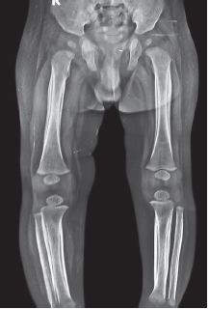
Radiological Features of Scurvy
Radiological changes, mainly seen at the lower end of femur and upper ends of humerus and tibia.
Bone assumes a ground glass appearance with a pencil thin cortex.
Metaphyses demonstrate a zone of well-calcified cartilage, (white line of Frenkel). White line may also be seen in healing rickets, severe protein energy malnutrition (PEM), plumbism, acute leukemia, and congenital syphilis.
Epiphyseal centers of ossification are surrounded by a white ring (Wimberger sign).
Subperiosteal hemorrhage results in periosteal elevation.
White ring around epiphysis (Wimberger sign), and pencil thin cortex, suggestive of scurvy

Slide 67
Biochemical Diagnosis
Plasma ascorbic acid levels not useful to detect early deficiency.
Ascorbic acid content of white blood cell (WBC) offers a sensitive estimate of its status in the body (25–40 mg/100 mg is normal).
Fasting vitamin C level >0.6 mg/dL excludes scurvy.
Urinary excretion of vitamin C 3–5 hours after a loading dose of 11 mg/kg is >80% in normal subjects.
Differential Diagnosis
Other causes of pseudoparalysis such as septic arthritis, osteomyelitis, and congenital syphilis should be considered.
Treatment
Ascorbic acid 100–200 mg per day provides quick relief. Treatment should continue for 3 months to ensure full recovery. Vitamin C rich foods need to be given.

Slide 68
IN A NUTSHELL
Vitamin C and Scurvy
Vitamin C is a water-soluble vitamin, lost in cooking as a result of heat and oxidation.
Fresh citrus fruits and vegetables (cauliflower, broccoli, and cabbage) are good sources of vitamin C.
Deficiency results in scurvy; manifests as petechial hemorrhages, painful and swollen bones, and poor wound healing.
Diagnosis is clinically supported by radiological changes.
Oral supplementation produces dramatic improvement in symptoms.

Slide 69
Thank you…

