Slide 1

Chapter 1
Growth and
Development

Slide 2


Slide 3
Why Study Growth and Development?
To know what is expected of a child at a given age
To identify children who may not look apparently sick but are having a disease process that is affecting growth
Early identification of handicaps
To assess the general health and nutrition status of the community
Evaluation of social action
To assess suitability of a baby for adoption

Slide 4
DEFINITIONS
Growth
Development
The Change
In size (quantitative)
In maturity (qualitative)
Because of
In cell numbers and cell size
In functions abilities (of neurons)
Example
Change in weight, height, BMI etc.
Change in developmental milestones
Both are Independent

Slide 5
Development (Qualitative measure)
Progressive series of orderly coherent changes occurring as a result of maturity and experience
Gaining skills in all aspects of life
Maturation- process of becoming fully developed in term of physiological and behavioural aspects
Learning- Assimilation of Information once the child is mature for a particular learning experience assenting in behavioural change

Slide 6

Concept of Early Childhood Development (ECD)
1. What is meant by Development
Holistic
2. What is meant by Early Childhood
First 1000 days/upto 3 yr/ upto 8 yr

Slide 7

ECD: Early Childhood Development
  Includes both growth and development
  Refers to childrens’ cognitive, social emotional, language and physical development
  Starts from conception up to first 8 year of life.
NC-ECD- Nurturing care for early childhood development
  Most useful for formative year
  Formative years- 0 to 3 years (time for max brain growth)
  5 Domains

Slide 8
IN A NUTSHELL
Definitions
Growth: Quantitative increase in structure of body (e.g., gain in weight or height).
Development: Qualitative changes in body function leading to acquisition of skills in all aspects of child’s life such as physical development, social and emotional development, intellectual development, communication, and speech development.
Early childhood development: A holistic term that encompasses both growth and development. Starts from conception, continuing till 8 years of age. Of these, the antenatal period and up to 3 years are the most crucial as 90% of neuronal connections are formed in this period.
Nurturing care: Caregivers need to provide nurturing care to their children to achieve ECD. Nurturing care has five components: good health, adequate nutrition, safety and security, responsive

Slide 9
Factors Affecting Growth and Development
Factors Affecting Fetal Growth
Factors Affecting Postnatal Growth

Slide 10
Factors predicting fetal growth
Demographic factors: Ethnicity/race, sex, parity, maternal age, socioeconomic status, and history of prior low birthweight
Nutritional factors: Pre-pregnancy maternal weight, maternal gestational weight gain, maternal height, and maternal caloric intake
Substance abuse: Maternal alcohol/tobacco consumption
Maternal infections (toxoplasmosis, rubella, and syphilis)
Maternal medications (thalidomide, ethanol, and antiepileptic medications)
Maternal illness (preeclampsia, anemia, and malnutrition)

Slide 11
Factors affecting postnatal growth
Genetic factors: Race, heredity, sex, and genetic disorders
Hormonal factors: Growth hormone, thyroid and gonadal hormones
Nutritional factors: Malnutrition
Sociocultural factors: Socioeconomic status, cultural beliefs, and family size and structure
Environmental factors: Secular trends, geographic factors, physical environment, access to health care
Health factors: Chronic ailments
Psychological factors

Slide 12
IN A NUTSHELL: Factors Affecting Growth and Development
Growth at birth is mainly dependent on intrauterine factors.
Postnatal growth is influenced by both genetic and environmental factors.
Maternal malnutrition, illness, and teratogens are the main factors controlling size at birth.
Race, heredity, and genetic disorders determine the basic framework of growth.
Prenatal growth is primarily influenced by IGF-1, while thyroid and gonadal hormones are important for postnatal growth.
Nutrition is the most important limiting or facilitating factor for postnatal growth.
Early childhood development is hampered by poverty, broken, parental illiteracy, and nutritional insults.

Slide 13
Principles of Growth
Growth and development are orderly and predictable
Growth progresses in a cephalocaudal and proximodistal manner
Growth is considered cyclic in the sense that the rate of growth is not constant
Rate of growth is not similar for all children
Different tissues of body grow at different rates
Growth is measurable both in terms of distance and velocity

Slide 14
Scammon’s Curves of Systemic Growth
Figure depicts the differential growth of body, brain, lymphoid organs, and genital organs, as the child passes through different phases of growth

Slide 15
Phases of Growth
Embryo | 0-8 weeks
Fetus | 9 weeks-birth
Early neonatal period | 0-7 days
Early neonatal period | 7-28 days
Infancy | Birth-1 year
Toddler | 1-2 years
Preschool | 2-5 years
Middle childhood | 5-11 years
Adolescent | 11-19 years

Slide 16
Prenatal Growth
Embryonic Period (0–8 Weeks)
  Egg is fertilized, transformed into a blastocyst and implanted in uterus by 2 weeks
  By 3 weeks, all the three germ layers are formed—with formation of primitive neural tube and blood vessels.
  By the end of embryonic period, rudiments of all major organs are formed. Times of intense development and rapid cell divisions are called critical period
  For example, critical period for neural tube development is 17–30 days; folate deficiency during this period could predispose to a neural tube defect.
Fetal Growth (9 Weeks to Birth)
  There is consistent increase in cell number and size and differentiation into tissues, organs, and systems.
  In early half of pregnancy, only 10–12% of body weight gain occurs. Early pregnancy is characterized by tissue differentiation, organ formation, and development of fetal structures. However, there is a steady increase in weight at the rate of 15 g/day from 24 to 37 weeks of gestation.
  There is a rapid increase in fetal weight, length, and head circumference in the last half of gestation.
  Intrauterine fetal growth can be assessed by ultrasonography in terms of fetal weight, femur length, and biparietal diameter.

Slide 17
Fetal Differentiation
Early weeks of pregnancy are characterized by differentiation and development of neurons and glial cells with neuronal migration.
Major part of “brain growth spurt” is characterized by rapid multiplication of glial cells in early stages, followed by myelination of nerve fibers, extending from mid-gestation to 18 months of age.
Fetal Growth Factors
Hormones such as insulin, insulin-like growth factor (IGF), and thyroid hormones have an important role in late gestation for tissue differentiation and growth.
Glucocorticoids play an important role near term gestation for initiation and control of maturational events that occur in organs such as lung, liver, and gut

Slide 18
Postnatal Growth
Infancy (birth to 1 year)
Childhood (1–11 years)
- Toddler (1–2 years)
- Preschool (2–5 years)
- School-going age group (5–11 years)
Adolescence (11-19 y)

Slide 19
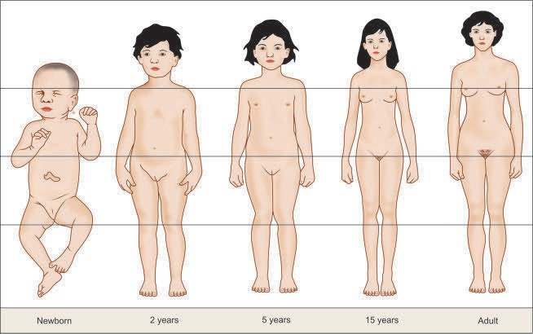
Body proportions as the child grows through different phases of growth

Slide 20
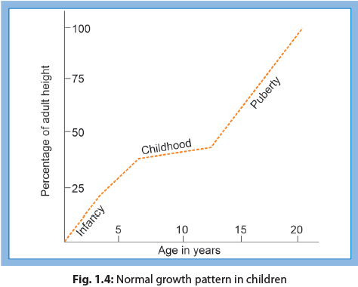

Slide 21
IN A NUTSHELL: Principles and Phases of Growth
Different tissues of the body grow at different rates. Maximum brain growth occurs in first year of life.
Growth is described in two categories: Prenatal and postnatal.
Prenatal growth is characterized by three phases (ovum, embryo, and fetus 9 weeks to birth).
Postnatal growth is characterized by three phases (infancy 0–1 year, childhood 1–11 years; adolescence 11–19 years)

Slide 22
Normal Growth
SIZE AT BIRTH
Birth weight: Average 2.8–2.9 kg.
Length of a normal full-term male infant is around 50 cm.
Head circumference at birth is 35–37 cm.
Physical proportions: The head is large for body size, face is small and rounded, mandible is small, chest is rounded, and the abdomen is protuberant. Limbs are short and ratio of upper to lower segment is high (1.7:1)

Slide 23
Factors Affecting Birth Size
Maternal nutrition: Infants born to mothers who are short (height <145 cm), underweight (<45 kg prepregnancy weight), anemic (hemoglobin <8 g/dL), or hypoalbuminemic (serum albumin < 2.5 g/dL) are likely to be born low birthweight, (<2.5 kg).
Maternal infection, toxemia, cigarette smoking, alcoholism or drug addiction, exposure to radiation, and systemic disorders may lead to decreased birthweight.
Fetal factors: Chromosomal and genetics anomalies

Slide 24
GROWTH IN INFANCY (FIRST YEAR OF LIFE)
Weight:
A term child loses 10% of his weight during first 3 days of life.
The birthweight is regained by 10 days of life.
Subsequently, weight gain occurs @ 25–30 g/day for the first 3 months.
Thereafter, 400 g of weight gain occurs every month, till 1 year.
Infant doubles his birthweight by 5 months and triples it by 1 year of age.
The weight at 5 months, 1 year, and 2 years is approximately 6, 9, and 12 kg, respectively.

Slide 25
Growth in Infants
Length: A term newborn measures 50 cm at birth, 60 cm at 3 months, 70 cm at 9 months, and 75 cm at 1 year of age.
Head growth: It occurs in parallel to the rapid brain growth during this period.
    - 0.3 mo-increase by 5-6cm.
    - 3-12 mo-increase by 5-6cm
    - At 1 year: 45-47cm
Chest circumference: This is less than the head circumference at birth. The two equalize by 6 months of age

Slide 26
GROWTH AFTER INFANCY: WEIGHT
Weight:
Weight of a child at the age of 2 years is four times and at 3 years is usually five times that of the birthweight.
Gains, 1.5–2.5 kg/year, from the age of 2 years till onset of adolescence.
Weight for age at a given age is more for boys (12-14y).
The adolescent acceleration in weight occurs earlier in girls (10–12 years) than boys.
The rapid weight gain is greatest in the year before menarche. Quick calculation of expected weight.
  3–12 months: expected weight = (age in months + 9)/2
  1–6 years: expected weight = 2 (age in years) + 8
  7–12 years: expected weight = [7 (age in years) – 5]/2
REFFER TO GROWTH STANDARD/REFERNCE FOR EXACT VALUES

Slide 27
Stature:
  At 2 year: 88-90 cm.
  Height at 4 years. 100 cm (double the birth length).
  Gains 4–5 cm/year from the age of 2 years till the onset of puberty.
  By 13 years of age, a child triples the birth length.
Adolescent spurt of growth in height corresponds closely to weight gain.
  Quick calculation of expected height, between the ages of 2 to 12 years.
Expected height = (age in years × 6) + 77
Head circumference:
  Increases by 2 cm in the second year of life (47–49 cm by 2 year)
  Then at a rate of 1 cm per year from 2–5 years of age.
  At 12 years of age, the average head size is 52 cm.

Slide 28
Mid-upper arm circumference (MUAC)
Normal mid-upper arm circumference of a term newborn is 9–11 cm.
By 1 year of age, it grows to 16 cm.
Mid-upper arm circumference (MUAC) increases by only 1.0 cm between the ages of 6 months and 5 years, therefore, it is also called an age-independent criterion between these ages.
MUAC < 12.5 cm: Moderate acute malnutrition (MAM)
< 11.5 cm: Severe acute malnutrition (SAM)

Slide 29
Growth Velocity
  Most rapid during the first year of life and then falls rapidly.
  Weight velocity is 6 kg (0-1 year) 2 kg/year (preschool child), and 3 kg/year till puberty.
  Height velocity is 25 cm in the first year of life, 12 cm in the second year, followed by around 5–6 cm per year till puberty.
Body Proportion
  The ratio of upper segment (crown to pubic symphysis) and the lower segment (pubic symphysis to heel) is 1.7 at birth.
  After birth, limbs grow much faster than the trunk.
  The ratio is 1.3 at 3 years of age.
  The upper segment equalizes the lower segment by 8–10 years of age (ratio 1:1).
Arm Span
  It is less than the stature by 1–2 cm by 10 years of age.
  Thereafter, arm span exceeds the height but the difference always stays <3–5 cm.

Slide 30
ERUPTION OF TEETH
  Age of onset of teeth eruption: Deciduous 6 mo; Permanent 6 year.
  All the deciduous teeth are replaced by the permanent teeth by 12 years.
Primary dentition:
  The lower central incisors appear between the ages of 5 and 8 months.
  The upper central incisors appear a month later and the lateral incisors usually within the next 3 months.
  The first molar teeth appear around the age of 12–15 months.
  Canines appear between the age of 18 and 21 months.
  The second molars are out at the age of 21–24 months.
Permanent teeth
  Erupt in the following order.
    — 1st molar— 6 years;
    — Central and lateral incisors
    — 6–8 years; canines and premolars
    — 9–12 years;
    — Second molars — 12 years; third molars— 18 years or later.

Slide 31
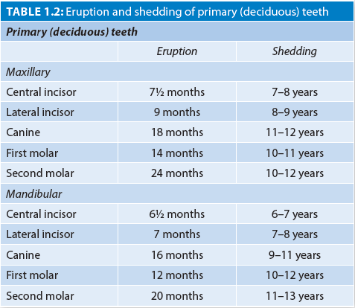
Eruption of Primary Teeth

Slide 32
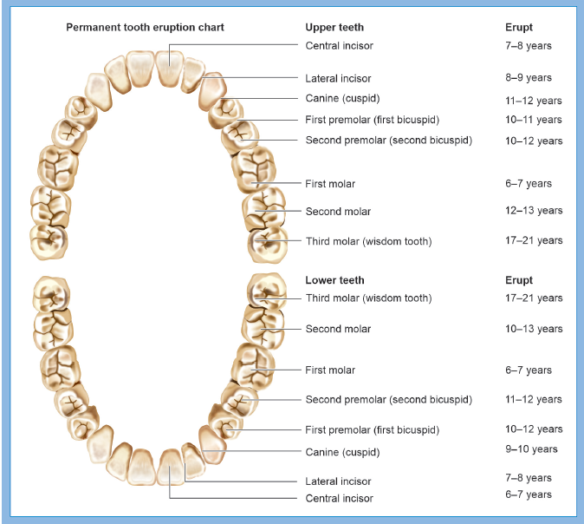
Timing of Permanent Tooth Eruption

Slide 33
IN A NUTSHELL
Normal Growth
Average size at birth: • Weight 2.8 kg; Length 50 cm, Head circumference 35–37 cm.
Average size at 1 year: • Weight 8–10 kg; Length 75 cm, Head circumference 45–47 cm.
After 2 years, weight increases by 1.5–2.5 kg/year and height increases by 4–5 cm/year, till puberty.
Mid-arm circumference is 9–11 cm at birth, increases to about 16 cm at 1 year. After 1 year, it increases @only 0.25 cm/year; thus called age-independent between 1 and 5 years of age.
Deciduous teeth start erupting by 6 months, and permanent teeth by 6 years of age.

Slide 34
WEIGHT
Weigh the child in bare minimum of clothes.
Ensure that the scale is resting on firm, stable and even surface.
Check the zero of the scale before weighing, every time.
Read the weight by standing in front of the scale and not from the side.

Slide 35
Length (< 2 years)
Place the child supine on the infant measuring board.
Ask the assistant to hold the child’s head in the Frankfort plane, while you steady the legs. The head is positioned in the Frankfort plane when the crown touches the headpiece and a vertical line from the ear canal to the lower border of the eye socket is perpendicular to the horizontal board (i.e., positioned vertically). Apply gentle traction to bring the head into contact with the fixed headpiece.
Position the child’s shoulders and hips at right angles to the long axis of the body. Apply gentle pressure on the knees to straighten the legs and prevent the knees from flexing.
Bring the movable footboard to rest firmly against the child’s feet with the soles flat on the board and the toes pointing directly upward.
Record the measurement to the nearest 0.1 cm from the counter on the measuring board.

Slide 36
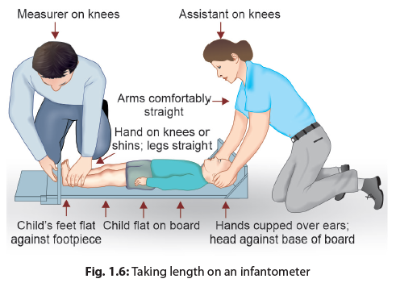
Length (Children < 2 year)

Slide 37
Height > 2 years
Remove the hair ornaments, undo the buns and braids, and take off the footwear.
Ask the child to stand on the stadiometer with feet slightly apart at a 60° angle and confirm that the weight is evenly distributed on both feet. The arms hang freely by the sides of the trunk with palms facing the thighs.
Ensure that the back of the head, shoulder blades, buttocks, calves, and heels are touching the vertical board/wall. This can be done by trying to insert a plastic rule at places where these points touch the wall. Inability to insert the rule implies good contact.
Ask the child to look straight. Position the child’s head so that a horizontal line drawn from the external auditory meatus to the lower edge of the eye socket runs parallel to the baseboard (i.e., the Frankfort plane positioned horizontally) (Fig. 1.7).
The headpiece is moved down to rest firmly on top of the child’s head, compressing the hair; keeping it perpendicular to the wall.
Record the reading to the last completed 0.1 cm.

Slide 38
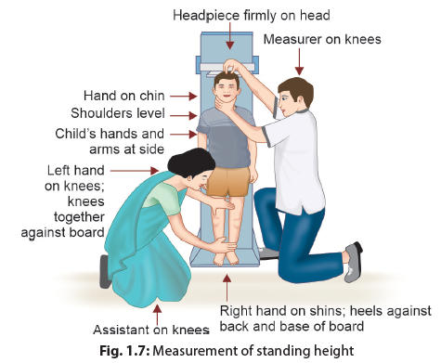
Height (> 2 y)

Slide 39
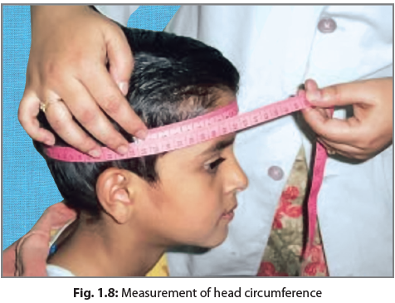
Head Circumference
Measured to nearest 0.1 cm with a overlying the occiput at back and supraorbital ridges in front.
Anchor the tape just above the eyebrows.
Ensure that the tape overlies the most prominent part of the occipital prominence at the back of the head.
The tape should be pulled firmly to compress the hair, skin, and underlying soft tissues.
Record measurement over the parietal eminence by cross-over technique.

Slide 40
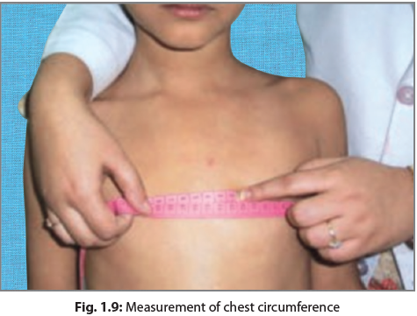
Chest Circumference
Place the infant in the lap of the mother and stand in front. The chest should be bare.
Abduct the arms of the infant slightly to permit passage of the tape around the chest.
Pass the tape around the chest of the infant, at the level of nipples or 4th costosternal joints.
Lower the arm to their natural position, once the tape is snugly in place.
Record the circumference in a horizontal plane, midway between inspiration and expiration.

Slide 41
Mid-upper Arm Circumference
Mid-upper arm circumference (MUAC) is recorded for children between 6 months and 5 years of age to nearest of 0.1 cm. A mid-upper arm circumference of <12.5 cm indicates malnutrition.
Palpate and mark the two important bony landmarks, i.e., the acromion process and the olecranon. Forearm should be flexed while marking these points.
Mark the mid-upper arm point. It is half the distance between the acromion process and the olecranon.
Encircle the tape around the arm, over the marked midpoint, perpendicular to the long axis of the upper arm, with arm hanging freely in a relaxed position.
Ensure that the tape lies flat around the arm, without compressing the skin or underlying tissue; there should be no gap or compression on the inner part of the arm.

Slide 42
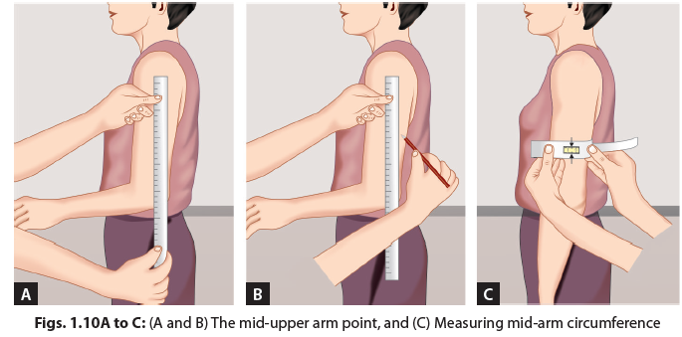
Recording MUAC

Slide 43
SKINFOLD THICKNESS
Useful for estimation of muscle mass or of body fat content.
Triceps and subscapular skinfold thickness taken are sufficient.
Thickness is taken using a skinfold caliper (Holtain or Harpenden).

Slide 44
Sitting height
Arm span

Slide 45
ASSESSMENT OF BONE AGE
Used for diagnostic evaluation of children with growth failure, and advanced or delayed puberty.
Discrepancy between bone age and chronological age suggests endocrine defect of the endocrine system.
The earliest epiphyseal centers to appear are those for os calcis and talus (22–26 weeks of gestation).
At birth distal epiphyses of femur and the proximal epiphyses of tibia are usually present.
Two carpal bones are present at 1 year; and by 6 years, epiphyses of 7 carpal bones are present except pisiform, which ossifies at around 12 years.

Slide 46
By convention, radiograph of the left limb is taken for computing bone age.
Radiographs at various age to assess bone age
  - Newborn: Foot, knee
  - 3-9 months: Shoulder
  - 1-12 years: Hands and wrists
  - 12-14 years: Elbow and Hip

Slide 47
IN A NUTSHELL
Assessment of Physical Growth: Anthropometry
Commonly measured anthropometric parameters include weight, length, height, head and chest circumference, and mid-arm circumference.
Weight and height/length are to be measured throughout childhood while body circumferences are important to be measured between birth and 5 years.
Body mass index (BMI) is calculated as [weight in kg/height in m2] and considered as most important parameter to assess growth in older children and adolescents.
Bone age is a tool to evaluate children with growth failure, or those with advanced/delayed puberty.

Slide 48
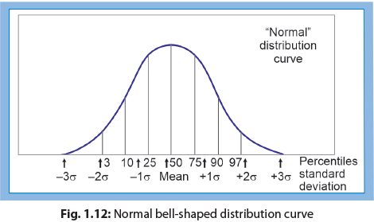
Statistical Principles in Assessment of Growth
GAUSSIAN DISTRIBUTION
Maximum values lie around the middle of the curve.
Mean and median are equal in a Gaussian distribution.
Median is considered as the central value in a non-Gaussian (skewed) distribution.

Slide 49
MEAN AND STANDARD DEVIATION
Mean
Obtained by dividing the sum of all observations by the number of observations.
Standard deviation
It denotes the degree of dispersion or the scatter of observations away from the mean.
  - 68.3% Values within 1SD
  - 95.4% Values within 2SD
  - 99-7% Values within 3SD

Slide 50
PERCENTILES
Percentile indicates the position that a measurement would hold in a typical series of 100 arranged in ascending order.
The median lies at the 50th percentile, on either side of which lie half the observations.
The 85th percentile curve, denotes that 15% of observations are expected to be above and 84% below it.
One standard deviation above or below the mean coincides with the 84th or 16th percentile curve, respectively.
2SD corresponds to 3rd a 97th percentile.
95% of the weight/height measurements of healthy children at a given age are expected to lie between 3rd and 97th percentile values.
A healthy child normally remains and follows the same percentile curve during the entire period of his/her growth.

Slide 51
Z(SD)-SCORE
It represents the deviation of anthropometric measurement from the reference median and is calculated as follows:
Observed value – Median reference value standard deviation (SD) of the reference population
An SD score value of +1.5 means that the difference between the present (observed) and the expected (reference median value) is 1.5 times of the standard deviation of the reference population.
A negative value of Z-score means that the observed value is less than the expected; and vice versa. Similarly, a positive (+) value of Z-score indicates that the observed value of the measurement/index is more than the reference median.
Usually, –1, –2, and –3 Z-scores correspond to 15.8, 2.28, and 0.13th percentiles; while 1st, 3rd, and 10th percentiles correspond to –2.33, –1.88, and –1.29 Z-scores, respectively.
Thus, the 3rd percentile roughly corresponds to –2SD.
Abnormal values usually refer to measurements below –2 Z-score (2.3rd percentile) or above +2 Z-score (97.7th percentile), relative to the reference median.

Slide 52
IN A NUTSHELL
Statistical Principles in Assessment of Growth
  Median, rather than mean is considered as the central value for most anthropometric parameters.
  Percentile indicates the position that a value will hold, arranged chronologically in a series of 100 values. Median is thus, the 50th percentile.
  Most normal children are expected to have their anthropometric measurements between 3rd and 97th percentiles.
  Z-score (also known as SD score) represents deviation from the central value.
  Usually, values between ±2 Z-score are considered normal

Slide 53
WHO Growth Standards (0-5y)
The WHO percentile charts depict 5 percentiles lines corresponding to 3rd, 15th, 50th, 85th, and 97th percentiles (from below to above). Any child who is below the 3rd or above the 97th centile is likely to be abnormal.
The WHO Z-score charts display curves for median, –2Z, –3Z, 2Z, and 3Z-scores. Abnormal is defined as any discrepancy of more than –2Z-scores. A deviation by more than –3Z-score denotes severe malnutrition. On the charts of growth velocity, the cut-off line for defining low-height velocity is below the 25th centile.

Slide 54
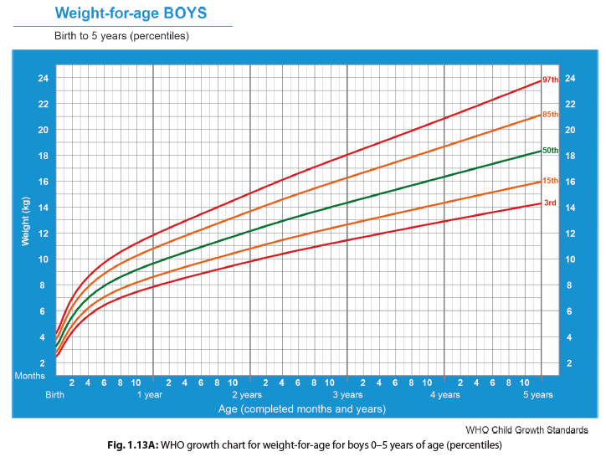

Slide 55
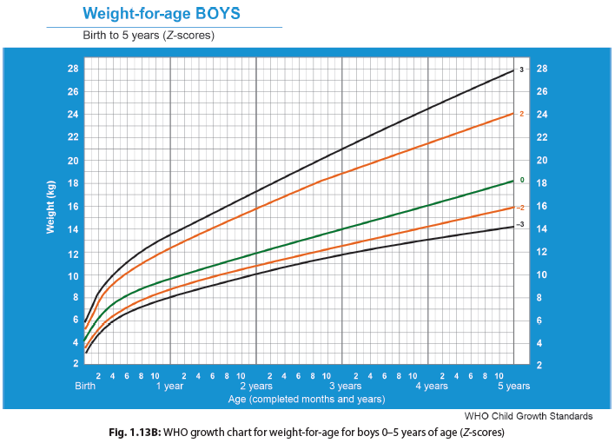

Slide 56
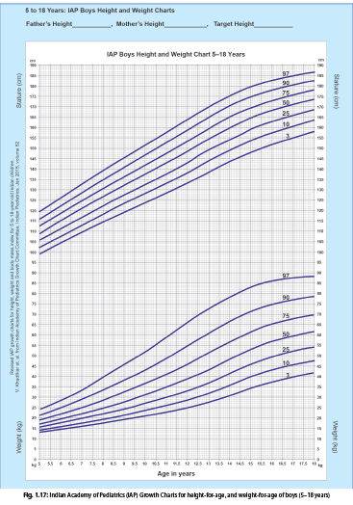
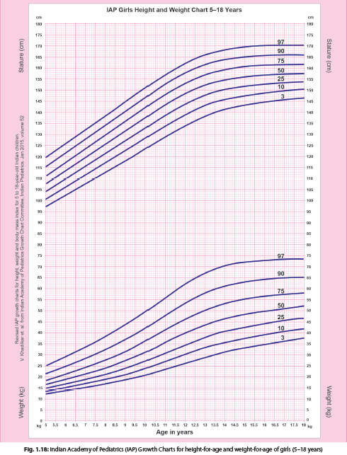
IAP GROWTH CHARTS FOR INDIAN CHILDREN (5–18 YEARS)
In 2015, Indian Academy of Pediatrics (IAP) published the revised growth charts based on data collected from published studies on apparently healthy Indian children and adolescents in the past one decade. IAP recommends use of these charts as reference values for Indian children between 5 and 18 years of age.

Slide 57
IN A NUTSHELL
Growth Charts, Growth References, and Growth Standards
WHO growth standards represent how children between 0 and 5 years should grow and show that all children of the world grow similarly till 5 years of age.
WHO growth charts are available as (a) percentile curves (corresponding to 3rd, 15th, 50th, 85th, and 97th percentiles); and (b) Z-score curves (corresponding to 3Z, – 2Z, median, + 2Z, and + 3Z scores).
Indian Academy of Pediatrics (IAP) growth charts (for weight, height, and BMI) are used as references for evaluating growth of children between 5 and 18 years of age.

Slide 58
Normal Development
LAWS OF DEVELOPMENT
Development is a continuous process from conception to maturity, and implies maturation of function, interaction with environment, communication, and independence in day-to-day activity. For example, at birth, a neonate is not able to roll over, sit, approach objects voluntarily, laugh, or interact with the help of language. In due course of time, sequentially, the infant acquires all such functions.
Normal development requires an anatomically and functionally normal central nervous system, peripheral nervous system, musculoskeletal system, hearing and vision, supported by a suitable environment. A child with a morphologically abnormal central nervous system (e.g., anencephaly and meningomyelocele) or damaged neurons and pathways (e.g., following hypoxic or ischemic insult) is unlikely to have a normal development.

Slide 59
  Abnormal development may result from intrauterine and perinatal insults (perinatal asphyxia, kernicterus, etc., resulting in delayed development right from birth), or disease affecting neuronal pathways and myelination in later life (trauma, meningitis, CNS hemorrhage, etc. during first 6 years of life, while the brain is still growing).
The sequence of development is same and predictable in all children but the rate may vary, e.g., head control always precedes sitting; however, the age of acquisition of these milestones may vary.
Primitive reflexes are to be lost before voluntary functions are acquired. Primitive reflexes are group of motor reflexes found in neonates and infants; these are protective brainstem reflexes, which develop sequentially during late fetal life.
These reflexes are essential for survival, feeding and movement while neonatal CNS is immature. For example, the grasp reflex should be lost (by 3–4 months) before the infant can learn to reach for objects and to grasp them voluntarily (by 4–5 months). Similarly, asymmetric tonic neck reflex should be lost before a child learns to turn over in bed (think, why?).

Slide 60
Persistence of a primitive reflex, beyond the age at which it should have disappeared, indicates and predicts abnormal development. For example, Moro reflex should disappear by 4–6 months of age. A 6-month-old child with a positive Moro reflex is suggestive of abnormal development.
Development always proceeds in a cephalocaudal manner, i.e., from head to toe. Thus, a child will learn to hold his head, followed by ability to sit and then be able to walk. This sequence will always remain the same; though, the age at which each function is achieved may differ within physiological range.
The fine motor function of upper extremity develops in proximodistal manner, i.e., beginning at the shoulder girdle and progressing to fine movement of hands and fingers attaining important milestone of pincer grasp.
Generalized mass activity is usually replaced by specific individual response, e.g., nonspecific, symmetric movements of arms and legs in infants are replaced by asymmetric precise grasping in older children, when presented with a toy.

Slide 61
DOMAINS OF DEVELOPMENT
Developmental milestones in first 5 years of life are categorized in five different domains for assessment and screening purpose:
Motor development:
Gross motor: Pertaining to development of locomotion, general body control and specific motor skills.
Fine motor: Pertaining to development of finer limb movements and coordination, i.e., grasping, fine hand movements, hand-eye co-ordination.
Cognition/problem solving: Refers to mental abilities of the child and includes imitation, simple problem solving, puzzles, drawings that eventually transform into reading, writing, and academic skills.
Personal-social development: Child’s reaction to other persons and his adjustment to domestic life, social groups, and community conventions. This includes social behavior, feeding, sphincter control, general understanding, play activity, and dressing.

Slide 62
Language and speech development: Ability to communicate; including comprehension (receptive language) as well as expression of language (expressive language includes gestures, speech, and written language).
Adaptive/activity of daily living: Development of skills needed by the child to initiate new experiences and to profit by past experiences. This adaptivity includes alertness, intelligence, and various forms of constructiveness and exploration. This subset majorly decides for self-help activities transforming into independent living in society in later life.

Slide 63
DEVELOPMENTAL MILESTONES
Children accomplish maturation of different biological functions (level of development or milestone) at an anticipated age, with a margin of a few months on either side. Milestones are like guideposts for various stages of development, through which every child passes in the normal trajectory at a particular age.
Motor Milestones
Gross motor development: It involves control of the child over his body and locomotion, i.e., head control, sitting, standing, walking, jumping, etc. Motor development depends on the maturation of muscular, skeletal, and nervous systems (
Figs. 1.19 to 1.24).

Slide 64
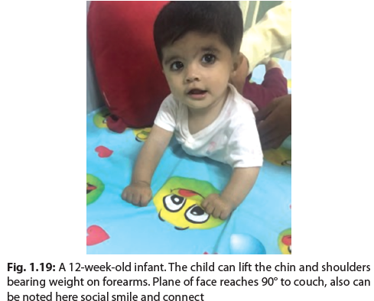
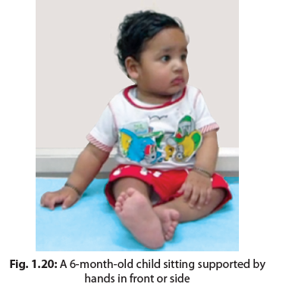

Slide 65
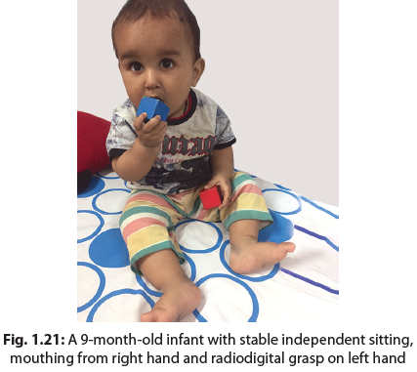
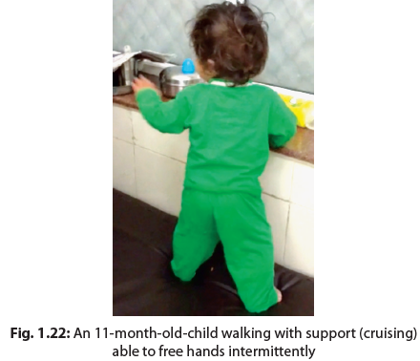

Slide 66
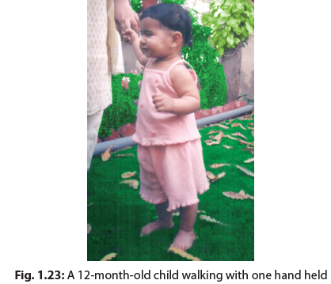
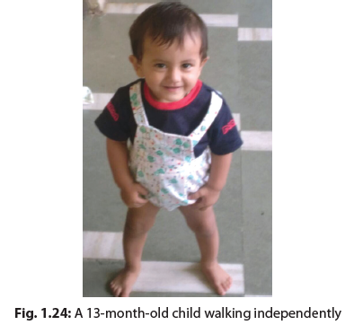

Slide 67
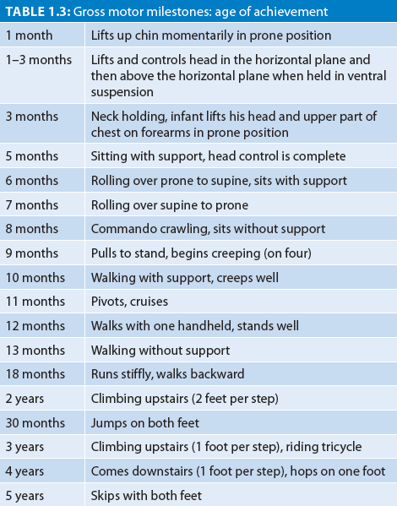

Slide 68
Fine motor development: It assesses the finer upper limb movements and coordination. This includes coordination of eyes, hand-eye coordination, hand-mouth coordination, and skills for manipulation with hands; i.e., grasping, fine hand movements (Figs. 1.25 to 1.29), making a tower, writing, etc. Ages of attainment of important fine motor milestones are provided in Table 1.4.
Adaptive/Cognitive Milestones
Adaptive/cognitive development is the ability to learn or deal with new situations. In initial few weeks of life, infant explores the environment visually. Initially, he follows faces and then objects. After gaining better control of arms and hands, he starts batting at and then reaching for objects. At first, objects are brought to the mouth for oral exploration. Later, the infant visually examines an object held in one hand while manipulating it with the other.
With maturation of vision, infant can focus on small objects by about 5 months of age.

Slide 69
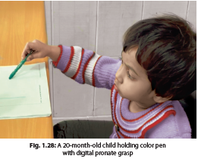
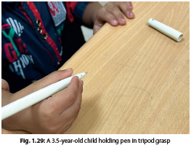

Slide 70
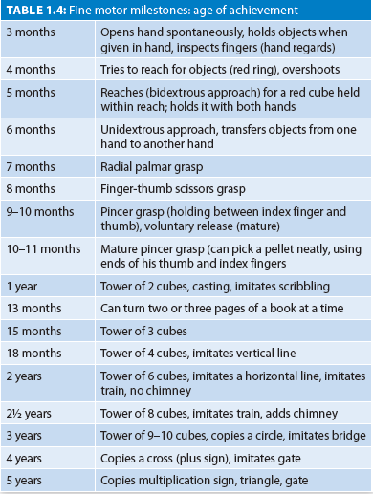
Fine Motor Milestones

Slide 71
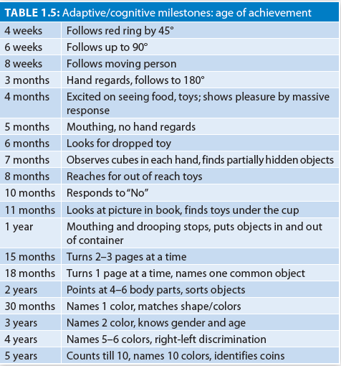
Adaptive/cognitive
milestones

Slide 72
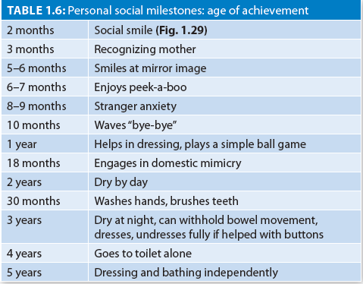
Personal Social Milestones

Slide 73
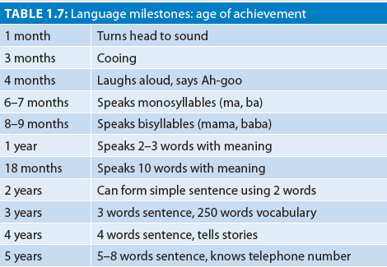
Language Milestones
It is the Expression of communication
Receptive language is ability to understand what is being said.
Expressive language: ability to make thoughts, ideas known to others through speech, gestures, and facial expressions.

Slide 74
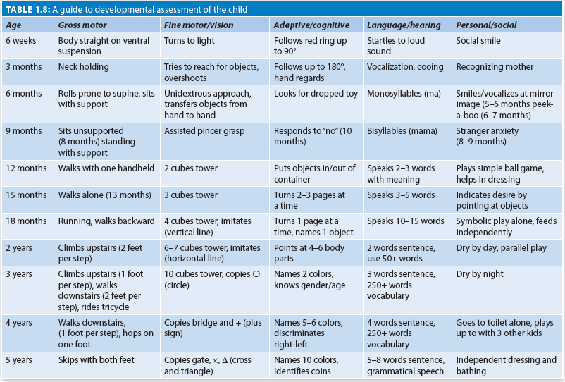
Overview of Achievement of Various Milestones

Slide 75
IN A NUTSHELL
Normal Development
At birth, a child’s sensory, motor, and neurologic capacities attribute to organizing experiences and interacting with the environment, resulting in development.
The laws of development are universal, and every child goes through the same sequence although rate and character may vary.
Development depends upon various mutually interactive factors which can be broadly divided into biological, social, and psychological factors.
Development is usually defined and measured under five domains namely: (1) Motor development (Gross motor and Fine motor), (2) Cognition/problem solving, (3) Personal-social development, (4) Language and speech development, and (5) Adaptive functioning/activity of daily living.
There may be variations in normal development which could manifest as developmental dissociation, developmental delay, and developmental deviance, and therefore development should be monitored over time.

Slide 76
Developmental Surveillance
It is an informal, flexible, and ongoing assessment of development)
Should be a part of all well-baby clinic visits like immunization.
During each visit the clinician should observe the normal milestones and presence of any red flags.
Presence of any developmental red flag warrants a detailed assessment.
List of developmental red flags are given in next slide.

Slide 77
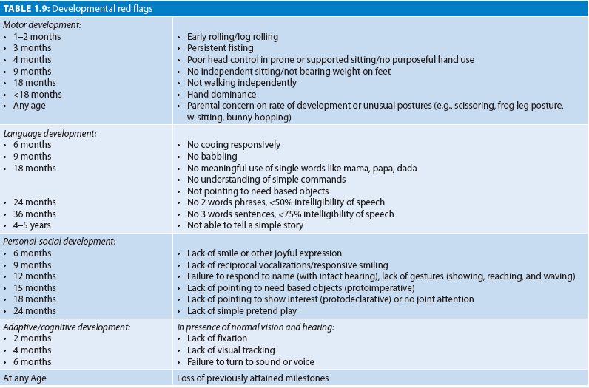
RED FLAG SIGNS

Slide 78
Developmental Screening
Supported with culturally accepted tools, developmental screening is considered superior to developmental surveillance.
Indian Academy of Pediatrics (IAP) recommends routine developmental screening using standardized screening tools at 9–12 months, 18–24 months of age, and at school entry and additionally at 4–6 months of age for high-risk infants.
The age of routine screening coincides with the immunization visits.
For autism, IAP recommends, children should be screened by standardized autism screening tools like Modified Checklist for Autism in Toddlers M-CHAT, and Trivandrum Autism Behavior Checklist (TABC) at 18 and 24 months of age.

Slide 79
DEVELOPMENTAL EXAMINATION
Prerequisites
Developmental examination should be done when the child is well fed, not sleepy, happy and in a playful mood.
The assessment should be performed in front of mother or primary caregiver
Keep only relevant toys and objects so as not to distract the child.
No rigid pattern should be followed while doing the assessment.
Before performing the developmental assessment, the vision and hearing of the child should be checked as it may affect development and interpretation of assessment.

Slide 80
Tools for developmental assessment:
A red ring (for visual fixation and tracking and reaching for objects)
A small bell (for testing hearing; held 30 cm away from ear and away from the sight)
Pellets made of cardboard, wool or paper; 8 mm size (pincer grasp)
10 cubes of 1 inch each (transfer of objects, different types of grasp, imitating/building tower/bridge)
Crayon and paper (scribbling, imitating, and copying strokes/shapes, naming colors)
A picture book of common objects (pointing, naming objects, fine motor skills of turning paper, joint interest)
Doll (pretend play)
Simple form board
Colored and uncolored geometric forms
Goddard’s form board (for children >3 years of age)

Slide 81
PROCESS OF ASSESSMENT
Between 1 and 3 Months
Observe the baby in the mother’s lap; observe for any obvious abnormality such as fisting, tightness of body, etc.
Notice, if the child watches the mother, smiles or produces sound (6-8 wk).
Note the shape and size of the head. Palpate sutures and anterior fontanel.
Assess resistance to passive movement for tone. Loose limbs indicate hypotonia while stiff limbs indicate hypertonia.
Place the child supine on the surface and observe the posture:

Slide 82
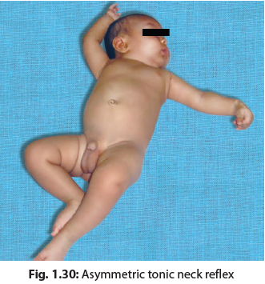
Asymmetric Tonic Neck Reflex
Disappears by 12 weeks

Slide 83
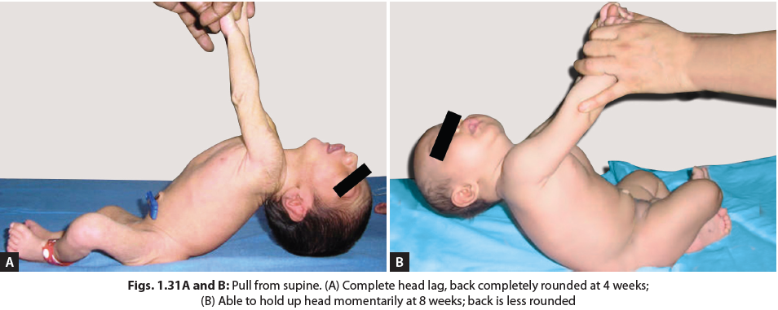
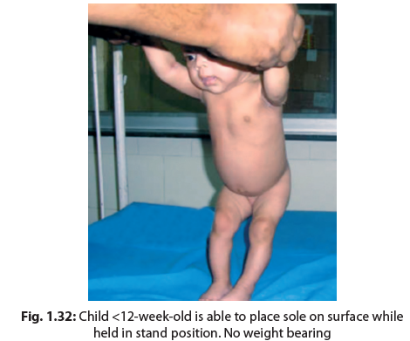
Supine Position
Observe the hands: z 4 weeks: Closed hands, presence of grasp reflex.
8 weeks: Opens hands frequently, slight grasp reflex.
12 weeks: Hands loosely open, may hold a rattle for a minute. No grasp reflex.
Pull the child from supine position. Observe head lag and back: 4 weeks: Complete head lag, back completely rounded (Fig. 1.31A).
8 weeks: Able to hold up head momentarily, less rounding of back (Fig. 1.31B).
12 weeks: Head held up most of the time.
Hold the child in standing position: able to place sole on the surface (Fig. 1.32).

Slide 84
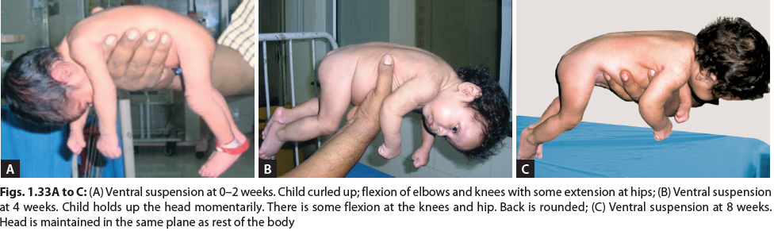
Ventral Suspension
0–2 weeks: Curled up on ventral suspension. Note flexion of elbows, knees with some extension at hips (Fig. 1.33A).
4 weeks: The child holds up the head momentarily. There is some flexion at the knees and hip. Back is rounded (Fig. 1.33B).
6 weeks: Head held momentarily in plane of body.
8 weeks: Maintains head in the same plane as rest of the body (Fig. 1.33C).
12 weeks: The child holds the head up and above for long

Slide 85
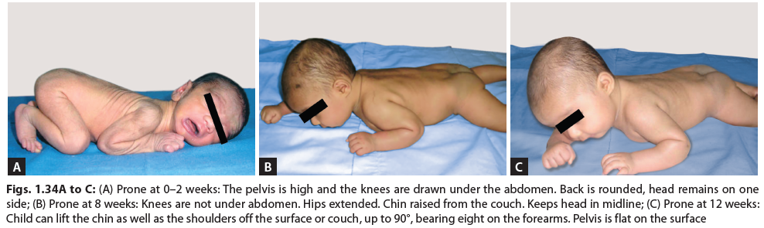
Prone Position
0–2 weeks: The pelvis is high and the knees are drawn under the abdomen. Back is rounded, head remains on one side (Fig. 1.34A).
6 weeks: Knees are not under abdomen. Hips extended. Chin raised from the couch intermittently.
8 weeks: Head mostly in midline. Lifts chin off the couch up to 45°C (Fig. 1.34B).
12 weeks: Can lift the chin and shoulders 90°, bearing weight on the forearms. Pelvis is flat (Fig. 1.34C).

Slide 86
Between 4 and 6 Months
Observe the child: Note facial expressions, vocalization, altertness, and interest in surroundings. Check vision and hearing.
Place a rattle in the hand of the child. Observe, how he plays with it? At 4 months, the child plays with rattle placed in hand for long period; but cannot pick it up, if he drops it. At 5 months, he recovers the rattle, if dropped; and at 6 months, he looks for the dropped rattle.
Place a 1-inch cube in front of the child. Observe whether he gets it (5 months) and if yes, whether he transfers it from one hand to the other (6 months).
Watch for hand regards (normal between 3 and 5 months of age). It should disappear by 5 months of age.
Place the child in prone position and observe:
  4–5 months: Can lift the head and chest off the surface, bearing weight on forearms (Fig. 1.35).
  5–6 months: Can lift the head and chest off the surface with weight bearing only on hands, may roll from prone to supine.

Slide 87
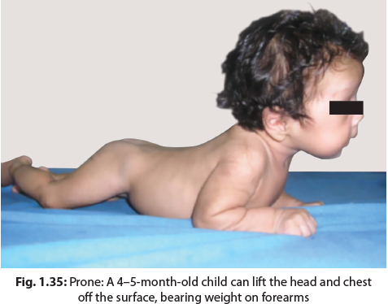

Slide 88
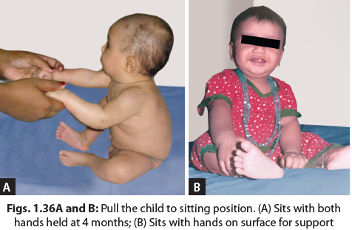
Place the child supine and observe: The child lifts the head off the surface when about to be pulled up (6 months).
Pull the child to sitting position. Look for head lag: z If head lag is present, the development is <5 months. There may be a slight head lag at beginning of 4 months.
If there is no head lag, watch for the support required for sitting:
  4 months: Sits with both hands held (Fig. 1.36A).
  5 months: Sits supported in a high chair or mother’s lap.
  6 months: Sits with his own hands on surface for support (Fig. 1.36B).
Hold the child in standing position. By 5–6 months, the child is able to bear most of the weight on legs.
Show a mirror: Smiles at mirror image by 6 months.
Observe the speech:
  4 months: Laughs aloud.
  5 months: Speaks Ah-goo.

Slide 89
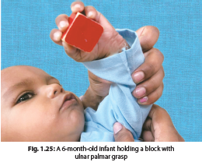
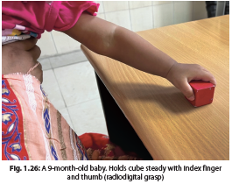
Between 6 and 12 Months
Observe the child’s interest, alertness, and quality of vocalization/language as he sits or moves around. Does he differentiate between family and strangers? Also, notice interaction with mother, e.g., in peek-a-boo and pat-a-cake games
Offer a cube: With the child sitting in the mother’s lap, place a cube on the table in front of the child. Observe, how the child approaches the cube and also observe what the child does with it:
  6 months: Approaches cube with fingers and holds cube with the palm on the ulnar. Unidextrous approach.
  7 months: Radial palmar grasp of cube.
  8 months: Scissor grasp (using all four fingers against the thumb).
  9–12 months: Approaches cube by index finger and holds cube steady with index finger and thumb. This is mature grasp

Slide 90
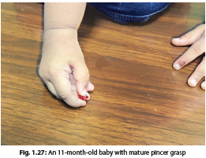
As soon as the child takes one cube, offer the second cube:
  5 months: Drops first cube when second is offered.
  6 months: Retains the first cube in hand and takes the second cube also. Transfers from one hand to another.
  9 months: Compares two cubes by bringing them together.
Offer a pellet. Watch the approach and the grasp:
  7–9 months: Approaches with all the fingers/hand (rakes). Not able to pick it up.
  9–12 months: Able to pick up the pellet between tip of thumb and forefinger.

Slide 91
Place the child in the sitting posture and observe:
  7 months: Can sit unsupported, momentarily.
  8 months: Can sit steadily on floor without support.
  10 months: Sits steadily. Can pivot around.
Place in the prone position and observe for creeping (9–10 months).
Pull to the stand position. Also watch, if he can walk around holding on to furniture.
  9–10 months: Stands holding on to furniture, pulls to stand.
  10–11 months: Can walk around holding onto the furniture.
  12–13 months: Stands independently, takes a few independent steps

Slide 92
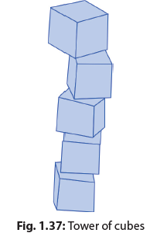
Between 1 and 2 Years
Watch his gait and assess its maturity. Observe his interest in toys or pictures. Does he point at things to ask for them?
Offer 10 cubes: Show him how to build a tower and then let him do the same. This process is known as imitating. See how many cubes he can utilize in building a tower (Fig. 1.37).
15 months: Tower of 2 cubes.
18 months: Tower of 3–4 cubes.
2 years: Tower of 6–7 cubes.
Warning signs: The child should not take the cube to his mouth after the age of 15 months. Similarly, he should not be throwing cubes on the floor, one after another, after 18 months

Slide 93
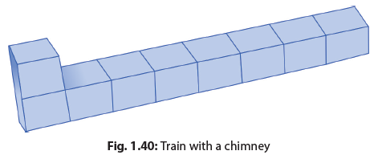

Train and chimney: Demonstrate, how to make a train of 9 cubes and place the 10th one on top of the first one (chimney). Ask him to do the same. A 2-year-old child can make the train, but fails to put the chimney.
■ Picture identification and naming: Show picture cards or book, and ask to identify them in the following format “where is the cat”? At a later age, you may ask “what is that”? This is known as picture naming and more difficult (Fig. 1.38).
18 months: Identifies 1 object and names 1 object.
2 years: Identifies 5 objects; can name 3 objects.

Slide 94
Give a picture book: See, how many pages of a book, he can turn at one time.
15 months: Turns 2–3 pages at a time.
18 months: Turns 1 page at a time.
■ Offer pen and paper and notice any spontaneous scribbling.
Ask to imitate (by showing how to do it by drawing in his/her sight) the drawing of a vertical stroke (|), horizontal stroke (—), and a circle. Interpret as follows:
12 months: Imitates scribbling.
15 months: Scribbles haphazardly.
18 months: Imitates vertical stroke.
2 years: Can imitate horizontal stroke and a circle.

Slide 95
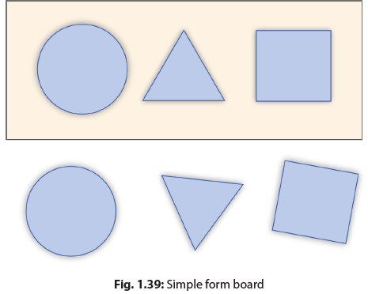
Offer simple form board (Fig. 1.39). First, offer only the round block. z If the child puts the round block in the correct slot without error, rotate the form board by 180°, take out the inserted block and ask the child to do it again. The child can do this by 15 months.
If a child can put in the round block, offer all three blocks. If the child puts all three correctly then ask to do it again, after you have rotated the Form board. If the child can correctly put in the blocks two to three times, he/she is at least 2 years of age.

Slide 96
Between 2 and 5 Years
Notice the gait. At the end of the session, see how he climbs stairs, jumps/hops/skips.
Can he throw a ball overhead? Undressing/buttoning-unbuttoning can be observed before the physical examination.
Offer 10 cubes:
Usually a child in this age group spontaneously begins to build a tower. Notice how many cubes he utilizes in making the tower.
Ask the child to imitate/copy (depending on expected maturity level) a train, bridge, gate, and steps, one by one (Figs. 1.40 to 1.43). (Note: Imitation means building the model while the child is watching and then asking him to build the same; while Copying means building the model out of sight of child, shielding with a paper, and then showing him the final model and asking him to build the same.)

Slide 97
2½ years: Tower of eight cubes; imitates train with chimney.
3 years: Tower of 9–10 cubes, imitates bridge.
3½ years: Copies bridge.
4 years: Imitates gate.
5 years: Copies gate.
6 years: May copy steps
While the child is handling cubes, observe minutely for any abnormal hand movements or disability.

Slide 98
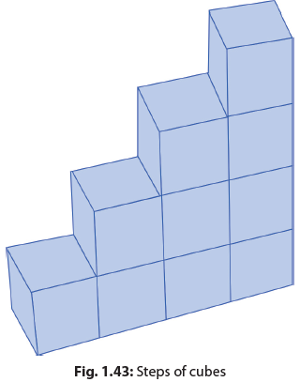
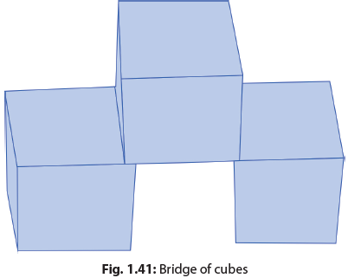
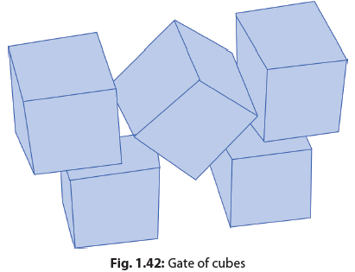

Slide 99
Give a pencil and paper: Ask to imitate vertical and horizontal stroke, circle, cross, square, triangle, and diamond, in that order. If the child is able to imitate a task, ask to copy the same.
2 years: Imitates horizontal/circular stroke.
3 years: Copies circle and horizontal stroke. Imitates cross.
4 years: Copies cross.
4½ years: Copies square.
5 years: Copies triangle.
6 years: Copies diamond

Slide 100
Show the picture cards and ask to identify or name the objects z 2½ years: Identifies seven objects; names up to 5.
3 years: Names 8–10 objects.
Offer simple form board and observe the ability of the child to insert the blocks and the accuracy with which he does that.
If the child is successful with simple form board, he should be tried with the colored geometric forms followed by uncolored geometric forms. In each case, he is asked where the shapes fit, being given different forms one after the other. He is not told about his mistakes and is given another chance with those he has placed incorrectly.
After developmental age (DA) of 3½ years, time his performance in Goddard Form board, the score being based on the best of 3 trials.
Goodenough draw-a-man test: After DA of 3 years, ask the child to draw a man as completely as he knows. Child is given 1 point for each of the body parts added. For each 4 points, 1 year is added to the basal age which is 3 years. The test has 51 items, details of which can be found in textbooks. This test can be used for developmental assessment between 3 and 10 years of age.

Slide 101
Gessel “Incomplete Man” test: In this test, picture of a man which is halfway complete is given to the child. The picture consists of a small circle for a head and below it a larger incomplete circle representing the trunk with one stick arm and one stick leg protruding. The head has one ear, half hair, a mouth and a nose but is missing eyes, one ear, half hair, one arm and one leg and various connecting elements. Child is asked to complete the man. Depending on how many and in what way the child adds the parts, DA is deciphered.
Digit repetition: Child is asked to repeat digits, e.g., six, five, and seven. Initially, he is given two digits. If he can repeat them, ask him to repeat three and then four digits followed by five. In each case, he is given three trials with different numbers.
Ask the child to identify colors in pictures.

Slide 102
Physical Examination
Take anthropometric measurements;
Look for major and minor congenital anomalies;
Examine carefully the skin, eye, ear, extremities in detail;
Conduct a thorough neurological examination.
Look for the presence of hepatosplenomegaly.

Slide 103
Risk Factors for Developmental Delay
Abnormal growth (e.g., height or weight less than 3rd percentile or head circumference less than –3 SD or >2 SD)
Major congenital anomalies (e.g., spina bifida or midline defects)
Minor congenital anomalies (e.g., hypertelorism, hirsutism, or micrognathia)
Neurocutaneous skin lesions (e.g., neurofibromatosis or cafe au lait spots)
Abnormal optical findings (e.g., esotropia, exotropia, cataracts, or poor visual tracking).
Abnormal findings in ears (e.g., unusual shape or placement or recurrent acute or serous otitis media)
Visceral abnormalities (e.g., hepatosplenomegaly)
Skeletal abnormalities (e.g., brittle bones or dwarfism)
Neurologic abnormalities (e.g., lack of alertness, abnormal reflexes, hypertonia or hypotonia, or asymmetric findings)

Slide 104
Warning signs of delay in development
Shrill/high-pitched cry
Excessive sleepiness/irritability
Frog-legged positioning/opisthotonus
Tremors/convulsions.
Small/large head size for age.
Poor eye following/poor response to sound.
Asymmetrical/increased/absent/persistent neonatal reflexes
Hypotonia/hypertonia/dystonia
Delayed developmental milestones

Slide 105
Development Quotient
Development quotient (DQ) is the numeric expression of a child’s developmental level as measured by dividing the DA by the chronologic age (CA) and multiplying by 100.
Ideally, CA should be equal to DA and the DQ should, therefore, be 100.
A DQ of <70 is considered as delay.
DQ should be estimated separately for each area of development, viz., motor, adaptive/ cognitive, language, and personal/social.
For preterm children till 2 years of age, corrected gestational age should be used instead of chronological age.

Slide 106
Presentation of Developmental Disorders
The age at which child presents with developmental delays varies with the domain of development in question and the severity of delay.
Generally, disorders of greater severity present at early ages and those of lesser severity may present later.
Severe motor delays present earliest, approximately between 6 and 12 months of life when the child fails to hold head, sit, or stand independently.
Sensory deficits also present usually within the first 6 months when the child does not respond to sound or fails to fixate.
Language and cognitive delays usually present after 24 months, when the child fails to demonstrate the expected expressive language.
Social and behavioral delays present over wide range of ages depending upon the extent to which it is affecting the functioning of child or life of caregivers. Adaptive skill delays are usually not the presenting complaints but may be noted during the developmental history and examination of children who present with other concerns.

Slide 107
IN A NUTSHELL
Developmental Assessment
Developmental surveillance is an informal and ongoing method of assessing development whereas developmental screening and assessment use standardized tools at recommended age groups for diagnosing developmental delays.
A good history and examination are the cornerstone for developmental assessment. Developmental examination should be performed with the age-appropriate toys in a comfortable and amiable setting.
While assessing development of the child, care should be taken as not to miss any red flag which usually indicates an abnormal development and warrants immediate attention.
Developmental quotient (DQ) is the numeric expression of a child’s developmental level as measured by dividing the developmental age (DA) by the chronologic age (CA) multiplied by 100. DQ should be calculated for each domain separately. DQ < 70 is considered delay.
For preterm children till 2 years of age, corrected gestational age should be used instead of chronological age for calculating DQ.

Slide 108
Thank you…

