Slide 1

Chapter 6
Breastfeeding and Lactation

Slide 2
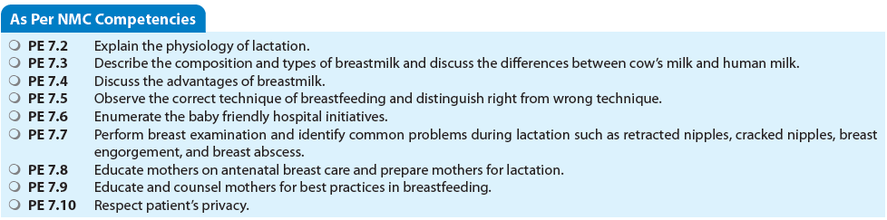

Slide 3
INTRODUCTION
Breastmilk is ideal for the newborn baby as it is tailormade to suit all the requirements of the baby.
Exclusive breastfeeding is the single most important and simple intervention that can prevent a significant proportion of neonatal morbidity and mortality.
All healthcare personnel should be dedicated and motivated toward helping mothers to breastfeed their babies.
Breastfeeding should be established before the mother and the baby are discharged from the health facility.

Slide 4
TERMINOLOGY
Exclusive Breastfeeding
Baby should receive only mother’s milk from birth up till 6 months of completed age.
Anything else such as water, animal milk, and ghutti, should not be given.
Breastfeeding should start within 1 hour of birth.
Most mothers are able to breastfeed soon after a cesarean section also, in lying down position but they need support and help.
Prelacteal Feeds
Include anything which is given to the baby before breastfeeds.
Include sugar water, honey, or any other milk.
PRELACTEAL FEEDS SHOULD NOT BE GIVEN as it satisfies the baby’s hunger and then the baby may not suck well at the mother’s breast and interferes in successful breastfeeding.

Slide 5
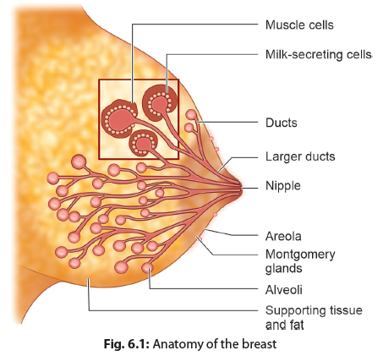
Anatomy and Physiology of Lactation
BREAST ANATOMY
Lobe
↓
Lobules
↓
Alveoli
↓
Secrete milk
Store milk
↓
Ducts
↓
Nipple
↓
Ejection

Slide 6
Nipple and Areola
The nipple has an average of 9 milk ducts passing to the outside, and also muscle fibers and nerves.
The nipple is surrounded by areola, in which are located Montgomery glands. These glands secrete an oily fluid that protects the skin of the nipple and areola during lactation, and produce the mother’s individual scent that attracts her baby to the breast.
Breast tissues undergo hypertrophy and hyperplasia in pregnancy. Milk synthesis is inhibited by estrogens and progesterone at this stage.
At delivery, the inhibiting influence is removed and milk production is stimulated by prolactin released in response to suckling.

Slide 7
PHYSIOLOGY OF MILK PRODUCTION
Two hormones play a crucial role in lactation:
Prolactin and
Oxytocin.
When the baby suckles at the breast the nerve endings on the nipple and areola transmit the impulses to the brain.
The anterior lobe of the pituitary gland in response secretes prolactin and the posterior lobe of pituitary secretes oxytocin.
Prolactin helps in production of milk and oxytocin is responsible for ejection of milk.

Slide 8
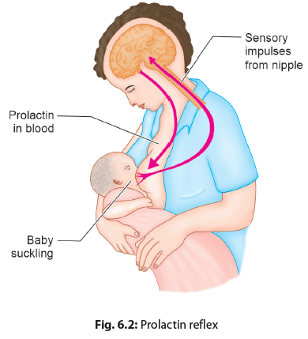
Prolactin Reflex (Milk Secretion Reflex)
Frequent sucking by the baby at the breast is the single most important factor determining the milk production in the mother.
More prolactin is produced at night therefore, night-time feeding is very important to maintain good milk output in the mother.

Slide 9
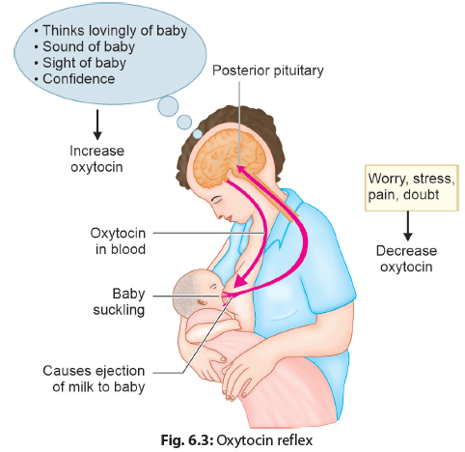
Oxytocin Reflex (Milk Ejection Reflex/ Let-down Reflex)
Oxytocin release is facilitated by a confident, tension-free mental state of the mother.
If the mother is in stress, the release of oxytocin may be affected leading to poor ejection of milk and decrease in milk output.

Slide 10
Feeding Reflexes in the Baby
Rooting reflex:
  When the mother’s breast or nipple touches the baby’s cheek/lips, the baby opens its mouth and turns toward the breast.
Suckling reflex:
  This reflex is essential for successful lactation. A baby reflexly suckles at the nipple and areola placed in his mouth. The tongue presses the nipple and areola against the palate squeezing the underlying sinuses by compressing and stretching the nipple between the tongue and palate, thus, milking the lactiferous sinuses.
  If the baby suckles only at the nipple, milk is not ejected, baby does not get sufficient milk, suckles more vigorously resulting in sore nipples.
Swallowing reflex:
  When the baby’s mouth is filled with milk, it starts swallowing. It develops earlier than sucking reflex. A baby who can suckle well, will always be able to swallow .

Slide 11
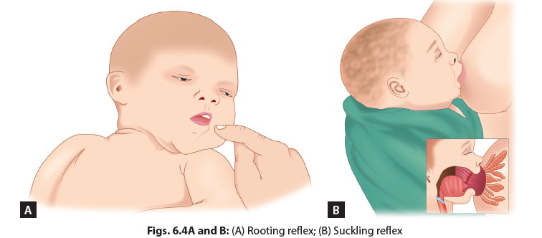

Slide 12
IN A NUTSHELL
Anatomy and Physiology of Lactation
Female breast has specialized function and anatomy which helps in lactation soon after birth.
Two hormones play an important role in lactation: prolactin and oxytocin.
A relaxed, confident, and tension-free state of mind of the mother are essential to ensure proper breastfeeding.
Frequent breastfeeding from both breasts is the most important way to ensure good milk output.
Neonatal reflexes such as rooting, suckling and swallowing reflexes help the baby to breastfeed.

Slide 13
TYPES OF MILK
Colostrum
Produced in the first 2–3 days after delivery.
Thick, sticky, yellow, and energy dense.
Rich in vitamin A, and lactoferrins and growth factors.
Has larger proportion of proteins, and fat-soluble vitamins.
All newborns must receive it.
Transitional Milk
Secreted from day 4–5 till the 2nd week after the birth of the baby.
Fat and carbohydrate content increase, and immunoglobulin and protein content decrease.
Mature Milk
Mature milk by the end of 2nd week, which is thinner and larger in amount.
Contains all the necessary constituents needed for the baby’s optimum growth and development.

Slide 14
Preterm Milk
Preterm milk is the breastmilk of a mother who delivers prematurely.
Contains more proteins, sodium, iron, and immunoglobulins.
Approaches term milk in composition after 4–6 weeks.
Foremilk and Hindmilk
The milk which is ejected when the baby starts feeding is the foremilk
It is watery to quench the thirst, is poor in fat and rich in sugar, proteins, vitamins, minerals.
Hindmilk
Energy dense and has more fat, to fulfill the energy requirement and satisfy its hunger, this is known as the hindmilk.
A feeding session must last for a minimum of 15–20 minutes so that the baby gets both the foremilk and also the hindmilk.

Slide 15
HUMAN BREASTMILK
Proteins
Contains all essential proteins which are beneficial.
Main proteins present in the breastmilk are whey and casein, (60:40) for easy digestibility.
Also has alpha-lactalbumin, lactoferrin, and IgA.
Rich source of taurine and cysteine, important neurotransmitters, in brain and retina.
Carbohydrates
Lactose is the main carbohydrate in breastmilk and is an important source of energy.
The lactose content in breastmilk is higher than other animal milk.
Fats
Rich in long chain fatty acids including essential fatty acids and medium chain triglycerides.
Long chain fatty acids (e.g., docosahexaenoic acid) present in human milk may influence brain structure and function.
Fat in human milk is better absorbed than in cow’s milk.

Slide 16
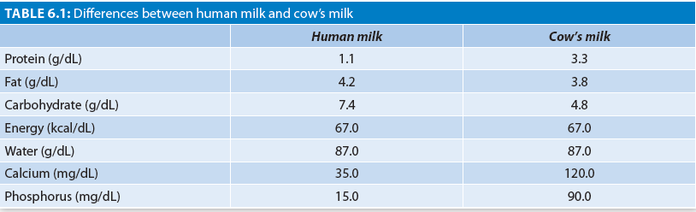
Composition of Breastmilk

Slide 17
Vitamins and Minerals
Breastmilk contains all vitamins and minerals needed for the baby except vitamin D and K.
Calcium and phosphorus are also present in 2:1 ratio, which is ideal for their absorption.
Others
Bile salt-stimulated lipase facilitates the complete digestion of fat once the milk has reached the small intestine.
Epidermal growth factor stimulates maturation of the infant’s intestine.

Slide 18
IN A NUTSHELL
Composition of Breastmilk
Breastmilk is tailored to suit the nutritional requirement of the baby and provides wholesome nutrition to the baby.
Colostrum is the milk produced in first 2–3 days after delivery and is rich in anti-infective factors. It is the first vaccination for the baby.
Baby must get the hindmilk to have good weight gain.
Breastmilk is easy to digest for the baby.
Breastmilk contains essential amino acids and long chain polyunsaturated fatty acids for the development of brain

Slide 19
Advantages of Breastfeeding
BENEFITS TO THE BABY
Right Nutrients
Contains the right nutrients (proteins, carbohydrates, fats, vitamins, and minerals) in right amount.
Nutrients in breastmilk are better absorbed, especially iron.
Protection from Infections
It has anti-infective factors and growth factors like Lactobacillus bifidus
Infants who are breastfed are 15 times less likely to die from pneumonia and 11 times less likely to die from diarrhea.
Intelligence
Studies show improved scores of cognitive function on average 8 points higher among children who were breastfed compared with those who were formula fed.

Slide 20
Anti-infective factors in human milk
1. Immunoglobulins: IgA, IgG, and IgM
2. Cells: Macrophages and lymphocytes
3. Complements: C3 and C4
4. Lysozymes
5. Lactoperoxidase
6. Lipids (antiviral and antistaphylococcal)
7. Iron-binding proteins: Lactoferrin
8. Bile salt-stimulated lipase (antiprotozoal)
9. Interferon
10. Growth factor for Lactobacillus bifidus

Slide 21
Economic Benefits
Cheaper than animal or powdered milk. All it costs is the extra food needed by the lactating mother.
Psychological Benefits
Helps form a close, loving relationship (bonding) between the mother and the baby.
Better parent-child adjustment and fewer behavior disorders.
Miscellaneous
Protects against allergic disorders such as atopic eczema and asthma.
The incidence of sudden infant death syndrome (SIDS) is less
reduces the incidence of necrotizing enterocolitis (NEC) in preterm babies.
reduces the incidence of atherosclerosis, type 2 mellitus, obesity, hypertension, and certain cancers later in life.

Slide 22
BENEFITS TO THE MOTHER
Reduces postpartum bleeding and hence anemia in mothers.
The mother is less likely to conceive till the time she breastfeeds her baby.
Helps the mother shed extra weight.
Protects the mother from breast and ovarian cancers.
Saves the mother a lot of time and effort.
BENEFITS TO THE SOCIETY
The cost involved in breastfeeding is negligible
Prevents infection and reduces the healthcare cost.
Eco-friendly

Slide 23
DISADVANTAGES OF ARTIFICIAL/ ANIMAL FEEDING
  It is not suited to the nutritional requirements of the baby.
  The babies are at high risk of infections such as diarrhea and respiratory tract infections.
  It is the most important factor behind malnutrition especially in young infants.
  Some newborns on top feeds especially those on predominantly formula feeds tend to become overweight and obese.
  The mortality rates are much higher in babies who are on artificial feeds.

Slide 24
DESIRABLE PRACTICES WHICH PROMOTE BREASTFEEDING
Antenatal counseling of the mother.
Rooming in.
The baby is allowed to suck at the mother’s breast as early as within 1 hour after birth.
Prelacteal feeds or pacifiers are not recommended.
Letting the baby suck frequently at the breast is the single most important factor which enhances milk output in mothers.
No artificial feeds should be given to the baby by bottle or by any other method.
The mother should be tension-free and relaxed.
The mother should receive proper privacy to breastfeed.

Slide 25
FACTORS HINDERING BREASTFEEDING
Separation of the mother and the baby especially immediately after birth.
Delayed and infrequent feeding, no night feeds.
Unconfident and stressed mother.
Painful breast conditions such as cracked nipples, engorged breasts, and breast abscess.
Improper positioning and attachment of the baby to the breast.
Mixed feeding, i.e., feeding with animal or formula milk along with breastfeeds.
Maternal illness.

Slide 26
CONTRAINDICATIONS OF BREASTFEEDING
If the mother is on antithyroid drugs, such as carbimazole or methimazole, or anticancer drugs.
Intake of drugs, such as radioactive compounds, lithium and gold salts.
If the baby is suffering from a disorder, such as galactosemia or phenylketonuria.
If the mother who is breastfeeding is on any medication, a doctor must be consulted regarding the safety of the drug to the baby. Infections such as human immunodeficiency virus (HIV), hepatitis B, and tuberculosis in the mother are not contraindications to breastfeeding.

Slide 27
Technique of Breastfeeding
Correct Positioning
Correct Attachment

Slide 28
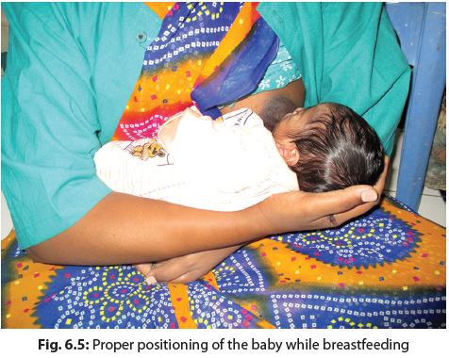
POSITIONING
The mother should sit with her back being supported. Following points indicate a good position:
The baby is held close to the mother.
The body of the baby, i.e., the head, neck, and trunk, should be in straight line or the head bent slightly backwards.
Baby’s whole body should be supported
Baby should be facing the breast and its nose should be opposite the nipple.

Slide 29
Points of Good Attachment
The baby’s chin should touch the breast.
Baby’s mouth should be wide open.
The lower lip should be turned outward.
More areola should be visible above the baby’s mouth than below it.
The baby should take deep and slow sucks with pauses in between. The sound of swallowing should be audible in between sucking.
Inappropriate positioning and attachment leads to ineffective suckling by the baby and therefore decrease in milk output. This is also the most common cause of sore nipples and may cause pain and discomfort to the mother.

Slide 30
Causes of Poor Attachment
Inexperienced mother.
A mother who is not confident about feeding her baby and its right technique.
Flat/inverted nipple.
Lack of support from healthcare workers.
Use of a bottle to feed the baby.
Cleft palate.

Slide 31
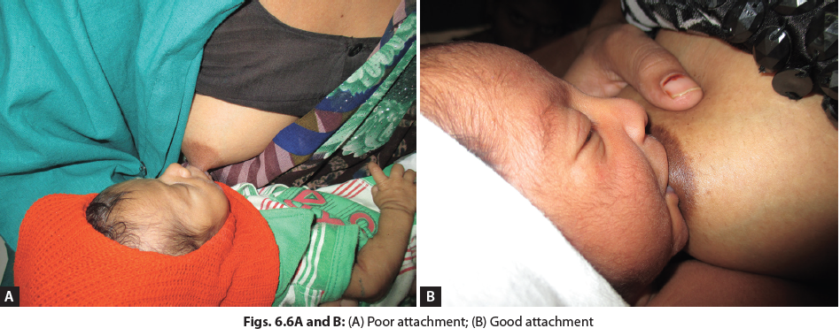
POOR vs GOOD ATTACHEMENT

Slide 32
DEMAND FEEDING
After timely initiation of feeding, the baby should be offered breastfeeds on demand. Normally, a baby demands feeds every 1½–2 hours but this may vary.
The mother must allow the baby to leave the breast on its own rather than forcing the baby to stop sucking.
BREAST MANAGEMENT
It is not necessary to breastfeed from both breasts in one session.
One breast must be emptied fully before the other breast is offered.
Feeding is done from the alternate breast in the next feed to ensure emptying of each breast.
FREQUENCY OF FEEDING
The baby must be breastfed frequently, a minimum of 8–10 times in 24 hours.
Night feeds are very important as prolactin, is also secreted more during the night.

Slide 33
WHEN TO OBSERVE A BREASTFEED
A. Outpatient Settings, e.g., Outpatient Department or Well-baby Clinic
  If infant’s weight is ≤2 SD for that age.
  Baby is taking any other feed/drink (other than breastmilk).
  If the frequency of breastfeeding is <8 times/day.
  If mother reports any problem with breast or difficulty in feeding (pain, fissure, or not enough milk).
B. Inpatient Setting, e.g., Postnatal Ward or Neonatal Units
  All primipara mothers.
  Mothers having lower LSCS.
  If baby birth weight <2.5 kg.
  Mothers who were separated from babies due to sickness.
  Any mother reporting any problem in feeding.
  History of not able to breastfeed exclusively for 6 months in previous pregnancy.

Slide 34
Observing a Breastfeed
Remember the following when you decide to observe breastfeeding:
Take mother’s consent to examine baby’s feeding.
Make sure the mother is sitting in a comfortable and relaxed position.
Then ask her to feed and observe.
Fill
Feeding Assessment Forms
Part A | History
Part B | Observation

Slide 35
DECISION AFTER OBSERVING A BREASTFEED
Based on your assessment of form (Part A and B) decide whether feeding problem is present or not.
Classify it as feeding problem, if one or more of the following five situations are present:
  1. If the baby is not exclusively breastfed.
  2. If the baby is on animal or formula feeds which is diluted.
  3. If the mother is using the bottle for feeding.
  4. If the mother is having breast or nipple problem.
  5. If the baby is suckling poorly.

Slide 36
ACTION: COUNSELING
If you have identified feeding problem, you will need to counsel the mother for breastfeeding.
Adhere to the following rules of “nonverbal communication,” while you are counseling the mother:
Keep yourself at the same head level as that of the mother.
Maintain an appropriate distance from her.
Maintain eye contact and pay attention.
Take time while talking.
Remove barriers and use touch appropriately.
Give her information according to your specific case
RESPECT MOTHER’S PRIVACY

Slide 37
Problems in Breastfeeding
Not Enough Milk
NIPPLE Confusion
Score/cracked Nipples
Engorged Breast
Retracted Nipples
Breast Abscess

Slide 38
NOT ENOUGH MILK
Most common reason is the misconception that she is not producing enough milk.
All mothers produce sufficient milk to fulfill the baby’s need.
Whenever a mother complains of “not enough milk” one must try and assess the positioning and attachment.
The mother should be counseled regarding benefits of breastfeeding.

Slide 39
Indicators that a mother is producing sufficient milk
Baby passing urine at least 5–6 times in a day.
The baby sleeps soundly after accepting feeds for 1–2 hours.
The mother has the sensation of fullness in the breasts when it is time for the baby to feed.
When the baby starts feeding at one breast, the milk may start dripping from the other breast.
The baby shows good weight gain on exclusive breastfeeds

Slide 40
NIPPLE CONFUSION
When a baby is given both bottle-feeding and breastfeeding, it creates nipple confusion in the baby’s mind and it stops putting effort while breastfeeding leading to a decline in the milk production.

Slide 41
SORE OR CRACKED NIPPLES
When the baby is not well-attached or well-positioned the baby may not hold the breast correctly and keep sucking only on the nipple. This leads to cracked or sore nipples which is a painful condition for the mother
TREATMENT
Ensure proper attachment and positioning of the baby.
Avoid frequent use of soap while cleaning the breasts.
If it is too painful for the mother to breastfeed, then breastmilk can be manually expressed till healing occurs.
Hindmilk applied to the nipples has a soothing effect.
Ointments and antiseptics should not be applied to the nipple.
No medicated creams should be applied.

Slide 42
ENGORGED BREASTS
Incomplete emptying of the breasts may lead to accumulation of milk and engorgement of breasts.
Breasts become full, tense, and shiny and painful to touch.
The mother may develop fever.
The mother is unable to feed from that breast and the baby also finds it difficult to attach. This worsens the situation as the breasts are not being emptied.
TREATMENT
Gentle manual expression of milk.
Warm and wet compress on the breasts
Massage of the breasts, back, and the neck to facilitate expression of milk.
Emotional support and building confidence of the mother.
Encourage to feed from the affected side to ensure emptying of the breast.
Breastfeeding should be resumed as soon as the pain subsides.
Frequent feeding and ensuring regular emptying of both the breasts will prevent this condition

Slide 43
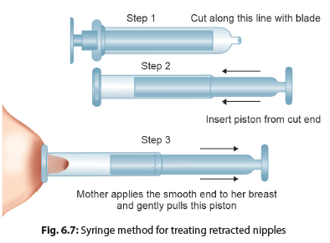
Retracted Nipples

Slide 44
BREAST ABSCESS
If congested engorged breast, infected cracked nipple, blocked duct or mastitis are not treated in the early stages, then an infected breast segment may form a breast abscess.
The mother complains of high fever, severe pain, and localized redness.
She should be treated with analgesics and antibiotics.
The abscess must be incised and drained.
Breastfeeding must be continued. If it is not possible to breastfeed on affected breast due to pain, gently express the milk and start breastfeeding on affected breast as soon as possible.
EXPRESSED BREASTMILK
If a mother is not able to feed her baby (e.g., ill mother, preterm baby, and working mother), she should express her milk in a clean, wide-mouthed container, and this milk should be fed to her baby. Expressed breastmilk can be stored at room temperature for 4 hours, in a refrigerator for 24 hours and in a freezer at −20°C for 3 months.

Slide 45
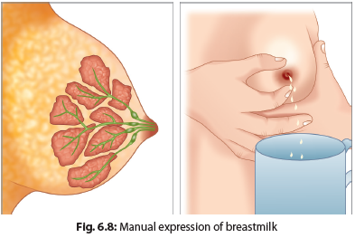
METHOD OF MILK EXPRESSION
Hands must be washed before starting the procedure.
The mother should lean forward, supporting the breast over the cup or bowl.
With thumb above and first finger below the nipple at the areola, the breast should be pressed in toward the ribcage.
Then the thumb and finger should be brought together, producing squeezing movements behind the nipple.
The breast should be released and the procedure repeated till milk starts to drip or flow.
The areola should be pressed to the left and right of the nipple in the same way, to make sure that milk is expressed from all sectors of the breast.

Slide 46
Counseling for Breastfeeding
Breastfeeding should be started within 1 hour of birth of the baby
Technique of breastfeeding
Baby must be breastfed frequently on demand and night feeds are important
Advantages of exclusive breastfeeding
Disadvantages of bottle feeding/feeding of top/animal milk
Anticipated problems, she may face while breastfeeding
Breastmilk is sufficient for her baby
Exclusive breastfeeding needs to be done for 6 months
Complimentary feeding should be started after the 6th month of life

Slide 47
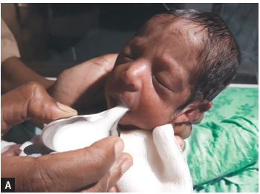
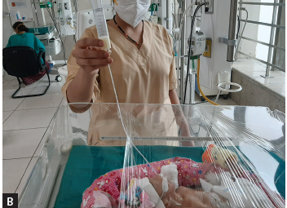
Breastfeeding in Special Situations
1. PRETERM/SICK BABY
Express milk and fed to the baby with a feeding tube or spoon or paladai.
Figs. 6.9A and B: (A) Paladai feeding; (B) Gavage feeding

Slide 48
HIV POSITIVE MOTHER
In absence of any intervention to prevent transmission, there is an overall 20–45% risk of perinatal transmission of HIV from an infected mother to her baby (during pregnancy, labor, and exclusive breastfeeding).
But if all preventive interventions are followed, the risk has been found to be <5%. These preventive measure include:
  Early diagnosis and initiation of antiretroviral therapy (ART) in the mother,
  Continuation of ART throughout antenatal period, labor, during breastfeeding, and beyond,
  Exclusive breastfeeding to the baby, and
  ART to the baby for a minimum of 6 weeks (nevirapine 2mg/kg/day)
The mother and the family should be explained the risks and benefits of both breastfeeding and top feeding.
It should be the decision of the mother and the family to choose between the two.
Top feeding should be started only if it is affordable, feasible, acceptable, safe, and sustainable (AFASS).

Slide 49
HEPATITIS B POSITIVE MOTHER
Risk of transmission is negligible. Exclusive breastfeeds coutinue.
CLEFT LIP AND PALATE
May have to feed the baby with expressed breastmilk with the help of a spoon or paladai.
WORKING MOTHERS
She can express milk before going for work.
The baby is fed with the expressed milk when the mother is away. EBM can be kept at room temperature for 4–6 hours and for 24 hours in a refrigerator.
MATERNAL ILLNESS
The mother can continue to breastfeed her baby in most of the illness unless she is too sick herself to feed.
ILLNESS IN BABY
The baby should continue to take breastfeeds even during illness unless the baby is too sick to accept feeds.

Slide 50
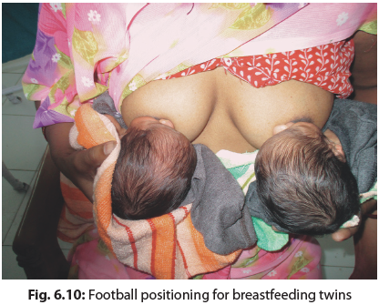
TWIN BABIES
If a mother delivers twins, she produces sufficient milk to fulfill the needs of both the babies.
The mother can simultaneously or alternately breastfeed the babies as per her convenience.

Slide 51
Baby Friendly Hospital Initiative
This initiative was started by the World Health Organization (WHO) and the United Nations International Children’s Emergency Fund (UNICEF) to primarily promote breastfeeding in health facilities providing maternity and newborn care services. Under this, the hospital must adopt a breastfeeding policy and follow the 10 steps to successful breastfeeding.
All hospital catering to young infants must have a written breastfeeding policy.
Training of the healthcare workers is the first and the most important step to promote exclusive breastfeeding.
Babies must be breastfed within 1 hour of birth.

Slide 52
10 STEPS TO SUCCESSFUL BREASTFEEDING
Have a written breastfeeding policy that is routinely communicated to all health staff.
Train all healthcare staff in skills necessary to implement this policy.
Inform all pregnant women about benefits and management of breastfeeding.
Help mothers initiate breastfeeding within 1 hour of birth.
Show mothers how to breastfeed and how to maintain lactation even if they are separated from their infants.
Give newborns no food or drink other than breastmilk, unless medically indicated.
Practice rooming in, allow mothers and infants to remain together all 24 hours of the day.
Encourage breastfeeding on demand.
Give no artificial teats or pacifiers to breastfeeding infants.
Foster the establishment of breastfeeding support groups and refer mothers to them on discharge from the hospital or clinic.

Slide 53
INFANT MILK SUBSTITUTES (IMS) ACT
Government of India has made exemplary efforts to promote and protect breastfeeding by enacting a legislation, “The Infant Milk Substitutes, Feeding Bottles, and Infants Food Act 1992”. Amended, 2003.
No Promotion of IMS/FB
No Misleading labels/advt.
No Promotion to healthcare system

Slide 54
MOTHER’S ABSOLUTE AFFECTION (MAA) PROGRAM FOR PROMOTION OF BREASTFEEDING
Launched in 2016, to bring undiluted focus on promotion of breastfeeding.
Objectives
  Build an enabling environment for breastfeeding through awareness generation.
  Reinforce lactation support services at all facilities.
  To incentivize health facilities that with rates of breastfeeding.
World Breastfeeding Week: 1-7 August

Slide 55
Human Milk Banking
Human milk banks are comprehensive lactation management centers where donor milk is collected, stored, and processed.
Pasteurized donor human milk may be used in special circumstances when the MOM is not available.
Healthy mothers can voluntarily donate their breastmilk without compromising breastfeeding of their own baby.

Slide 56
PASTEURIZED DONOR HUMAN MILK: BENEFICIARIES
Preterm and sick babies who are unable to get their MOM due to separation, maternal illness, or insufficient lactation.
Babies of mothers who are temporarily unable to provide breastmilk due to illness/hospitalization.
Babies of mothers who are unable to offer breastmilk to their infants due to health risk.
Adopted babies.
Babies whose mothers are unable to secrete sufficient milk.
Babies whose mothers have died in the postpartum period.

Slide 57
Steps to Successful Breastfeeding
Motivate: Start from the antenatal period.
Start early: Within 1 hour of birth.
Rooming in: Babies should be roomed-in with mother.
Frequency: Feed on demand.
Prelacteal feeds: Avoid water, glucose water, tea, and honey, as the first feed to the baby.
Avoid bottle feeds
Feeding from both breasts:
Complementary feeds: Start after 6 months.

Slide 58
Thank you…

