Slide 1

Chapter 7
Complementary
Feeding

Slide 2


Slide 3
DEFINITION
Complementary feeding implies giving the child other nutritious foods in addition to breast milk (WHO, 2000).
Use of the term weaning has now been discarded in favor of complementary feeding.
Appropriate complementary feeding starting at 6 months can, prevent 6% of child deaths, and child undernutrition.
Introduction of diverse foods during infancy might have a protective effect on asthma, food allergy, and immune regulation.
Complementary feeding is not initiated in more than half of infants aged 6–8 months, in India.

Slide 4
Principles and Attributes of Complementary Feeding
Practice exclusive breastfeeding from birth to 6 months of age and introduce complementary foods at 6 months of age (180 days) while continuing to breastfeed until 2 years of age or beyond.
Feed infants directly and assist older children to feed by themselves.
Feed slowly and patiently, and encourage but do not force them.
Experiment with different food combinations, tastes, textures and methods of encouragement.
Minimize distractions during meals. Do not engage the child in screen while feeding
Remember that feeding times are periods of learning and love. Talk to children during feeding, with eye-to-eye contact.

Slide 5
Safe preparation and storage of complementary foods
Washing caregivers’ and children’s hands before food preparation and eating
Storing foods safely and serving foods immediately after preparation
Using clean utensils to prepare and serve food
Using clean cups and bowls when feeding children
Avoiding the use of feeding bottles, which are difficult to keep clean.
Amount of complementary food needed
Start at 6 months of age with small amounts of food and increase the quantity as the child gets older, while maintaining frequent breastfeeding.
Complementary foods should provide at least
  - 200 kcal per day at 6–8 months of age
  - 300 kcal per day at 9–11 months and
  - 550 kcal per day at 12–23 months of age.

Slide 6
Food Consistency
Gradually increase food consistency and variety as the infant gets older, adapting to the infant’s requirements and abilities.
Infants can eat pureed, mashed, and semisolid foods beginning at 6 months.
By 8 months most infants can also eat “finger foods” (snacks that can be eaten by children alone).
By 1 years, most children can eat the same types of foods as consumed by the rest of the family.
Avoid foods that may cause choking, i.e., items that have a shape or consistency that may cause them to become lodged in the trachea, such as nuts, grapes, or raw carrots.

Slide 7
Meal Frequency and Energy Density
Increase the number of times that the child is fed complementary foods as he/she gets older.
The appropriate number of feedings depends on the energy density of the local foods and the usual amounts consumed at each feeding.
For the average healthy breastfed infant, meals of complementary foods should be provided
  2–3 times per day at 6–8 months of age and
  3–4 times per day at 9–11 and 12–24 months of age.
Give additional nutritious snacks fruit etc. 1-2 times a day.
If energy density or amount of food per meal is low, or the child is no longer breastfed, more frequent meals may be required.

Slide 8
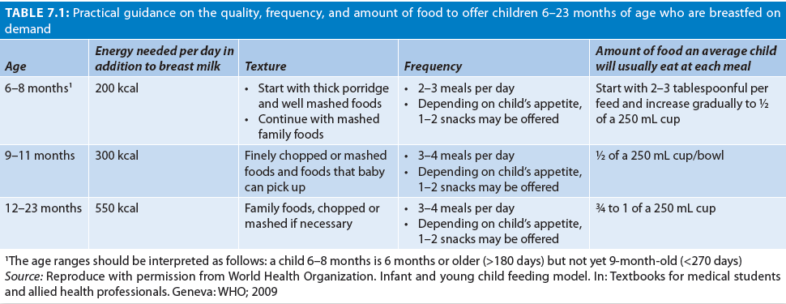
Meal Frequency
If a child is not breastfed, complementary foods should be given more frequently. If baby is not breastfed, give in addition: 1–2 cups of milk per day, and 1–2 extra meals per day.

Slide 9
Nutrient Content of Complementary Foods
Feed a variety of foods from 7 Groups
Cereals, tubers, roots;
Legumes and pulses;
Vitamin A rich fruit and vegetables;
Other fruit/vegetables
Milk, cheese, etc.,
Eggs; and
Flesh foods (meat, fish, etc.)
This is known as minimal dietary diversification.
Tea, coffee, and sugary drinks are not to be given at all.
Fruit juices are not recommended below 2 years of age (IAP, 2019).
At least 4 of the 7 groups should be included in diet daily.

Slide 10
Use of vitamin–mineral supplements
Iron supplementation is routinely recommended after 6 months of age.
Vitamin D supplementation (400 IU/day) is recommended between birth and 1 year.
Feeding during and after illness
Increase fluid intake during illness, including more frequent breastfeeding, and encourage the child to eat soft, varied, appetizing, favorite foods.
After illness, give food more often than usual and encourage the child to eat more.
Avoid giving fruit juices in illness or during recovery

Slide 11
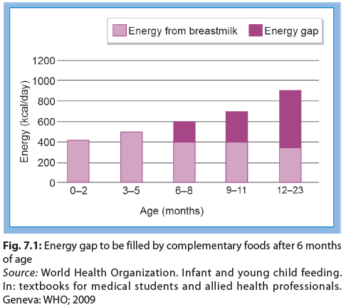
WHEN TO START?
Breastmilk is sufficient to promote growth and development till 6 months.
After 6 mo there is a gap between the total energy needs and the energy provided by breastmilk (Fig. 7.1).
The gap increases as the child gets older.
Also, around this age, infant’s behavior makes him ready for semisolid foods.
NIN-ICMR recommends home-based semisolid foods to the infant after 6 months of age.

Slide 12
6 Months is the RIGHT Age
Infant’s tendency to push solids out of mouth decreases
Infant starts showing interest in other people eating and reaches for food
Holds objects and likes to put things in his or her mouth;
Starts moving the food around the mouth with better control of tongue
Teeth begin to erupt, and biting movements begins
Digestive system is mature
Child is ready to eat soft and starchy foods.
Care must be taken to ensure that these foods complement, and NOT replace the breastmilk.

Slide 13
ATTRIBUTES OF COMPLEMENTARY FEEDING
Timely start
Adequate in amount, variety, and frequency
Properly fed and safe
Complementary foods should be of right consistency, soft, prepared with easy to digest, inexpensive, locally available, culturally acceptable ingredients; and easy to prepare at home.
Meals can be made energy dense by adding sugar/ jaggery and ghee/butter/oil.

Slide 14
Timely Start
Complementary foods (CF) should be introduced after 6 months of age along with continued breastfeeding when need for energy and nutrients exceeds what can be provided through exclusive breastfeeding.
Introduction of CF before 6 months may decrease the intake of breastmilk, making it difficult to meet the child’s nutritional needs and exposes the child to risks of diarrhea and other infections at an earlier age.
Addition of CF in formula fed infants before 4 months of age has been found to increases the risk of childhood obesity.
Adding CF too late may lead to suboptimal growth and development, risk of nutritional deficiencies, and malnutrition.

Slide 15
FOOD CONSISTENCY
To provide more calories from smaller volumes, food must be thick in consistency (Fig. 7.2).
The first food a child eats should be soft, and homogeneous (mashed or strained).
Different tastes should be gradually introduced with varying texture.
Consistency of foods should be appropriate to the developmental readiness of the child in munching, chewing, and swallowing.
Foods which can pose choking hazard are to be avoided.
Gradually, food consistency, amount, and variety are increased with age.
  Introduce lumpy or granular foods by 9–10 months.
  Small, chopped pieces of food can also be mixed.
Give finger foods by 8-9 mo and family foods by 1yr.

Slide 16
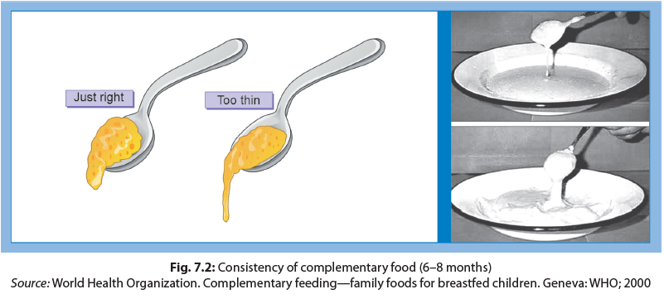
A food that stays easily on the spoon is just the right consistency

Slide 17
DIETARY DIVERSITY
Minimum dietary diversity is consumption of 4 or more food groups from the 7 food groups to meet daily energy and nutrient requirements.
This ensures that the child has a high likelihood of consuming at least one animal-source food and one fruit or vegetable that day, in addition to a staple food (grain, root, or tuber).
Providing children diverse range of foods ensures fulfillment of their micronutrient requirements, including the need for vitamin A, iron, calcium, thiamine, folate, zinc, vitamins B6 and B12.

Slide 18
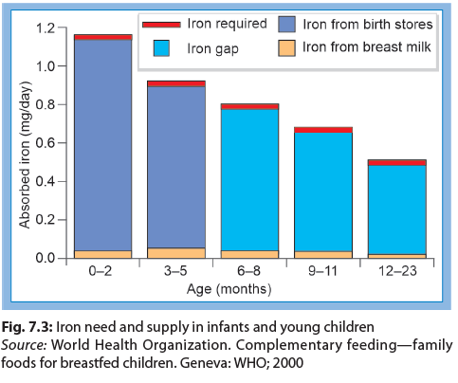
IRON GAP
Full-term infants are born with adequate iron store and get some iron in breastmilk, thus do not require additional iron for first 6 months of life.
After 6 months of life, breastmilk iron, is inadequate.
Iron rich foods are needed after 6 mo to fill iron gap.
Iron rich foods include green leafy vegetables, legumes, dried fruits, meat, fish, and poultry products.

Slide 19
Foods to be Avoided in Infants
Tea and coffee (interfere with iron absorption),
Aerated beverages (no nutritional value),
Too much sugary drinks and fruit juices (cause decreased appetite for other nutritious foods and also may cause loose stools),
Nuts (may cause choking).
Commercial complementary foods (associated with lower intake of fruit and vegetables).
Ultra-processed and commercial snack foods such as biscuits, cookies, candies, chips, savory snacks, etc., which are aggressively advertised, and rich in sugar, salt, and fats.

Slide 20
In Between Snacking
Adequate total energy intake can also be ensured by addition of one to two nutritious snacks between the three main meals.
Snacks are in addition to the meals and should not replace meals.
They should not be confused with foods such as sweets, chips or other processed foods.
Junk food and commercial food, readymade, processed food from the market, e.g., tinned foods/juices, cold-drinks, chocolates, crisps, health drinks, bakery products, etc., should be avoided.
Giving drinks with low nutritive value, such as tea, coffee and sugary drinks should also be strictly avoided.

Slide 21
Responsive and Safe Feeding
Responsive feeding means the reciprocity between child and caregiver. It is important to make feeding a pleasurable experience for the infant. It also helps in ensuring intake of adequate amount of variety of foods. Responsive feeding is a three steps process:
The child signals requests through motor actions, facial expressions, or vocalizations.
The caregiver recognizes the signals and responds promptly in a manner that is emotionally supportive, contingent on the signal, and developmentally appropriate
The child experiences a predictable response to signals. Respond to the child with
  smiles and eye contact;
  talking to the child while feeding;
  feeding the child slowly with patience increase food intake;
  experimenting with different food combinations, tastes, and textures; and
  minimizing distractions during meals.

Slide 22
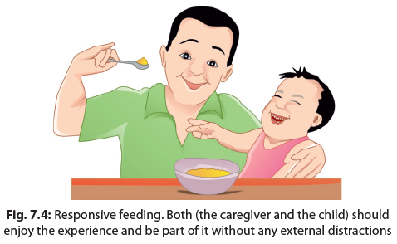

Slide 23
Feeding Technique
Add one complementary food a time, in small quantities.
This is followed by introduction of the second complementary food after some days.
The child should be fed slowly and patiently.
Force feeding and bribing should be avoided.
Forced feeding, threatening and punishment interfere with development of good/proper feeding habits.
As the child grows older, he should be encouraged to feed by self with fingers or spoon.
Young children should be actively encouraged to take feed by praising them and their foods, paying attention, talking, playing with him, and showing pleasure .

Slide 24
Hygiene Related to Complementary Feeding
Complementary foods should be hygienically prepared and stored, and fed. This can be achieved by:
Washing caregiver’s and child’s hands before preparing, handling, eating food, and after using toilet.
Using clean water and raw materials to cook food
Storing foods safely: Keeping food covered and serving shortly after preparation
Using clean utensils to prepare and serve food
Using clean bowls and cups when feeding the child and not using bottles and teats.
Careful preparation and storage of the complementary food is essential to prevent contamination. Unhygienic feeding practices result in infections like diarrhea

Slide 25
NATIONAL GUIDELINES ON INFANT AND YOUNG CHILD FEEDING (IYCF)
Recommendations
Early initiation of breastfeeding; immediately after birth, preferably within 1 hour.
Exclusive breastfeeding for the first 6 months of life, i.e., 180 days (no other foods or fluids like honey, ghutti, animal or powdered milk, tea, or glucose water, not even water since these are potentially harmful; but allows infant to receive ORS, and drops or syrup of vitamins, minerals and medicines when required).
Breastfeed should be given as often as the baby desires and each feed should continue for as long as the infant wants to suckle.
Timely introduction of nutritionally adequate and safe complementary foods (solid, semisolid, or soft foods) after the age of 6 months, i.e., 180 days, to meet their evolving nutritional requirements.

Slide 26
Continued breastfeeding for 2 years or beyond.
Expectant mothers should be motivated and prepared for early initiation of breastfeeding and exclusive breast-feeding.
Age-appropriate complementary feeding for children 6–23 months, while continuing breastfeeding.
Children should receive food from 4 or more food groups [(1) Grains, roots and tubers; (2) legumes, and nuts; (3) dairy products; (4) flesh foods (meat fish, poultry); (5) eggs; (6) vitamin A rich fruits and vegetables; (7) other fruits and vegetables]
Children should be fed for at least a minimum number of recommended times as per age (two times for breasted infants 6–8 months; three times for breastfed children 9–23 months; four times for nonbreastfed children 6–23 months)
Active feeding for children during and after illness.

Slide 27
Complementary Foods
Should be well balanced nutritionally
At least 8–10% of the energy should be obtained from proteins of good quality.
Should be prepared from cereals such as rice, wheat or maize, pulses, milk, and root staples like potato.
Deficiency of lysine, an essential amino acid in the protein of wheat, can be compensated, if both wheat and legumes (rich in lysine) are consumed simultaneously
Addition of small quantities of proteins of animal origin such as milk, egg, or meat is helps to make up the deficiency of limiting amino acids.
Oils, fats, and sugars increase dietary energy levels and improve taste of the food.
Addition of vegetables and fruits will further provide minerals such as iron and vitamins

Slide 28
Tips for Improving Quality of Feeds
Complementary feeds containing a cereal pulse combination of rice/rice flakes (poha)/wheat and roasted Bengal gram dhal/soybean/green gram dhal would increase intakes of iron, compared to other cereal: pulse combinations due to either higher absorption and/or higher iron content.
Soaking, germination/sprouting of cereals and pulses will reduce their phytate content by about half. To do this, soak grains overnight, and then lay on a clean wet cloth for 1–2 days. After germination, the grains can be lightly dry roasted and powdered for cooking.
If locally available fruits such as guava (in children over 1 year of age), papaya, musambi (sweet lime), orange, and lime rich in ascorbic acid are provided as a freshly made mash along with the food, it will increase absorption of iron.
If an iron supplement is to be given, it is best provided after meals.

Slide 29
AGE-WISE COMPLEMENTARY FOODS
Start with mashed bananas, as it is easily accepted.
Within 1-2 weeks can start semolina (suji) cooked in milk.
Shortly thereafter, well-cooked and mashed lentils or peas, followed by khichri (kanji) are added.
By 8–9 months of age, the child should be consuming home-cooked foods adults.
Iron-fortified foods, iodized salt, vitamin A enriched food, etc., are to be encouraged.
Soup or purees of dark green leafy vegetables are good source of iron for infants and should be added.
Vegetables and fruits will further enhance the nutritional quality of food.

Slide 30
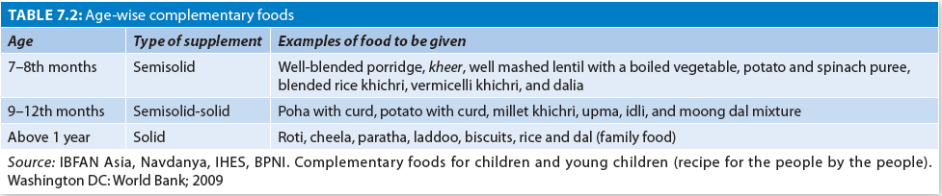
In most parts of India, a well-cooked gruel (khichri, kanji) prepared from rice (3 parts), legume (1 part), green leafy vegetable, and some milk curd is a satisfactory complementary food.
Another good complementary food is wheat gruel (dalia) made in milk with added sugar. Oil should be added to these foods to make them energy dense.

Slide 31
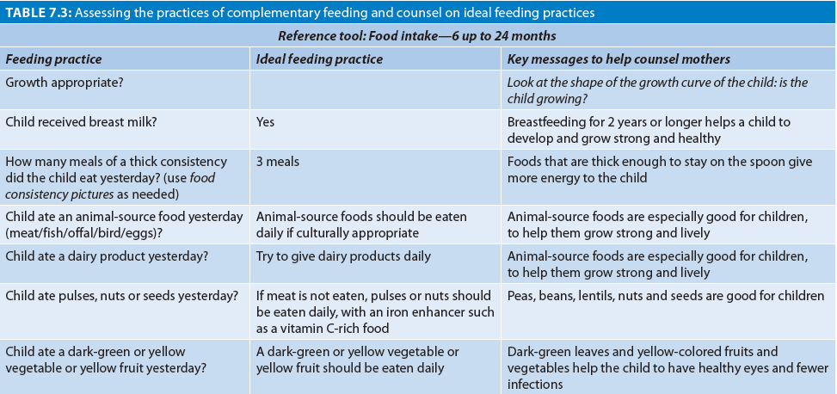
History Taking for Complementary Feeding

Slide 32
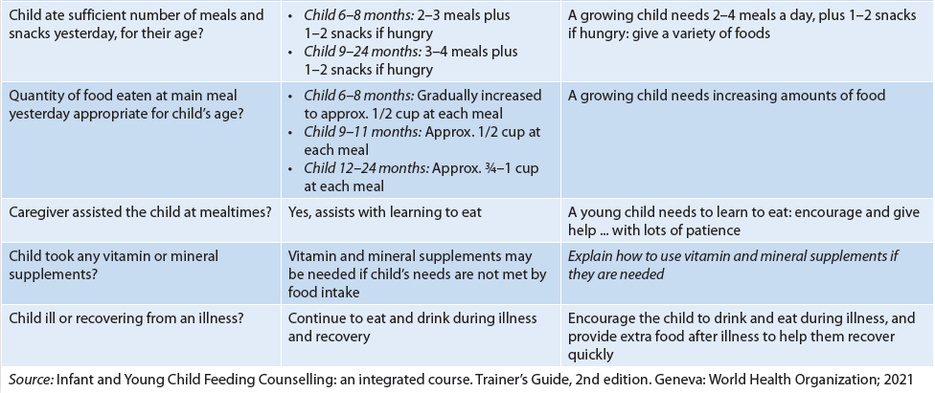

Slide 33
Counseling and Education for Complementary Feeding
Comprehensive message for balanced food should be given to the mother during complementary feeding counseling (Table 7.4).
The food should consist of various (as diverse as possible) food groups/components in different combinations .
As the babies start showing interest in complementary feeds, the variety should be increased by adding new foods in the staple food one by one.
Easily available, cost-effective seasonal uncooked fruits, green and other dark-colored vegetables, milk and milk products, pulses/legumes, animal foods, oil/butter, sugar/jaggery may be added in the staples gradually .

Slide 34
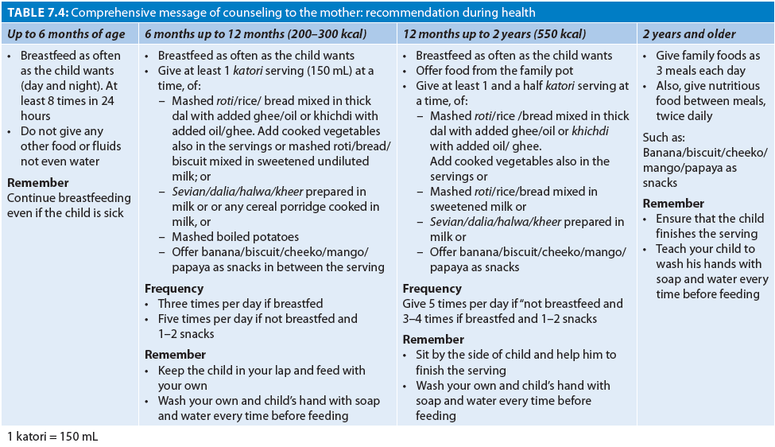

Slide 35
Thank you…

