Slide 1

Chapter 8
Normal Nutrition, Assessment, and Monitoring

Slide 2
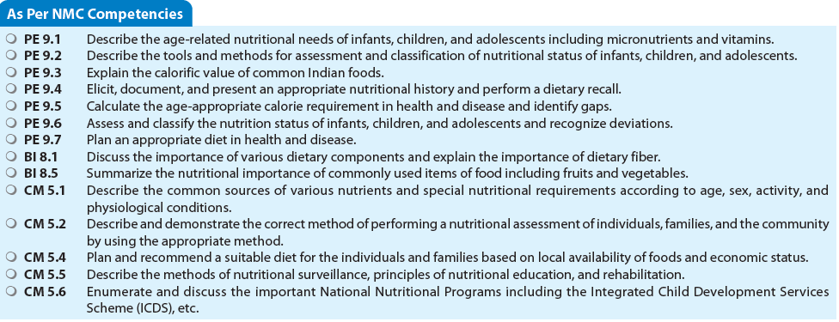

Slide 3
Nutrients and Nutritional Requirements
INTRODUCTION
Nutrients are the chemical substances in the food that the body uses for functions that support growth, tissue maintenance, and repair. There are six categories of nutrients: (1) carbohydrates, (2) proteins, (3) fats, (4) vitamins, (5) minerals, and (6) fibers.
Carbohydrates, fats, and proteins are the chief sources of energy for man, and therefore, are also known as, macronutrients.
Micronutrients are the nutrients required in tiny amounts, may be a few micrograms per day, and include various minerals and vitamins.
Nutrients, which are not synthesized in the body or not synthesized adequately by the body, are known as essential nutrients. They need to be provided by the diet and include carbohydrates, essential amino acids, essential fatty acids (EFAs), vitamins, minerals, and water. Nonessential nutrients can be synthesized by the body (examples—glucose and cholesterol).

Slide 4
ENERGY
Required for growth, metabolism, maintenance of body temperature, and physical activities.
Factors affecting energy requirements: Age, sex, physical activity, climate, body size and composition, and physiological status such as pregnancy and lactation.
At rest, energy is spent for basal metabolism.
Carbohydrates (50-60%), fats (20-30%), and proteins (10-15%) are the chief sources of energy.
One gram of carbohydrate or protein provides 4 kcal or 16.7 kJ, while 1 gram of fat releases 9 kcal or 37.7 kJ of energy.

Slide 5
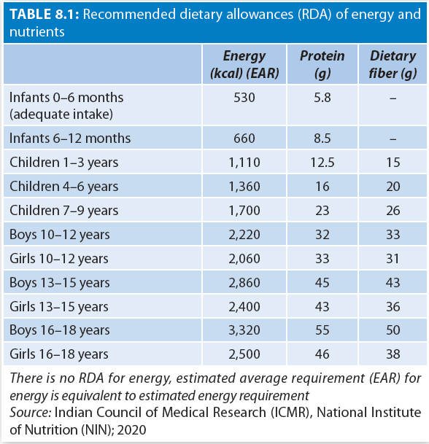
Energy Requirement for Different Ages and Groups
Pregnant and lactating women require additional supplements of energy giving foods for the growth of the fetus and milk secretion. The optimal additional needs are estimated as (70–85 kcal/day in first trimester, 350 kcal/day in 2-3 trimester, and is 600 kcal/day during lactation).

Slide 6
Carbohydrates
Carbohydrates provide energy, contribute to taste and texture, preserve foods, and are essential for digestion and assimilation of other foods.
Body converts carbohydrates to glucose, which is used as a fuel or converted to glycogen and stored by liver and muscles.
ICMR recommends 100–130 gram of carbohydrates per day at all ages.
Obtained from grains, legumes, vegetables, and fruits.
Excessive consumption is associated with dental caries, obesity, and metabolic syndrome.
Lack of carbohydrates may produce ketosis, loss of energy, depression, and breakdown of body proteins.

Slide 7
PROTEINS
Functions
  Proteins are needed for growth and tissue repair.
  Essential for the formation of digestive juices, hormones, plasma proteins, enzymes, vitamins, and hemoglobin.
Also act as buffers to maintain acid-base equilibrium in the body.
Requirements
  - 6-46 g/day depending on age

Slide 8
PROTEINS
Proteins from vegetable sources are often biologically incomplete, as these usually lack one or more of the essential amino acids. However, proteins of vegetable origin may be used together in a judicious combination so that limiting essential amino acid in one of these is compensated for by an excess of that amino acid in the complementing protein.
For example, protein from legumes is deficient in methionine whereas cereals are poor in lysine; both taken together in the diet compensate for each other.
Egg protein is considered a reference protein as its biological value is 100.

Slide 9
FATS (LIPIDS)
Lipids are a concentrated source of energy and provide insulation to the body.
They help in digestion, absorption, and transport of fat-soluble vitamins, and are precursors of sex hormones and long chain polyunsaturated fatty acids (PUFAs).
Fats improve the palatability of diet and delay gastric emptying.
Lipids include triglycerides (fats and oils), phospholipids (lecithin), and sterols (cholesterol); each important to nutrition.

Slide 10
Classification of Lipids
Saturated fatty acids:
  Primarily derived from animal sources (except coconut oil) and remain solid at 20–30°C (Palmitic and stearic acids).
  These can be synthesized in the body.
Unsaturated fatty acids:
  Usually liquid at room temperature, and obtained from vegetables, nut, or seed sources. Further classified as MUFA and PUFA.
  PUFAs include essential fatty acids; these cannot be adequately synthesized in the body
  Mustard oil, safflower oil, corn oil, and sunflower oil are rich in polyunsaturated EFAs.

Slide 11
Essential Fatty Acids (EFA)
The EFAs are omega-6 (linoleic acid, arachidonic acid), or omega-3 PUFAs (linolenic acid, EPA, DHA).
EFAs are essential for normal fetal and infant growth, brain growth, and visual acuity.
At least 3% of energy requirement of an individual should be derived from linoleic and linolenic acids.
Linoleic acid is present in vegetable oils and human milk. ALA is present in fish oil and flax seed.
Body can synthesize very small amounts
  arachidonic acid from ingested linoleic acid; and
  EPA and DHA from linolenic acid.
Endogenous synthesis is not enough to sustain the body demands, therefore, omega lipids have to be supplied in diet.

Slide 12
Omega Fatty Acids
EPA and DHA lower blood cholesterol and triglycerides; also serve as raw materials for synthesis of eicosanoids (prostaglandins, thromboxane, and leukotrienes).
Eicosanoids play an important role in regulation of lipid concentration, blood pressure, immune response, and inflammatory response to injury and infection.
EPA produces the series-3 prostanoids, e.g., PG3, thromboxane-3 (Tx3), and PGI3. PG3 and Tx3 inhibit formation of series-2 prostanoids (PG2 and Tx2), which favor atherogenesis. DHA is especially active in retina and cerebral cortex.
Normal diet with vegetable oils is sufficient in omega-6 but lack omega-3 lipids.
Omega-3, especially DHA and EPA are plentiful in fish.
Conventional formula milk may contain linoleic acid and linolenic acid but is low in arachidonic acid.
Arachidonic acid is plentiful in meat.

Slide 13
Deficiency of Essential Fatty Acids
May result in growth retardation, reproductive failure, skin disorders, increased susceptibility to infections, decreased myocardial contractility, renal hypertension, and hemolysis.
Selective deficiency of omega-6 fatty acids leads to skin changes
Lack of omega-3 results in neurological and visual symptoms.
Omega-6: omega-3 ratio of 5:1 or less is ideal for cardiovascular health. High omega-6 and low omega-3 content as in groundnut and sunflower oil, respectively can lead on to free radical injury, angiotoxicity, and impaired immune function.

Slide 14
Recommended Intake of Fats
Total fat intake (beyond infancy) should provide not more than 30% of daily energy intake.
Saturated fats should not exceed 10% and trans fatty acids should not exceed 1% of total energy intake from fats.
A minimum of 6% energy should be derived from PUFA (with at least 2.5% from linoleic acid and 0.5% from linolenic acid).
Omega-6 fatty acids and omega-3 fatty acids should provide 4–13% and 1–3% of the total calories respectively.
Omega-6: omega-3 ratio of 5:1 to 10:1 is desirable.
Excess fat contributes to obesity, type-2 diabetes, cancer, hypertension, and atherosclerosis. It is better to avoid excess of total fats, trans fats, saturated fats, and cholesterol, in that order of priority.

Slide 15
DIETARY FIBER
Refers to the edible components in plants that are not digested in the small intestine; Instead, they are digested and absorbed in the large intestine.
Fiber components include polysaccharides such as cellulose, hemicellulose, pectins, gums, mucilages, and nonpolysaccharide lignins.
Insoluble Fibers helps in preventing constipation, hemorrhoids and diverticulitis.
The large water-holding capacity of soluble dietary fiber allows it to bind to bile acids, helps to reduce blood cholesterol levels, and limit glucose absorption.

Slide 16
Fiber in Diet
Whole grains, cereals, pulses, legumes, vegetables, and fruits are excellent sources of dietary fiber. Fruits and vegetables contain more water-soluble fiber.
An adequate fiber consumption can be achieved by having at least two servings of fruits, three servings of vegetables, and six servings of grain products per day after the age of 2 years.
Consumption of 30 g/2,000 kcal is recommended per day
Consumption of >60 g a day can reduce the absorption of nutrients and may cause bowel irritation, flatulence, diarrhea, and decreased appetite.
High-fiber diet may prevent cardiovascular disease and colonic cancer.
High-fiber diet is advocated for chronic constipation, diabetes, obesity, and hypercholesterolemia.
Low fiber diet is particularly useful in irritable bowel syndrome, chronic colitis, and partial chronic gastrointestinal obstruction.

Slide 17
Nutritional Value of Foods
INTRODUCTION
Indian Council of Medical Research (ICMR) in 2011 identified four main food groups in our diet.
  (1) Cereals and pulses,
  (2) Milk, egg, and meat products,
  (3) Vegetables and fruits, and
  (4) Oils, fats, nuts, and oilseeds based on their predominant nutrients.
To fulfill the nutritional requirement of the body, it is important to include each group in daily diet, in the recommended proportion.

Slide 18
Type of Foods
Energy-rich food:
  Carbohydrate-rich foods such as cereals, millets, sugar, starchy vegetables,
  Fat-rich foods such as oil, ghee, butter, nuts, and oilseeds are
  Needed for physical activity and maintenance of overall health, growth, and recovery from illness.
Body building food:
  Protein rich foods, e.g., pulses, legumes, and nuts;
  Milk and other dairy products, egg, meat, and fish,
  Vital for growth spurt, maturation, and bone development.
Protective food:
  Vitamin and mineral rich food sources such as fruits and vegetables, eggs, milk, and milk products.
  Required to fight infections and prevent oxidative damage.

Slide 19
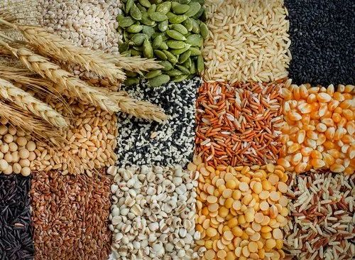
CEREALS
Cereals (e.g., wheat, rice, corn, oats, and barley) form the major staple food
They furnish generous amounts of energy and nutrients at low-cost.
Significant source of protein (6–12%), although of low BV.
Whole grain cereals are considerable sources of iron, phosphorus, thiamine, zinc, manganese, folate, magnesium, copper, niacin, vitamin B6, selenium, vitamin A, and dietary fiber.
Cereals are easily digestible, supply roughage, and have a laxative property.

Slide 20
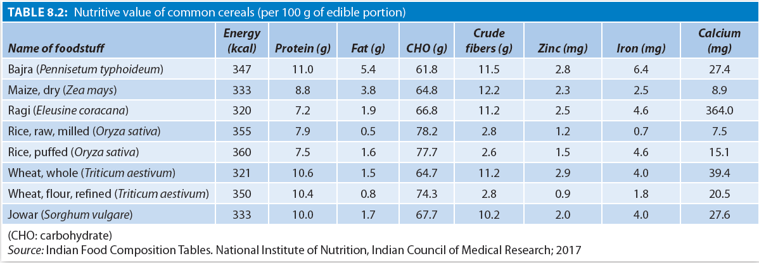
Nutritive Value of Common Cereals

Slide 21
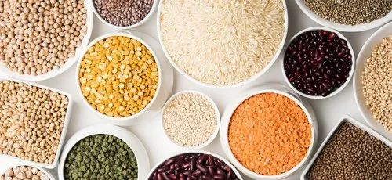
Pulses And Legumes
Essential components of vegetarian diets due to their high protein content (20–40%).
Groundnut and soybean are rich in oils.
Good sources of Ca, Mg, Zn, Fe, K, and P, and niacin, but poor in riboflavin and contain small amounts of carotene.
Legumes are excellent sources of dietary fiber and folate.
Germination improves the nutritive value of pulses.
The ascorbic acid riboflavin, niacin, choline, and biotin content increase considerably, and antinutritional factors (phytates and tannins) and toxic factors are eliminated.
Fermentation increases digestibility, palatability, and improves availability of essential amino acids.

Slide 22
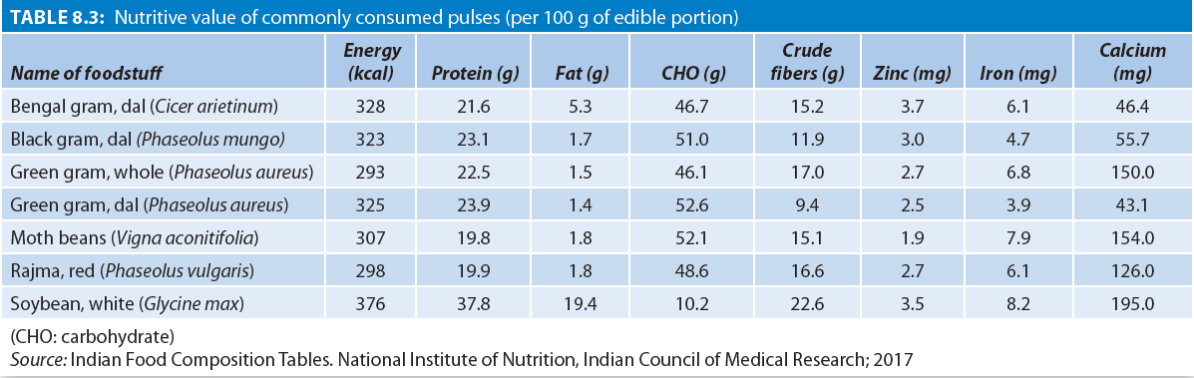
Nutritive Value of Commonly Consumed Pulses

Slide 23
Vegetables
Water is the major constituent of vegetables (about 99%).
Vegetables contribute to the bulk of the diet and are low in calories, proteins, and fats.
Green leafy vegetables (GLV) such as spinach (palak), fenugreek (methi), chaulai, cabbage are good sources of vitamin A, iron, ascorbic acid, calcium, and B-group vitamins.
Tuberous vegetables such as potato, sweet potato, and yam (garadu or ratalu) are good sources of carbohydrates, but are poor in proteins, vitamins, and minerals.
Carrots have rich amounts of beta carotene.

Slide 24
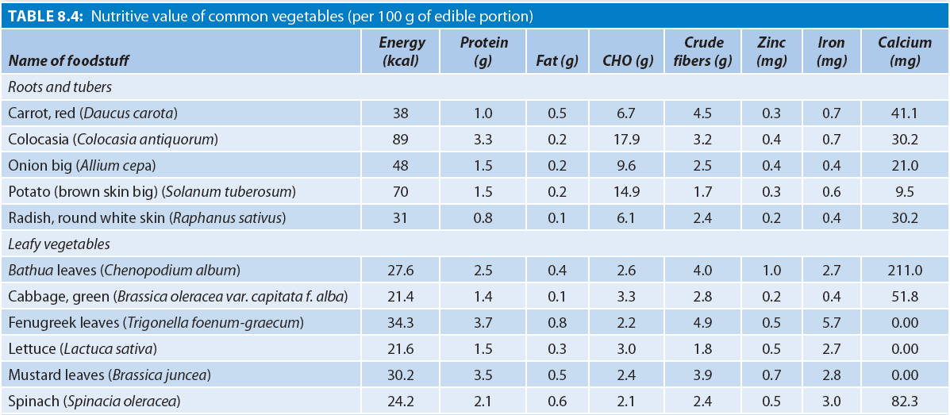
Nutritive Value of Common Vegetables

Slide 25
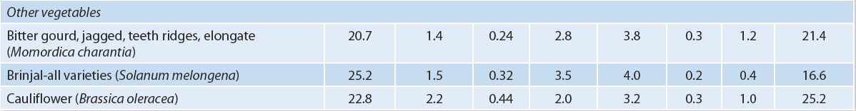
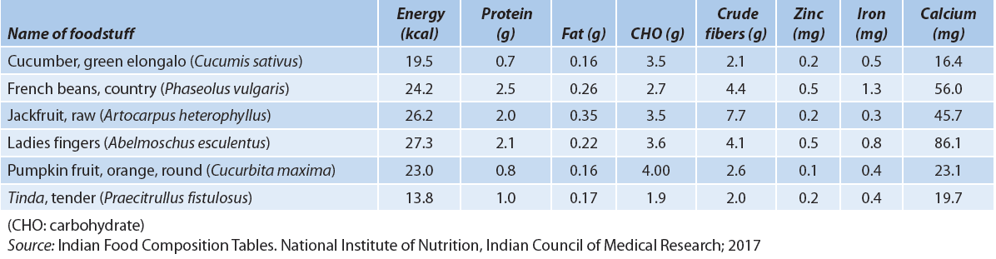
Nutritive Value of Common Vegetables

Slide 26
Fruits
Valued for their minerals, vitamins, and digestible fiber.
Citrus fruits and guava are rich in ascorbic acid,
Yellow fruits contain carotenoids (precursors of vitamin A).
Bananas provide calories in a nonresidue diet. They act as a mild laxative in constipation.
Fruits are not good sources of calcium, phosphorus, and iron.
Vegetables and fruits are also rich sources of phytonutrients, which act as natural antioxidants.
Eating a wide variety of fruits and vegetables is recommended to prevent free-radical mediated diseases.

Slide 27
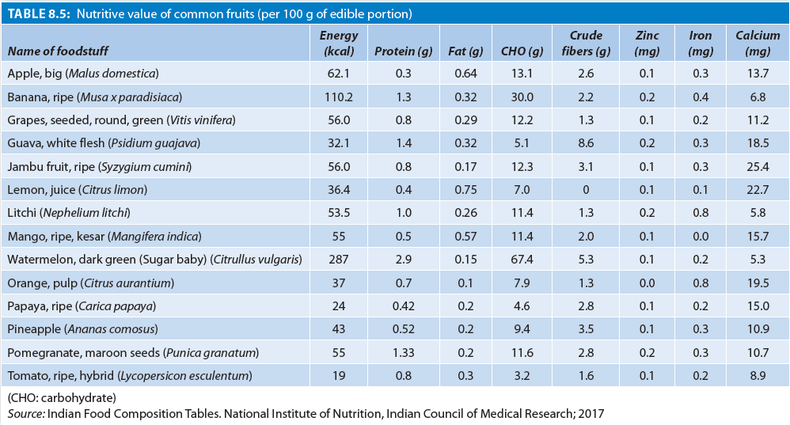
Nutritive Value of Common Fruits

Slide 28
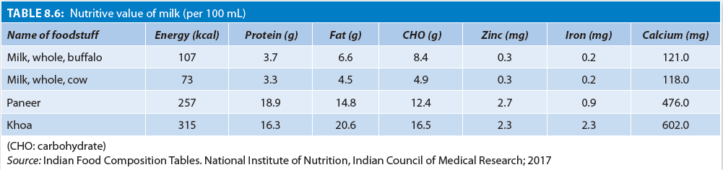
Milk and Milk Products
Rich sources of calcium, protein, riboflavin, vitamin A, phosphorus, and thiamine.
Poor sources of iron and ascorbic acid.
Milk is the only sources of vitamin B12 for strict vegetarians and the only natural source of lactose.

Slide 29
EGG
It consists of approximately 11% shell, 58% white, and 31% yolk.
Egg protein is considered a standard or reference protein.
It supplies generous amounts of both fat-and water-soluble vitamins.
Vitamin C is present in small quantity.
Calcium, phosphorus, iron, and zinc are also present in egg.
Iron and vitamin A are contained only in the yolk.
Egg is easily digestible and low in fiber hence, suited for convalescing.

Slide 30
MEAT
Meats contain about 15–20% proteins of high-nutritive value, with good amounts of essential amino acids.
Fat content of meat varies between 5–40%.
Organ meats (liver and kidney) are iron rich, especially heme iron, which is more bioavailable than the nonheme iron found in plant sources.
Meat also provides zinc and B-vitamins.
It is a poor source of calcium.
Liver is a rich source of vitamin A.

Slide 31
FISH
It is an excellent source of proteins (16–20%) of good BV, and of unsaturated fats especially omega-3 fats.
Vitamin A and D are plenty in fish liver oils.
B-vitamins and ascorbic acid present in raw fish are heat labile.
Fish is also rich in calcium and phosphorus.

Slide 32
Nuts and Oil Seeds
Good sources of energy and contain good quality proteins
Contain appreciable amounts of carbohydrates, B-group vitamins, vitamin E, calcium, phosphorus, and iron.
Oilseed proteins are of inferior quality as they lack methionine. But, being rich in lysine, they can be used to supplement cereals for development of weaning foods.

Slide 33
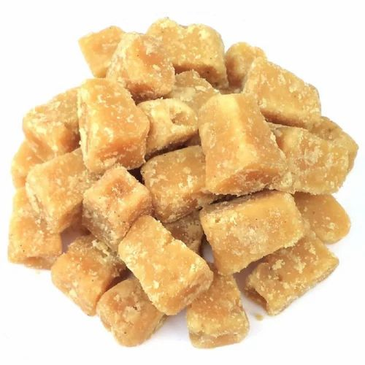
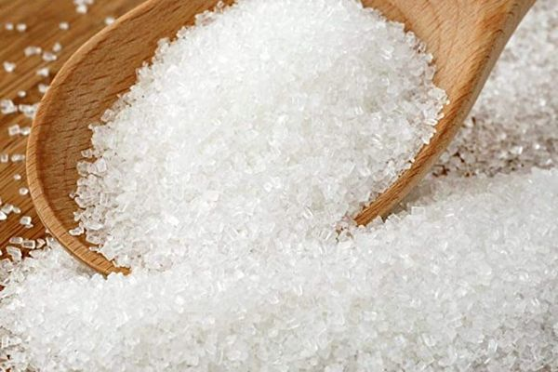
Sugar and Jaggery
They contribute calories and palatability to the diet.
Some amount of iron is also obtained from jaggery.
Excessive amounts of sugar should be avoided as it might cause dental caries in small children.
Intake of free sugar should be <5% of total energy.
Sugar sweetened beverage mostly supplies empty calories without nutritional value.

Slide 34
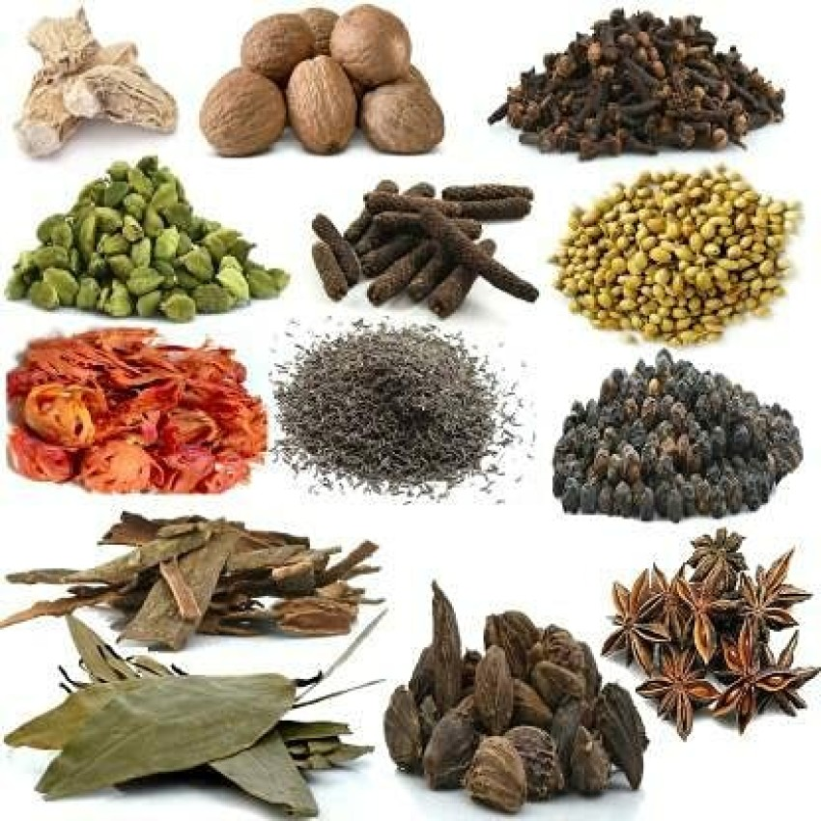
Condiments and Spices
Used as flavoring substances.
Chilies and coriander (dhania) have little amounts of β-carotene.
Most of them contain tannin, which interferes with absorption of iron.
Garlic is considered to have antibacterial property.
Turmeric, ginger, garlic, cumin, and cloves are rich in antioxidants.
Excessive amounts of condiments may cause gastritis and ulcers.

Slide 35

Salt
Sodium is vital to nerve conduction and fluid balance in the body.
High intake of salt (sodium chloride) is associated with high blood pressure, and reduction in bone density due to increased calcium excretion.
Preserved foods such as pickles, papads, sauces, ketchup, and canned foods contribute to higher intakes of salt.
The intake of sodium chloride should not exceed 4–5 g/day.

Slide 36
Tea and Coffee
Caffeinated drinks, should not be given at all to children <5 years [Indian Academy of Pediatrics (IAP), 2019].
Older children should not consume >100 mg of caffeine per day.
Higher intake of caffeine can lead to anxiety, nervousness, higher blood pressure, arrhythmia, and insomnia.

Slide 37
Soft Beverages
Synthetic drinks are best avoided as they contain artificial colors, flavors, and preservatives, but no nutrients.
Carbonated beverages also affect appetite adversely and damage teeth enamel due to the phosphoric acid content.
Packaged fruit juices are high in sugar. Whole fruit is always better than fresh juice.
IAP does not recommend any fruit juices in children <2 years.
Natural drinks such as lassi, coconut water, and buttermilk are healthier options

Slide 38
IN A NUTSHELL
Nutritional Value of Foods
Four main food groups are: (1) cereals and pulses, (2) milk, egg, and meat products, (3) vegetables and fruits, and (4) oils, fats, nuts, and oilseeds.
Carbohydrates are classified as energy rich food, proteins as body building food, and vitamins and minerals as protective food.
Milk is the only source of vitamin B12 for strict vegetarians and the only natural source of lactose.
Caffeinated drinks or caffeine in any form should not be given to children <5 years. Children >5 years should not consume >100 mg caffeine/day.

Slide 39
Anthro-based Nutritional Assessment
Anthropometric Parameters
Measures used to undertake anthropometric assessment include: (i) age, (ii) sex, (iii) weight, and (iv) height or length.
Other anthropometric measures include mid-upper arm circumference (MUAC), waist-hip ratio, and skinfold thickness.
Index
When two of these measurements are used together, they are called an index.
Commonly used indices in assessing the nutritional status re “weight-for-age”, “length-for-age or height-for-age”, “weight-for-length or weight-for-height” and body mass index.
Indicators
Wasting, Stunting, Underweight

Slide 40
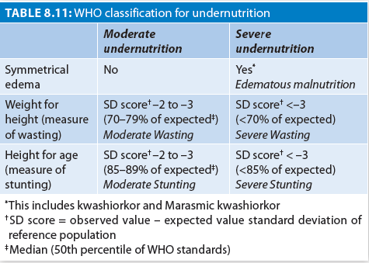
WHO Classification of Undernutrition

Slide 41
Biochemical Assessment
Biochemical tests can identify specific nutrition related abnormalities.
These may help to indicate subclinical deficiency.
Most biochemical tests are carried on serum/blood and urine as they are easily obtainable in the field.
  Urine: hemoglobin, thiamine and riboflavin
  Blood: vitamin A, carotene, ascorbic acid.

Slide 42
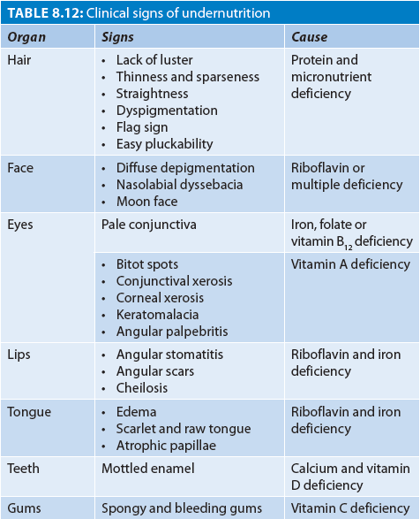
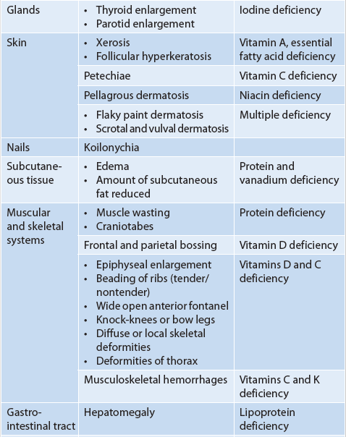
Clinical Signs

Slide 43


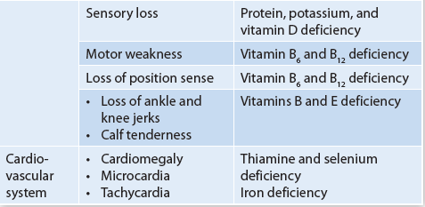
Clinical Signs

Slide 44
DIETARY SURVEY
Nutritional History
Breastfeeding, complementary feeding, and family pot feeding history is taken. Feeding practices are also taken in account.
An average food intake (prior falling ill) detail is obtained by a 24-hour recall method. During the mid-week average of a 3-day recall (not including a festival day) is recommended.
A food frequency table is used to record the frequency of intake of each food item, i.e., thrice a day, once a week, etc. It is interpreted as daily, frequently (4–6 days/week), occasional (1–3 days/week), or never.
Weighing the uncooked as well as the cooked food and then assessing the nutritive value of food eaten are the other methods, but often not practical.
The calculated intake should be finally compared with the recommended dietary allowances for the age.

Slide 45
Group Methods
Food balance sheet:
  On the basis of food availability ‘Food balance sheet’ for the entire population is prepared. The mean annual amount per person is obtained by dividing the total amount of different foods with the total population of the area.
Household food consumption:
  It is an estimate of the total amount of food used by an entire household for a fixed duration. The most commonly used methods are
  food account (by checking the food inventory),
  food list (by recall), and
  food record (by recording).

Slide 46
IN A NUTSHELL
Nutritional Assessment
Nutritional assessment is done by four methods namely nutritional anthropometry, biochemical assessment, clinical assessment, and dietary survey.
Wasting represents acute malnutrition, stunting reflects chronic malnutrition whereas underweight is a composite index of acute and chronic malnutrition.
Biochemical tests help to indicate nutritional abnormality prior to clinical or anthropometric changes.

Slide 47
Balanced Diet
Contains all nutrients in right quantity and required proportion
Offers diversity belonging to the four basic good groups.
50–60% of total calories would come from carbohydrates, preferably complex carbohydrates, 20–30% from visible and invisible fats, and 10–15% from proteins.
Besides, several non-nutrients such as antioxidants, vitamin, minerals, and dietary fiber should also be the parts of a balanced diet.
Garlic, ginger, clove, cumin, and turmeric are good antioxidants.

Slide 48
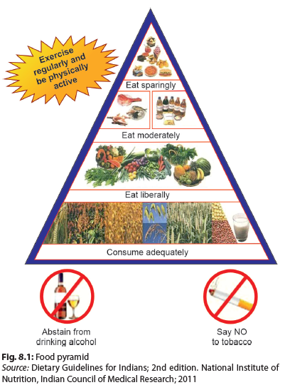
Processed Foods and Sugars
Proteins and Fats
FOOD
PYRAMID
Vegetables and Fruits
Cereals, Milk

Slide 49
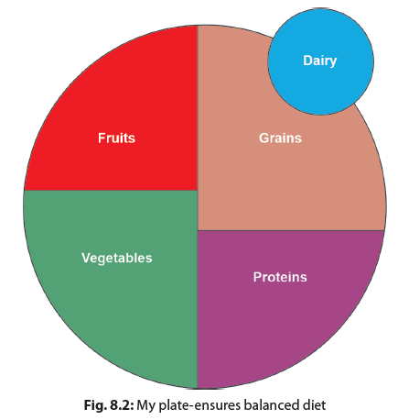
My Plate
The concept of “my plate” (Fig. 8.2) originally populated by the US Department of Agriculture (USDA), provides a visual concept of the proportion of different food groups needed for ensuring a balanced diet. Variety is encouraged within the different food groups. This is an easy-to-follow food guide and helps in nutritional education of parents and children.

Slide 50
Diet In Disease
Diabetes: Eating whole grain foods and avoidance of sugar, salt, and saturated fat.
Hypertension: Restrict salt. Promote high intake of fruits, vegetables, whole grain, low-fat dairy products and high protein foods. Avoid of red meat, sugar, salt, and saturated fats.
Obesity: Reduce free sugars to <5%, saturated fat intake to <10% and trans-fat to nil. Increase consumption of vegetables and fruits. Avoid sugar sweetened beverages and juices.
Celiac disease: Gluten free diet
Liver Disease: Higher requirements MCT, fat-soluble vitamins
Kidney disease: Restrict sodium, High energy
Malignancies: Need more calories and proteins

Slide 51
IN A NUTSHELL
Diet in Health and Disease
A balanced diet has 50–60% of total calories from carbohydrates, 20–30% from fats, and 10–15% from proteins along with antioxidants, phytochemicals, and dietary fibers.
Young children between 1–5 years should be given energy and protein rich food but low in bulk.
Chronic illnesses often have higher energy requirements to overcome the ongoing catabolic losses due to poor oral intake, malabsorption, and cell breakdown.

Slide 52
Unhealthy Foods
Nutrition Chapter of the IAP has proposed a new acronym “JUNCS foods”, which encompasses various unhealthy foods.
  — Junk foods (foods high in fats, salt, and sugar),
  — Ultra-processed foods,
  — Nutritionally inappropriate foods,
  — Caffeinated/colored/ carbonated foods/beverages, and
  — Sugar-sweetened beverages.
Other Nomenclatures
EDNLF: Energy dense, low nutrient density foods,
EDNPF: Energy dense and nutrient poor foods
FMNV: Foods of minimal nutritional value
HFSS foods : Foods that is high in fat, salt, and sugar

Slide 53
Ultra-processed Foods: The NOVA Classification
Group 1: Unprocessed or minimally processed foods
  —For example, milk, eggs, fresh fruits, and vegetables.
Group 2: Processed culinary ingredients
  — such as oils, fats, butter, sugar, and salt, are added to the main food.
Group 3: Processed foods
  —For example, canned foods, tomato puree, fruits in sugar syrup, salted nuts, etc.
Group 4: Ultra-processed foods
  — Made in an industrial scale or synthesized in laboratories. These include all packaged sweets, biscuits, savories, ice-creams, colas, instant soups, and noodles, preprepared meals, etc., they are hyperpalatable.
Ultra processed Foods are Harmful

Slide 54
Fruit Juices and Fruit Drinks
Fruit juices are NOT same as whole fruits.
The fiber and phytochemical in fruits are lost in junices.
Dental caries is also higher with sweetened fruit juices.
The Indian Academy of Pediatrics recommends that children <2 years of age should not be offered fruit juices or SSB’s.
They should also be avoided above 2 years as far as possible with a maximum permitted intake of 125 mL/day between 2–5 years and 250 mL/ day >5 years; and that too not on daily basis.

Slide 55
IN A NUTSHELL
Unhealthy Foods
Unhealthy food is now defined by new acronym: JUNCS defined as Junk foods, Ultra-processed foods, Nutritionally inappropriate foods, Caffeinated/colored/carbonated foods/ beverages, and Sugar-sweetened beverages (SSB).
The Indian Academy of Pediatrics (IAP) recommends no fruit juices or SSB in children <2 years of age.
Maximum intake of fresh juices with no added sugar between 2–5 years is 125 mL/day and >5 years is 250 mL/day. Unhealthy Foods

Slide 56
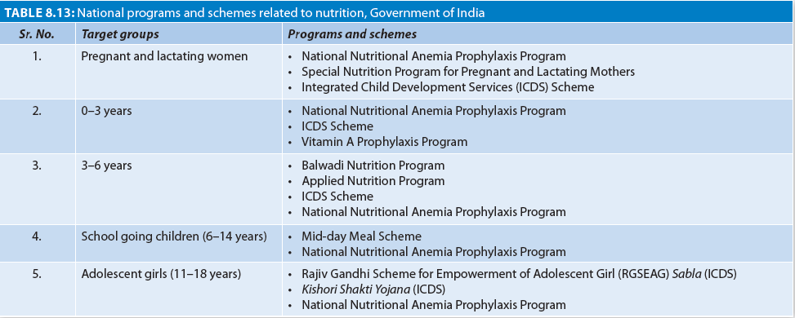
National Nutritional Initiatives

Slide 57
Integrated Child Development Service Scheme
Beneficiaries
  Children <6 years; pregnant and lactating women; women in the age group of 15–44 years; and adolescent girls in selected blocks.
Package of services
  Supplementary nutrition to children below 6 years and pregnant and nursing women; immunization; health check-ups; referral services; treatment of minor illnesses; nutrition and health education to women; nonformal preschool education (3-6y) water supply and sanitation.
Supplementary nutrition
  Provides 500 kcal and 12– 15 g protein per day to children between 6 month and 6 years; 800 kcal and 20–25 g proteins per day to severely malnourished children; and 600 kcal and 18–20 g of protein to pregnant women per day for 300 days in a year.
Growth monitoring and nutrition surveillance are also done in the Anganwadis.

Slide 58
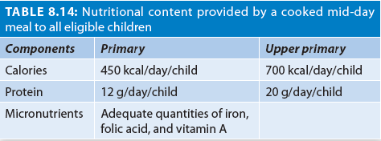
Mid-day Meal Scheme
Launched on 15th August 1995.
Provide cooked mid-day meal to all children studying in class I–VIII.
The program aim to provide one-third of the energy and one-half of the overall protein requirements.

Slide 59
Vitamin A Prophylaxis Program
The program was launched in 1970
Objective: Reducing blindness due to vitamin A deficiency.
Strategy:
  Administration of prophylactic vitamin A
    100,000 international units (IU) at 9 months with measles immunization,
    200,000 IU at 16–18 months, with diphtheria-tetanus-pertussis (DPT) booster, and then
    200,000 IU every 6 months, up to the age of 5 years.
  Other components include health and nutrition education to encourage colostrum feeding, exclusive breast feeding for the first 6 months, introduction of complementary feeding thereafter and adequate intake of vitamin A-rich foods, and early detection and proper treatment of infections.

Slide 60
Anemia Mukt Bharat
Universal Strategy
  Prophylactic iron and folic acid supplementation
  Deworming
  Intensified year-round behavior change communication campaign
6X6X6 Strategy
  6 beneficiary groups
  6 interventions
  6 institutional mechanisms

Slide 61
IN A NUTSHELL
National Nutritional Initiatives
Various national nutritional initiatives by Government of India include Integrated Child Development Services Scheme (ICDS), Mid-day Meal Scheme, Vitamin A prophylaxis program, POSHAN Abhiyaan, and Anemia Mukt Bharat.
Mid-day Meal Scheme aims to provide cooked mid-day meal with 300 calories and 8–12 g of protein to all children studying in class I–V (further extended till class VIII) in Government and aided schools.
Vitamin A prophylaxis program consists of administration of prophylactic vitamin A as 100,000 international units (IU) at 9 months, 200,000 IU at 16–18 months, and then every 6 months, up to the age of 5 years.
Anemia Mukt Bharat (AMB) strategy aims to reduce prevalence of anemia by 3 percentage points per year till 2022.

Slide 62
Nutritional Surveillance
Strategies
  To identify nutritional problems in the community, analyze their causes, and strategies to counter them.
Sources of Data
  Large-scale food and nutrition surveys
  Repeated small-scale surveys
  Sentinel site surveillance
  School census data
  Growth monitoring
  Emergency situations

Slide 63
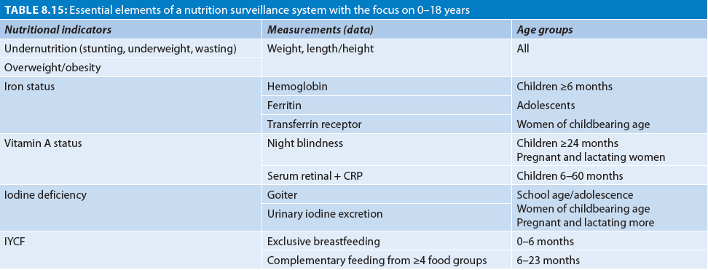
Essential Elements of a Nutrition Surveillance System

Slide 64
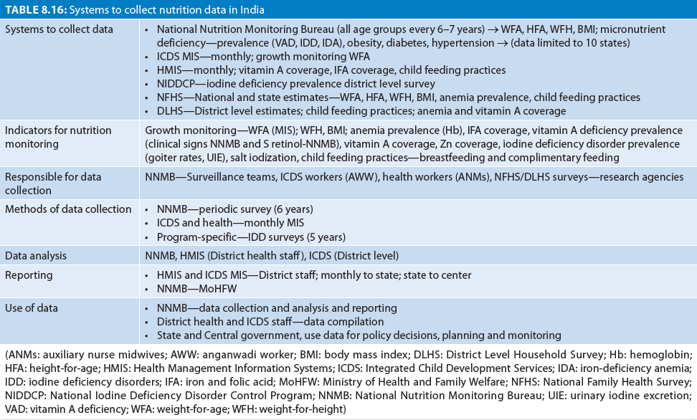

Slide 65
Nutritional Education
Objective
To equip people with sufficient information, expertise, and motivation to pick up and to eat appropriate diets.
Guiding Principles
  Healthcare provider should be able to build rapport and have detailed knowledge of the people’s beliefs, attitudes, knowledge, and behavior.
  Understand why certain practices exist, and find measures for change situation.
  Don’t ignore subcultural groups.

Slide 66
Strategies for Nutrition Education
Iatrogenic restriction of feeding in fevers and diarrhea should be discouraged .
Exclusive breastfeeding for first 6 months of life should be vigorously promoted and encouraged.
Complementary feeding should begin in all children at completion of 6 months of age.
Complementary feeding should be based on a judicious mixture of 7 food groups.
As much milk, meat, eggs or foods of high biologic value as the family can afford should be offered.
Encourage discussions among the group of mothers.

Slide 67
Nutritional Rehabilitation
Nutritional rehabilitation can be home based, center based, or hospital based; depending on the severity of the nutritional deficit.
Day Nutritional Rehabilitation Center (NRC): For rehabilitating milder forms of malnutrition; caters to not more than 30 children; care provided to 6 to 8 hours/day, 6 days/ week.
Residential Nutritional Rehabilitation Center: Meant for severe malnutrition—after treated in a hospital for complications, usually attached to a hospital.
Community-based nutritional rehabilitation: For children with moderate acute malnutrition.

Slide 68
Thank you…

