Slide 1

Chapter 9
Nutritional Disorders

Slide 2
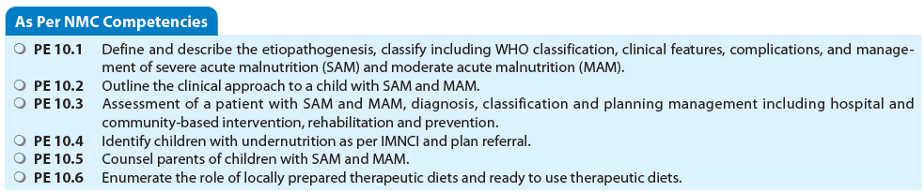

Slide 3
BURDEN OF UNDERNUTRITION
Prevalence
Global Situation
680 million under-5 children
200 million having stunting, wasted, or both
Overall stunted 2.2%
Wasted overall 7%

Slide 4
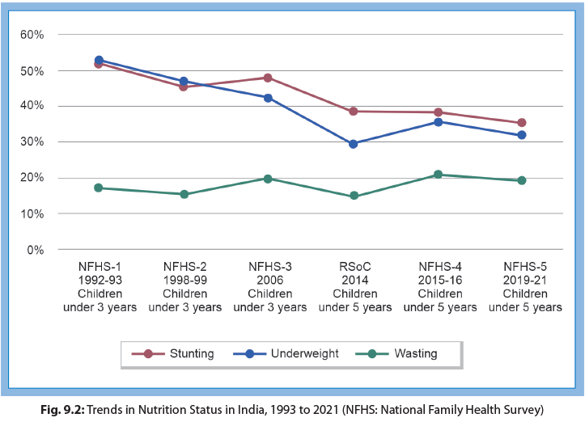
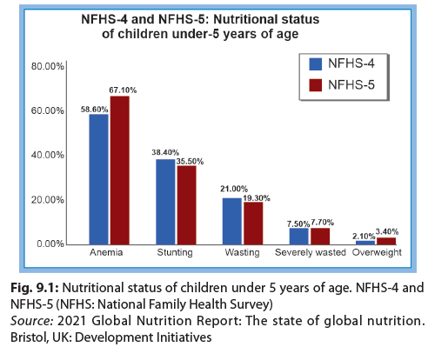
Undernutrition in India

Slide 5
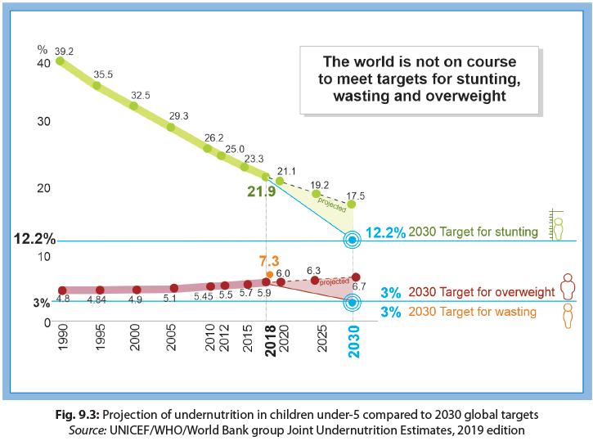
Projection of Undernutrition in Children under-5 Compared to 2030 global targets

Slide 6
Classification of Undernutrition
Severity classifications are based on anthropometric measurements, mainly weight, height, and mid-upper arm circumference (MUAC).
For the purpose of these classifications, the term “expected” denotes the median (50th centile) value of the reference standard.
Growth standards provided by the World Health Organization (WHO) are widely acceptable international growth standards for comparison for under-5 children,
Indian Academy of Pediatrics (IAP) growth charts are recommended as references for children 5–18 years age
Classifications
- IAP : Based on weight for age
- Wellcome: Deficit in bodyweight + edema
- WHO: Stunting and wasting

Slide 7
INDIAN ACADEMY OF PEDIATRICS CLASSIFICATION BASED ON WEIGHT FOR AGE
Normal: Weight of >80% of expected for that age.
  Grade I (71–80%),
  Grade II (61–70%),
  Grade III (51–60%) and
  Grade IV (<50%) of expected weight for that age.
  Alphabet K is postfixed in presence of edema.
For example, boy weighing 8 kg at 2 years of age with pedal edema (50th percentile for 2 years is 12.3 kg) can be classified as PEM Grade II(k) as per IAP classification.
IAP classification has a major disadvantage that it does not take in account the child’s height. Also, the term PEM has gradually fallen out of use.

Slide 8
WELLCOME TRUST CLASSIFICATION
Weight for age | 60-80 % of expected | < 60 % of expected
Without edema | Undernutrition | Marasmus
With edema | Kwashiorkor | Marasmic kwashiorkor
This classification also is now mainly of historical/anecdotal value

Slide 9
WHO CLASSIFICATION

Slide 10
ACUTE MALNUTRITION
A. Severe acute malnutrition (SAM)
  Identifies malnourished children at the highest risk of death, defined by
    very low weight for height (below –3 Z-scores of the median WHO growth standards), or
    visible severe wasting, or
    presence of nutritional edema, or
    mid-arm circumference below 11.5 cm for children aged between 6 months and 5 years.
B. Moderate acute malnutrition (MAM)
  WFH SD between –3 and –2 Z-scores of the median WHO growth standards or
  mid-upper arm circumference between 11.5 and 12.4 cm
  And no bilateral pitting edema.

Slide 11
IN A NUTSHELL
Undernutrition: Prevalence and Classification
Undernutrition can be categorized as macronutrient (protein, fat, and carbohydrates) and micronutrient (vitamins and minerals) deficiency.
The spectrum of macronutrient deficiency extends from mild underweight to severe acute malnutrition and includes wasting, stunting, and severe forms such as marasmus and kwashiorkor.
Weight-for-age, HFA, and WFH are indicators to assess and grade underweight, stunting, and wasting, respectively.
Wasting is an indicator of acute malnutrition while stunting indicates chronic nutritional deficit.
Severe acute malnutrition is a life-threatening form of undernutrition and causes maximum mortality.

Slide 12
Etiopathogenesis of Undernutrition
1. Low Birthweight
  LBW and IUGR babies are more likely to become undernourished.
2. Feeding Habits
  Lack of exclusive breastfeeding for first 6 months.
  Delayed introduction of complementary feeding.
3. Infections and Infestations
  Diarrhea, pneumonia, malaria, measles, whooping cough, and tuberculosis precipitate acute undernutrition and aggravate the existing nutritional deficit.
4. High Pressure Advertising of Baby Foods
5. Social Factors
  Repeated pregnancies, inadequate child spacing, food taboos, and broken homes
6. Poverty
7. Large Family Size
  Rapid succession of pregnancies adversely affects the nutritional status

Slide 13
PATHOPHYSIOLOGY
Changes in Body Composition and Function
  Preferential loss of muscle and subcutaneous tissues
  Brain and heart are relatively spared.
  Body fat and total bone mass are reduced.
2. Fluid and electrolytes
  Total body water is increased to 70–80%
  Sodium pump malfunctions.
  Cell membranes become more permeable leading to increased intracellular sodium and reduced total body potassium and magnesium.
Fluid and sodium administration, especially in face of clinical dehydration, should be planned with caution in these children. Dehydration should preferably be corrected orally; intravenous fluids are best avoided unless there is shock .

Slide 14
PATHOPHYSIOLOGY-2
3. Metabolic alterations
  Basal metabolic rate (BMR) is reduced by 30%, energy expenditure is low.
  Heat generation and heat losses are affected.
  These factors predispose to hypothermia.
4. Biochemical changes
  Synthesis of all proteins is reduced.
  Capacity of the liver to take up, metabolize, and excrete toxins is severely affected.
  Gluconeogenesis is impaired leading to hypoglycemia.
  Plasma transferrin is markedly reduced.
5. Other nutritional deficiencies
  Anemia because of deficiency of iron, vitamin B12, and folic acid.
  Vitamin A deficiency may result in keratomalacia.
  Riboflavin deficiency is also common.
  Scurvy may manifest as painful legs and knees, gum bleeding, Subperiosteal bleeds.
  Rickets is also evident in one-third of cases, vitamin D levels are low.

Slide 15
PATHOPHYSIOLOGY-3
6. Immunity
Severe undernutrition is a state of relative immunodeficiency.
Cell-mediated immunity is impaired (atrophy of thymus and lymphoid tissues).
Sensitization to antigens and recognition of earlier sensitization is impaired.
Delayed hypersensitivity reactions (e.g., Mantoux test) is impaired.
Humoral immunity is relatively less affected. Circulating antibody levels are normal or elevated
Antibody response to most vaccines (e.g., measles, diphtheria, tetanus, and poliomyelitis) is adequate.
Secretory IgA may be reduced resulting in increased severity, prolonged infectivity, and delayed recovery from infections.
Leukocyte count is generally normal but their fungicidal and bactericidal capacity is impaired.

Slide 16
PATHOPHYSIOLOGY-4
7. Physical barriers
Skin and mucosal membranes are thin/atrophied breached, easily penetrated by microbes.
8. Gastrointestinal system
Salivary glands atrophy.
The liver shows fatty infiltration, pancreatic acini are atrophied and zymogen granules are reduced.
Intestinal mucosa demonstrates reduction in villus height, and increase in their width, change of columnar villus epithelial into cuboidal cells.
Total absorptive surface is reduced.
Steatorrhea and lactose malabsorption may occur.

Slide 17
PATHOPHYSIOLOGY-5
9. Central nervous system
  Impaired brain function resulting in lag in development and (IQ).
10. Renal impairment
  GFR and RPF are reduced
  Capacity of the kidneys to excrete excess acid or water is reduced
  Urinary phosphate and sodium excretion are reduced.
11. Endocrine system
  Insulin levels are reduced, with glucose intolerance.
  Cortisol and growth hormone levels are increased.
12. Cardiovascular system
  Cardiac output and stroke volume are reduced.
  BP is low and renal perfusion is compromised.

Slide 18
IN A NUTSHELL
Etiopathogenesis of Undernutrition
Undernutrition is a common public health problem in under-5 children and of multifactorial in origin, e.g., LBW, lack of exclusive breastfeeding, recurrent infections and poverty, etc.
Theories of adaptation and free radical injury have been proposed for its pathogenesis.
Adrenocortical response to stress of protein and calorie deficiency plays a key role in the development of marasmus and kwashiorkor.
Proinflammatory mediators also contribute to impaired growth in undernutrition.
Generalized changes in different systems occur in severe undernutrition and responsible for systemic manifestations.
Total body water and sodium are increased; and potassium is decreased in severe malnutrition.

Slide 19
Severe Acute Malnutrition
CLASSIFICATION
Wasting indicates current or acute malnutrition resulting from failure to gain weight or weight loss, represented by low weight-for-height (WFH).
Wasting is further graded into SAM and MAM.
Lower the Z-score or MUAC, higher is the risk of death.
For children with WFH Z-score is < −3 Z and MUAC < 11.5 cm, risk of mortality increases significantly. Risk of mortality is also more in edematous SAM children.

Slide 20
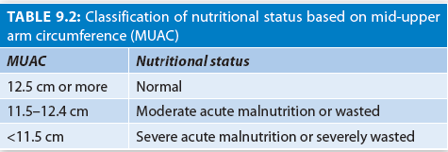
Classification on Nutritional Status based on Mid-upper Arm Circumference (MUAC)

Slide 21
Severe Acute Malnutrition: Definition

Slide 22
Reductive Adaptation
The body systems slow down to allow survival on limited calories.
When a child’s carbohydrate intake is insufficient, fat stores are utilized to provide energy.
Later, protein is mobilized from muscles, skin, and gut.
A child with SAM conserves energy by
  reducing physical activity and growth;
  reducing basal metabolism by slowing protein turnover;
  reducing the functional reserve of organs; s
  lowing the sodium and potassium pumps in cell membranes and
  reducing their number; and reducing inflammatory and immune responses.

Slide 23
Consequences of Reductive Adaptation
The liver is less able to make glucose (increased risk of hypoglycemia and hypothermia).
Liver is less able to excrete excess dietary protein (Avoid long gaps without food).
The kidneys are less able to excrete excess fluid and sodium. (Avoid excess fluid and sodium).
The heart is smaller and weaker and has a reduced output (Fluid and sodium intake must be carefully controlled.

Slide 24
Absorption is affected, decreased enzymes and motility (feeds must be small to avoid exceeding the gut’s functional capacity, and the composition of feeds should be such that it can easily be absorbed. Feeds should be enteral, never parenteral, to reduce the risk of fluid overload).
Sodium leaks into cells (excess body sodium); Potassium leaks out of cells (hypokalemia) and So, to restrict sodium and provide potassium and magnesium.

Slide 25
Iron in SAM
Red cell mass is also reduced, liberating iron
Conversion of harmful free iron to ferritin needs
Free iron promotes the growth of pathogens and the production of free radicals which damage cell membranes
During initial feeding, we need to withhold iron, and provide vitamins and minerals to help mop up free radicals

Slide 26
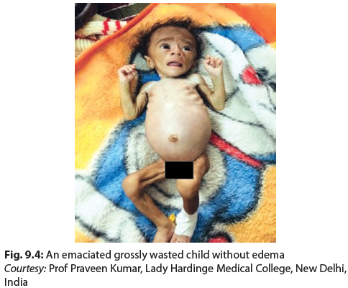
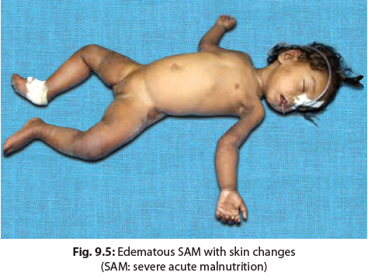
Visible severe wasting
Edematous SAM

Slide 27
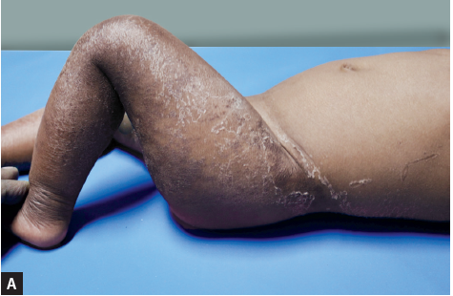
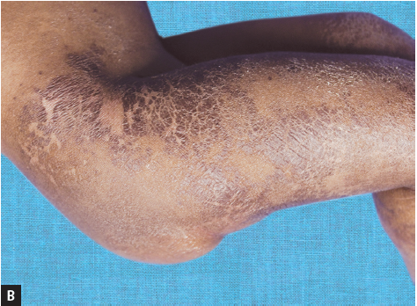
Skin Changes in Edematous SAM
Figs. 9.6A and B: Crazy pavement dermatosis characterized by jet black patches over flexures and pressure sites

Slide 28
COMPLICATIONS
Edema
Persistent vomiting
Very weak, apathetic
Fever or hypothermia (axillary temperature >38.5°C or <35°C)
Children with fast breathing/chest indrawing/cyanosis
Extensive skin lesions, eye lesions, post-measles states
Diarrhea with dehydration based on history and clinical signs
Severe anemia, bleeding, convulsion, or systemic infection
Any other general sign that warrants transfer to in-patient facility for assessment or care
If caregiver is unable to care for the child at home
Source: Participant Manual for Facility Based Care of Severe Acute Malnutrition. Ministry of Health and Family Welfare, 2013

Slide 29
Ten Reasons for High Mortality in SAM
Inability to distinguish between acute and rehabilitation phases
2. Excessive use of intravenous fluids
3. Fluid overload due to lack of monitoring during rehydration
4. Use of diuretics for edema
5. Use of albumin for edema
6. Not keeping the child warm and euglycemic
7. Low index of suspicion for infection
8. Early use of diets high in protein and sodium
9. Failure to monitor food intake
10. Early treatment of anemia with oral iron

Slide 30
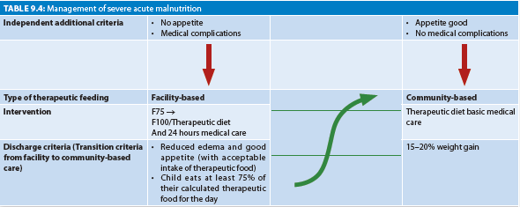
Treatment of SAM

Slide 31
Appetite Test
Ask the mother to offer energy dense therapeutic food to the child in a quiet area gently. Child is allowed to drink water while feeding Interpretation
Passed test, if child eats eagerly
Failed test, if refuses therapeutic food even after persistent encouragement
Community based management
Facility-based management

Slide 32
HOSPITAL-BASED INTERVENTION: 10 STEPS (WHO)
These steps are accomplished in two phases
Initial stabilization phase where the acute medical conditions are managed (Steps 1–6); and
Longer rehabilitation phase (Steps 7–10). Median case fatality rate in children with SAM is very high, i.e., approximately 23.5%, if these management protocols are not kept in mind.
The case fatality can be brought down to approximately 7–10% by standard case management protocol.

Slide 33
The 10 STEPS: MNEMONIC
A. The first six steps (steps 1–6) are related to treatment of complications. Children with SAM need to be SHIELDED.
  S — Sugar deficiency—i.e., hypoglycemia
  H — Hypothermia
  I — Infection and septic shock
  EL — ELectrolyte imbalance
  DE — DEhydration
  D — Deficiencies of iron, vitamins, and other micronutrients.
B. Steps 7–10 are related to dietary management.
Children with SAM need BEST management.
  B — Beginning of feeding
  E — Energy dense feeding
  S — Stimulation of emotional and sensorial development
  T — Transfer to home-based diets before discharge or transfer to NRC

Slide 34
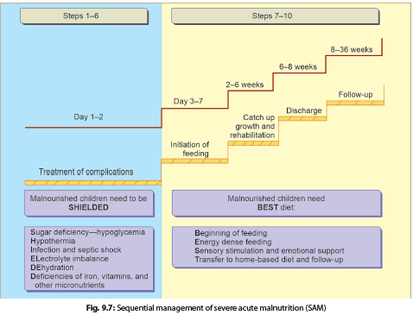
Sequential Management of Severe Acute Management (SAM)

Slide 35
Step 1: Hypoglycemia: Treat and Prevent
Obtain blood sugar. The child may throw seizures or become unconscious due to hypoglycemia (blood sugar <54 mg/dL).
If the child is unconscious, lethargic, or convulsing, administer 10% glucose 5 mL/kg intravenously.
If the child is conscious, administer 50 mL 10% glucose solution orally or by nasogastric tube. Feeding should be started immediately with F-75 milk-based diet (described in Step 7) and continued every 30 minutes for 2 hours.
If blood sugar continues to be low after 2 hours, give another 50 mL bolus of 10% glucose and continue feeding F-75 every 30 minutes until stable. Thereafter, feeds are given every 2 hourly.

Slide 36
Step 2: Hypothermia: Treat and Prevent
Cover the hypothermic child (rectal temperature <35.5°C) with a warmed blanket and place near a heat source (not hot water bottle).
Start feeding immediately with F-75.
Alternatively, use kangaroo technique.
Monitor body temperature 2-hourly (half-hourly if heater is used) until it rises to >36.5°.
Prevention
Give 2-hourly feeding and cover with a warm blanket, especially during the night.
Keep the child dry and let the child sleep with mother at night for warmth.

Slide 37
Step 3: Dehydration: Treat and Prevent
Evaluation of dehydration is difficult in children with severe undernutrition.
Thus all children having watery diarrhea should be assumed to have at least some dehydration.
Presence of weak pulses and oliguria indicate severe dehydration or septic shock.
Treatment of some Dehydration
Do not use IV fluids to correct dehydration except in shock.
Give WHO low osmolarity ORS 5 mL/kg every 30 minutes for 2 hours, orally or by nasogastric tube, then 5–10 mL/kg/h for next 4–10 hours.
ReSoMal (recommended ORS solution for malnourished children) is not universally available; and, it can be safely replaced by the standard low osmolarity WHO ORS.

Slide 38
Treatment of Severe Dehydration
Administer Ringer lactate or N/2 saline in 5% dextrose (15 mL/kg) over 1 hour.
If the child fails to improve after the first hour of treatment (15 mL/kg), assume septic shock and manage accordingly (see Step 5).
If there are signs of improvement (pulse volume improves, and pulse rate decreases), repeat IV fluids at 15 mL/kg over next 1 hour.
Then switch to oral or nasogastric rehydration with low osmolarity ORS (100 mL/kg at the rate of 10 mL/kg/h in next 10 hours).
Alternate aliquots of ORS can be replaced with starter F-75.
Maximum attempt should, be made to stop IV fluids and shift to feeding F-75 diet, as soon as possible.
Give 50–100 mL of ORS after each watery stool. If the child is breastfed, encourage to continue breastfeeding.
If the child cannot be given orally due to paralytic ileus or repeated vomiting, same fluid (100 mL/kg @ 10 mL/ kg/h) can be given as N/6 saline in 5% dextrose, intravenously.

Slide 39
Step 4: Electrolyte Imbalance: Treat and Prevent
All severely malnourished children have excess body sodium even though plasma sodium may be low.
Therefore, give low sodium fluid.
Hypertonic saline should NEVER be used.
Correct deficiencies of potassium (3–4 mMol/kg/day) and magnesium (0.4–0.6 mMol/kg/day).
Prepare food without salt.

Slide 40
Step 5: Infection—Treat and Prevent
In severe undernutrition, infections are often hidden.
Therefore, antibiotics should be given routinely on admission.
If the child appears to have no complications, give oral amoxicillin
If the child is severely ill (apathetic and lethargic) or has complications (hypoglycemia, hypothermia, broken skin, respiratory tract infection, or urinary tract infection), administer a combination of ampicillin and gentamicin, parenterally.
Where specific infections are identified, give specific antibiotics as appropriate.
Always obtain blood culture, chest radiograph, peripheral smear, and urine culture before starting antimicrobials.

Slide 41
Septic Shock
Shock from dehydration and sepsis are difficult to differentiate.
Children with severe dehydration will respond to IV fluids.
Those with septic shock will not respond to initial bolus of 15 mL/kg over 1 hour.
  In this case, give maintenance IV fluids (4 mL/kg/h) while waiting for blood.
  Transfuse fresh whole blood at 10 mL/kg slowly over 3 hours.
  Broad-spectrum antibiotics are initiated.
  Steroids and adrenaline are of no use.
In non-responsive septic shock, insert central line and give vasopressors in ICU.

Slide 42
Step 6: Micronutrient Deficiencies
Vitamin A orally on day 1 (200,000 IU for age >12 months; 100,000 IU for 6–12 months and 50,000 IU for 0–5 months).
Repeat on the next day and 2 weeks later in presence of xerophthalmia, the same dose should be.
Folic acid 5 mg on day 1, followed by 1 mg every day
Magnesium sulfate 2 mL of 50% solution on day 1
Vitamin K 2.5 mg IM on day 1
Give multivitamin supplements, zinc (2 mg/kg/day), copper (0.3 mg/kg/day), and potassium (2 mEq/kg/day) daily for at least 2 weeks.

Slide 43
Treat Anemia
Blood transfusion is required if hemoglobin is <4 g/dL.
If there is respiratory distress, transfusion can be given with hemoglobin between 4 and 6 g/dL.
Give whole blood 10 mL/kg slowly over 3 hours with furosemide 1 mg/ kg IV at the start.
In presence of cardiac failure, transfuse packed cells (5–7 mL/kg) rather than whole blood.
Give oral iron for mild to moderate anemia for 2 months.
DO NOT GIVE IRON UNTIL INFECTIONS ARE CONTROLLED

Slide 44
Step 7: Begin Cautious Feeding (0–7 days)
Essential features of feeding in the stabilization phase
Small, frequent feeds of low osmolarity and low lactose
Oral or nasogastric (NG) feeds (never parenteral preparations), and
Calories: 100 kcal/kg/day; Proteins: 1–1.5 g/kg/day; and fluids: 130 mL/kg/day (100 mL/kg/d if the child has edema.)

Slide 45
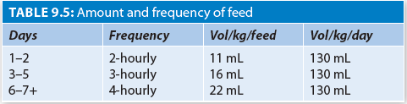
Type of Feed
Start with, milk-based starter F-75 formula containing 75 kcal/100 mL and 0.9 g protein/100 mL. Give from a cup or spoon.
The volume of feed is gradually increased and feeding frequency gradually decreased from day 1 to day 7 (Table 9.5).
Amount and Frequency of Feed
Do not exceed 100 kcal/kg/day in this phase.

Slide 46
Step 8: Energy Dense Feeding
Increase the amount of calories by giving energy dense foods.
Therapeutic diet should contain energy (150–220 kcal/ kg/day) and protein (4–5 g/kg/day).
The aim should be to achieve a rapid weight gain of >10 g/kg/day.
F-100—the Catch-up Formula diet:
  Contains 100 kcal and 2.9 g protein/100 mL.
To change from starter to catch-up formula, replace starter F-75 with the same amount of catch-up formula F-100 for 48 hours then, increase each successive feed by 10 mL.
After the transition, give frequent feeds (at least 4-hourly) 150–220 kcal/kg/day and protein intakes of 4–6 g/kg/day.

Slide 47
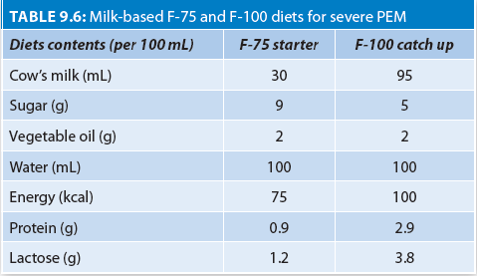
Milk-based F-75 and F-100 diets for severe PEM

Slide 48
Ready-to-Use Therapeutic Foods (RUTFs)
Soft or crushable foods used in the domiciliary management of severe undernutrition.
Useful in situations where preparation and availability of home-made catch-up food is doubtful.
RUTFs have a similar nutrient composition to F-100 but are not water-based and have a longer shelf life.
Most RUTFs are made of peanut paste, fats, and added micronutrients and minerals.
At least half of the proteins contained in these foods should come from milk products.
RUTF has been successfully used in emergency situations globally.

Slide 49
Modified Family Foods
Can be prepared from mixture of cereal flour, pulses, oil or ghee and jaggery.
One example of such energy dense food is “besan panjiri” which provides 500 calories and 9 g of proteins per 100 g.
Home available foods can also be used with added oil and sugar/jaggery to make the food energy dense.
  adding oil and curd to khichdi,
  cooking “parantha” in place of “chapati”
  cooking rice with jaggery and oil.

Slide 50
Step 9: Sensory Stimulation and Emotional Support
Provide tender loving care; and a cheerful, stimulating environment.
Structured play therapy is essential for at least 15–30 min/day.
Encourage physical activity as soon as the child is well enough.
Maternal involvement is a must for ensuring complete recovery.
Good feeding practices and sensory stimulation should be continued at home.
Show parent or caregiver how to feed frequently with energy-and nutrient-dense foods.

Slide 51
Step 10: Transfer to Home-based Diet and Prepare for Follow-up
Child should be shifted to the adequate quantities of home-based diets.
The diet should be
  Affordable, culturally acceptable
  Easily cooked with long shelf-life
Early signs of Recovery
  Return of appetite,
  Gain In Bodyweight
  Loss Of Edema,
  Disappearance Of Hepatomegaly,
  Rising serum albumin are the.
Complete Recovery
Achieved 90% weight-for-length. This may take 6–8 weeks.
Advise parent/caregiver to bring child back for regular follow-up.

Slide 52
Failure to Respond to Treatment
This is characterized by inadequate weight gain during rehabilitation phase. The rate of weight gain is classified as
Poor: <5 g/kg/day;
Moderate: 5–10 g/kg/day; and
Good: >10 g/kg/day. A child may have a primary or secondary failure to respond to treatment.
Possible causes of poor weight gain include (a) inadequate feeding, (b) specific nutrient deficiencies, (c) untreated infection, (d) HIV/AIDS; (e) underlying systemic disorder; and (f ) psychological deprivation.

Slide 53
Primary vs Secondary Failure
A. Primary failure to respond
Failure to regain appetite by day 4;
Failure to start losing of edema by day 4;
Failure of disappearance of edema by day 10; or
Failure to gain weight at least by 5 g/kg day by day 10.
B. Secondary failure to respond
Weight gain <5 g/kg/day for 3 consecutive days.
Children who fail to respond to treatment should be screened for persistent diarrhea, giardiasis, shigellosis, amebiasis, otitis media, pneumonia, urinary tract infections, fungal infections, scabies, tuberculosis, helminthiasis, malaria, any underlying immunological disease, inborn errors of metabolism and malignancies.

Slide 54
Severe Acute Malnutrition in Less than 6 Months
All possible efforts should be directed toward establishment or re-establishment of effective exclusive breastfeeding by the mother.
Supplementary suckling technique (SST) can be utilized to support or re-establish lactation. Donor human milk can be given in failure to re-establish lactation.

Slide 55
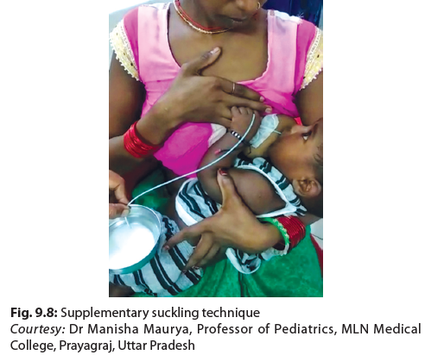
Supplementary Suckling Technique
F-100 diluted feed 130 mL/kg/day, divided in 6–8 feeds is given through an infant feeding tube of 8-F size.
The sucking stimulates milk production and milk from the bowl through the tube satisfy the need of baby.
SST should be done with both breasts alternatively and more than four times per day.

Slide 56
Criteria for Discharge
WFH/WFL is ≥ –2 Z-score, or MUAC is ≥12.5 cm;
No edema for at least 2 weeks.
Ensure that all immunizations have been initiated and
Mother trained and counseled for care at home .
Consider Early discharge only when
  age >6 months;
  completed antibiotic treatment;
  has good appetite and good weight gain; and
  has taken micronutrients for 2 weeks.
  The mother/caregiver is not employed; has the financial resources to feed; lives within easy reach of the hospital can be visited weekly; is trained to give structured play therapy; and is motivated to follow the advice given.

Slide 57
10-key Interventions to Prevent Undernutrition
Timely initiation of breastfeeding within 1 hour of birth
Exclusive breastfeeding during the first 6 months of life 3.
Timely introduction of complementary foods at 6 months 4.
Age-appropriate foods for children 6 months to 2 years 5.
Hygienic complementary feeding practices 6.
Immunization and biannual vitamin A supplementation with deworming
Appropriate feeding for children during and after illness.
Therapeutic feeding for children with severe acute malnutrition
Adequate nutrition and support for adolescent girls to prevent anemia
Adequate nutrition and support for pregnant and breastfeeding mothers

Slide 58
IN A NUTSHELL
Severe Acute Malnutrition
Children with WHZ< –3 OR MUAC <11.5 cm OR bilateral pedal edema are classified as SAM.
Due to reductive adaptation, children with SAM are at high-risk of hypoglycemia, hypothermia, electrolyte imbalance, infections, and heart failure. Presence of SAM increases risk of mortality in common illnesses such as diarrhea and pneumonia.
All SAM children with loss of appetite and medical complications should be treated in a health facility while those without complications may be treated in community.
WHO has recommended 10 steps of management for children with SAM. Early identification, special therapeutic diet (F-75/F-100), broad-spectrum antibiotic, sodium restriction, and supplementation of potassium and magnesium are integral parts of management.
IV fluids should not be used to treat dehydration except in shock.
For infants <6 months with SAM, establish exclusive breastfeeding, and/or facilitate relactation by SST.

Slide 59
Moderate Acute Malnutrition
DEFINITION
(a) WFH Z-score between −3 Z and −2 Z, or MUAC of 11.5–12.4 cm without any edema.
ETIOPATHOGENESIS
Could be a result of chronic and low-grade inflammation.
CLINICAL FEATURES
Growth is affected; (weight > height).
The child appears less energetic.

Slide 60
TREATMENT OF MAM
Best managed in their home
Two pillars of the management of MAM.
  Nutritional education/counseling,
  Supplementary food (lipid based RUSF, fortified flour, corn soy blend (CSB) and milled flour).
Give 25 kcal/kg/d in addition to the standard nutrient requirements.

Slide 61
Therapeutic Diets
The decision regarding the type of diet used in the community management of SAM is based on food accessibility and affordability.
WHO and UNICEF have recommended use of ready-to-use therapeutic food (RUTF) for management of children with SAM without complications..
RUTF is an energy dense therapeutic food, that contains at least 50% proteins from milk products and could be given to children with SAM of >6 months of age.
The cost of current standard RUTF is high. Absence of strict administrative control increases chance of commercial exploitation and misuse of RUTF.
Alternative local food products being utilized, range from special formulation as being used in Telangana, to take home ration (THR)-based intervention as seen in Madhya Pradesh (MP), Chhattisgarh, and Odisha with a target of providing 150–180 kcal/kg and protein 3.5–5.5/kg on a daily basis.

Slide 62
Parental Counseling for Undernutrition
Counseling of parents is vital for sustained improvement in SAM and MAM children.
Counseling sessions should start with first encounter and should continue till the discharge of child from health facility.
Mothers should be taught the correct practices to prepare food, make toys, feed, bathe, take care of hygiene, and play with child.

Slide 63
Thank you…

